Slide 2
Commissioned
The Message of the Gospel

Slide 3
I. The Gospel
Defined
Euaggelion - yoo-ang-ghel'-ee-on a good message, that is, the gospel:—gospel.
Evangelist – preacher of the gospel
Good News

Slide 4
The Power of God - Romans 1:16-17
Not ashamed of this good news
The power of God at work
Saving everyone who believes
Tells us how God makes us right in his sight

Slide 5
Colossians 1:6 ⁶This same Good News that came to you is going out all over the world. It is bearing fruit everywhere by changing lives, just as it changed your lives from the day you first heard and understood the truth about God’s wonderful grace.

Slide 6
II. Initiated by Jesus
Luke 4

Slide 7
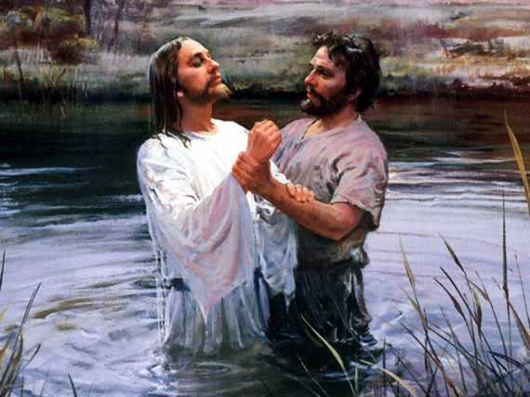

Slide 8
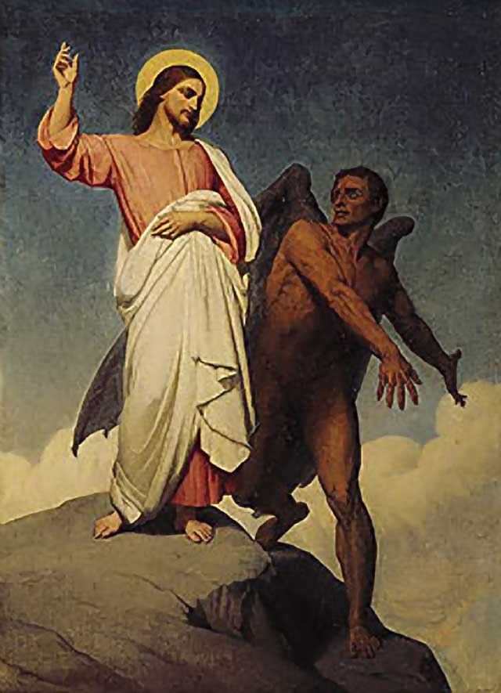

Slide 9
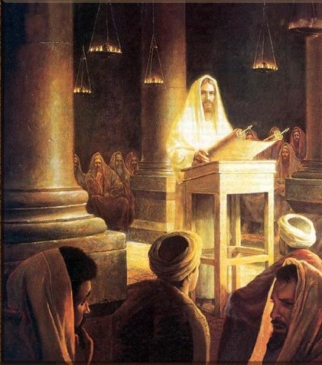
Quoting Isaiah 61 – Appointed to bring the Good News to the poor (in spirit)
Fulfilled this day

Slide 10
The Good News by demonstration

Slide 11
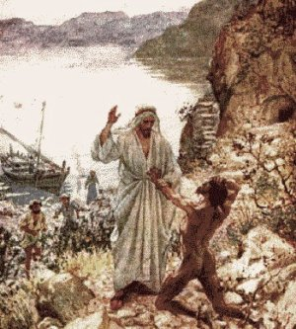
Deliverance

Slide 12
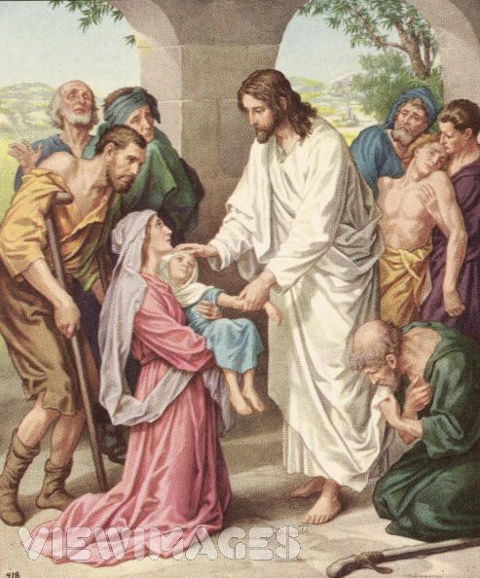
Healing

Slide 13
I must preach the Good News of the Kingdom of God in other towns too
The Kingdom of God
Other rule
Other world
Other results – changed lives!!

Slide 14
III. Commissioned to Jesus’ Followers
Pre and Post Resurrection Commissions
Pre – kingdom of God
Post – witness of the resurrection
Luke 9 – Jesus sends the 12
Power and authority to cast out all demons and heal all diseases
Tell everyone about the Kingdom of God

Slide 15
Luke 10 – Jesus sends the 72
Harvest is great – workers are few
Pray for more workers
Tell them the Kingdom of God is near you
Dealing with rejection
Returned with joyful report – demons obey us
Rejoice because your names are written in heaven

Slide 16
Luke 24:44-49
Jesus opens their minds to understand the scriptures
It was written that this message would be proclaimed in the authority of his name
The message – there is forgiveness of sins for all who repent
Stay until the Holy Spirit comes and fills you with power

Slide 17
Matthew 28:18-20
Jesus given all authority in heaven and on earth
Luke 4:5 - 8 ⁵Then the devil took him up and revealed to him all the kingdoms of the world in a moment of time. ⁶“I will give you the glory of these kingdoms and authority over them,” the devil said, “because they are mine to give to anyone I please. ⁷I will give it all to you if you will worship me.” ⁸Jesus replied, “The Scriptures say, ‘You must worship the LORD your God and serve only him.’”

Slide 18
Therefore go and make disciples
Teach them to obey all I have given you
I am always with you

Slide 19
Mark 16:15-20
Go into all the world and preach the Good News to everyone
Believers saved – unbelievers condemned
Miraculous signs will accompany those who believe

Slide 20
Next Week – “Empowered”
Saved or condemned?

Slide 21
Romans 10:13 - 15 ¹³For “Everyone who calls on the name of the LORD will be saved.” ¹⁴But how can they call on him to save them unless they believe in him? And how can they believe in him if they have never heard about him? And how can they hear about him unless someone tells them? ¹⁵And how will anyone go and tell them without being sent? That is why the Scriptures say, “How beautiful are the feet of messengers who bring good news!”

Slide 23
IV.

Slide 24
V.

