Slide 1
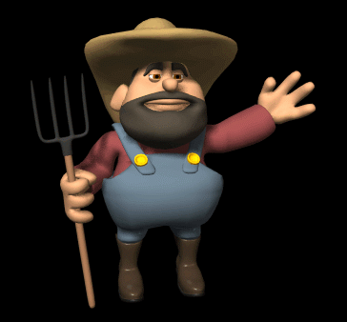

Slide 3
Living for Christ in Your Work
Living For Christ Series

Slide 5
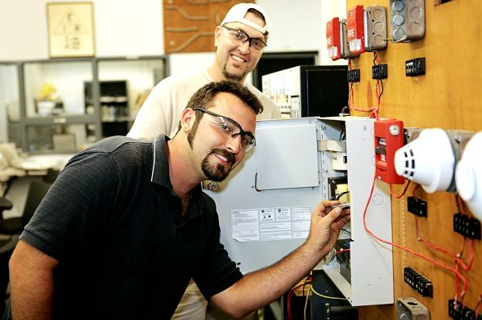
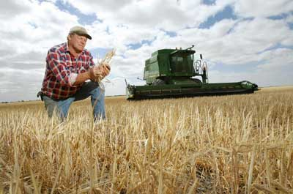

Slide 7
Two views of work
Necessary evil – result of the fall/curse
Genesis 2:15 The LORD God placed the man in the Garden of Eden to tend and watch over it.
A calling of God blending spiritual/natural – opportunity to be a witness

Slide 8
I. Why Work? - Motivations
Because I have to 2 Thessalonians 3:10 Even while we were with you, we gave you this command: “Those unwilling to work will not get to eat.”

Slide 9
Because I want to meet my needs and the needs of my family 1 Timothy 5:8 ⁸But those who won’t care for their relatives, especially those in their own household, have denied the true faith. Such people are worse than unbelievers.

Slide 10
Because I desire to have a certain standard of living Ecclesiastes 5:19 ¹⁹And it is a good thing to receive wealth from God and the good health to enjoy it. To enjoy your work and accept your lot in life—this is indeed a gift from God.

Slide 11
Because I desire to accomplish something meaningful to me Ecclesiastes 2:24 ²⁴So I decided there is nothing better than to enjoy food and drink and to find satisfaction in work. Then I realized that these pleasures are from the hand of God.

Slide 12
Because I seek to do something through my work that is helpful and of service to others 1 Peter 4:10 ¹⁰God has given each of you a gift from his great variety of spiritual gifts. Use them well to serve one another.

Slide 13
Because I can earn money that I can give to help others Ephesians 4:28 ²⁸If you are a thief, quit stealing. Instead, use your hands for good hard work, and then give generously to others in need.

Slide 14
Because I can earn money that I can give to advance God’s kingdom on the earth Proverbs 3:9 ⁹Honor the LORD with your wealth and with the best part of everything you produce.

Slide 15
Because I can serve and glorify God in my work and spiritually impact people Colossians 3:23 - 24 ²³Work willingly at whatever you do, as though you were working for the Lord rather than for people. ²⁴Remember that the Lord will give you an inheritance as your reward, and that the Master you are serving is Christ.

Slide 16
II. Who’s the Boss?
Ephesians 6:5-9
Employees obey and respect your employers
Serve them as you would serve Christ
Please them always – not just when watching
Work with enthusiasm as working for the Lord
The Lord will reward each one for the good we do
Employers respect employees – the Lord is your master as well

Slide 17
III. Work/Witness
Work Ethic
Your witness through your work is a combination of your gifts and your character
It is possible for your gifts to take you beyond where your character will keep you

Slide 18
In addition to skill and intelligence add these character qualities
Trustworthy
Loyalty
Submissive
Honest
Prompt

Slide 19
Promotion
Matthew 25:23 “The master said, ‘Well done, my good and faithful servant. You have been faithful in handling this small amount, so now I will give you many more responsibilities. Let’s celebrate together!’
Proverbs 22:29 Do you see any truly competent workers? They will serve kings rather than working for ordinary people.
Proverbs 18:16 A man’s gift makes room for him And brings him before great men.

Slide 20
1 Peter 2 and 3
Respect all human authority
Honorable lives silence accusers
Accept authority of masters even if cruel
God is pleased when you do what is right and endure unfair treatment
Leave your case in the hands of God the just judge
Keep conscience clear – people see what a good life you live
Be ready to explain your Christian hope

Slide 21
IV. I need a Job ☹
Who’s your boss?
Is his supply according to the economy or is it according to his riches in glory?

Slide 22
Philippians 4:12 - 13 ¹²I know how to live on almost nothing or with everything. I have learned the secret of living in every situation, whether it is with a full stomach or empty, with plenty or little. ¹³For I can do everything through Christ, who gives me strength.
Philippians 4:12 - 13 (TMSG) ¹²I’m just as happy with little as with much, with much as with little. I’ve found the recipe for being happy whether full or hungry, hands full or hands empty. ¹³Whatever I have, wherever I am, I can make it through anything in the One who makes me who I am.

Slide 23
Help
James 2:15 - 17 ¹⁵Suppose you see a brother or sister who has no food or clothing, ¹⁶and you say, “Good-bye and have a good day; stay warm and eat well”—but then you don’t give that person any food or clothing. What good does that do? ¹⁷So you see, faith by itself isn’t enough. Unless it produces good deeds, it is dead and useless.

