Slide 1
Mission and Purpose of Praise Fellowship Church
Loving God and People too and making Followers of Jesus
Ready and able to express God’s love to people
Ready and able to be used by God to teach others to observe all that Jesus has taught

Slide 2
Useful Vessels for Honor
Living For Christ Series

Slide 3
I. Useful
2 Timothy 2:20-21
Utensils for special use
Utensils for everyday use

Slide 4
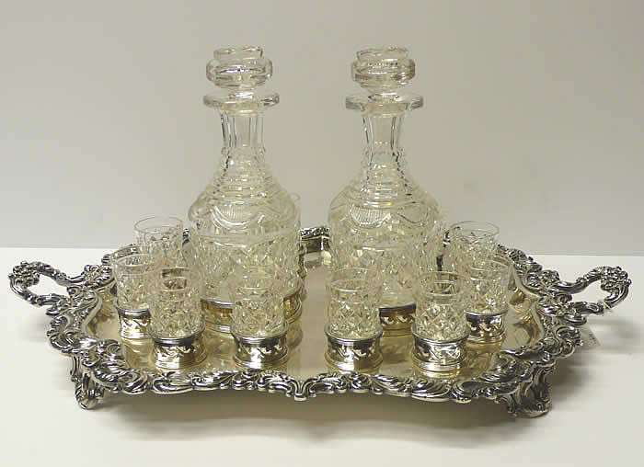
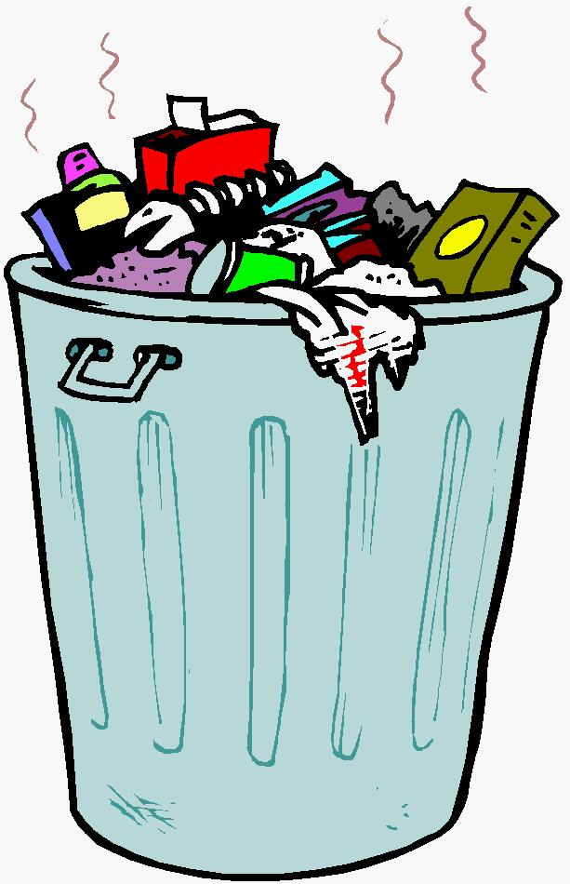
2 Timothy 2:20 (TMSG) In a well-furnished kitchen there are not only crystal goblets and silver platters, but waste cans and compost buckets—some containers used to serve fine meals, others to take out the garbage.

Slide 5
Keep yourself pure
Special utensil
Honorable use
Ready for the master to use for every good work
Purity and Dealing with Addictions
Addictions – substance and behavior
Physical and psychological dependence despite the negative consequences

Slide 6
II. Tempted
James 1:12-15
Temptation comes from our own desires
Enticed and dragged away
Desires give birth to sinful actions
Sin gives birth to death

Slide 7
1:15 (NASB) Then when lust has conceived, it gives birth to sin; and when sin is accomplished, it brings forth death.
Lust - a longing especially for what is forbidden, a passionate or overmastering desire or craving
lust – conception – sin – death (wages of sin)
To prevent conception and birth - Abstain

Slide 8
1 Corinthians 10:13 The temptations in your life are no different from what others experience. And God is faithful. He will not allow the temptation to be more than you can stand. When you are tempted, he will show you a way out so that you can endure. (show you a way to abstain)

Slide 9
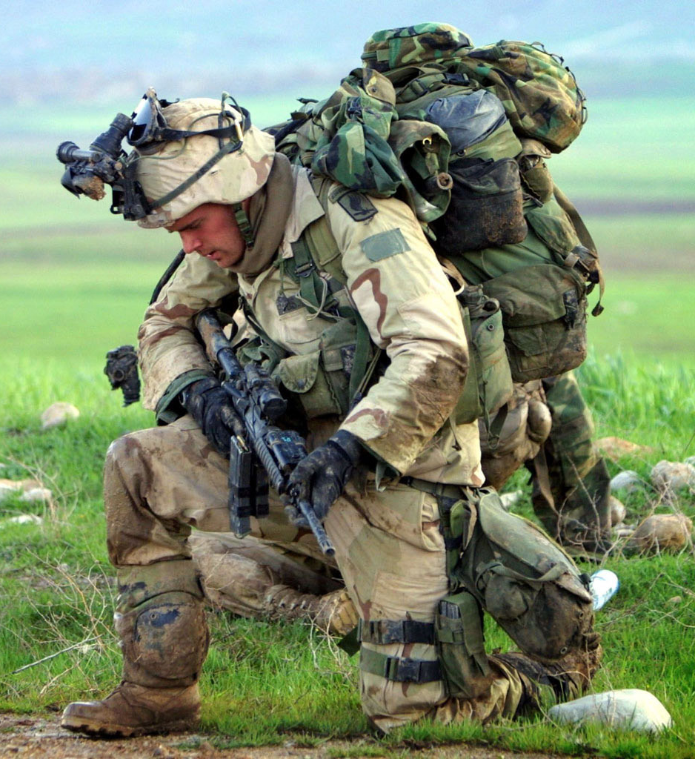
Methods to abstain

Slide 10
Die – Romans 6:6-7
Sinful self crucified with Christ
Sin lost its power in our life
No longer slaves to sin
Galatians 5:24 (NASB) Now those who belong to Christ Jesus have crucified the flesh with its passions and desires.

Slide 11
Just say no – Romans 6:12-14
Do not let sin control the way you live
Free from slavery to sin
Slaves to whomever you choose to obey
Slavery – addiction
V.19 – slavery – weakness of human nature
Romans 7:21-8:2 – the war within
The answer is in Jesus
The Spirit has freed you from the power of sin
The power to say no

Slide 12
Run away – 2 Timothy 2:22
Run from lust stimulation
1 Corinthians 6:18 Run from sexual sin! No other sin so clearly affects the body as this one does. For sexual immorality is a sin against your own body.
Romans 13:14 But put on the Lord Jesus Christ, and make no provision for the flesh in regard to its lusts.

Slide 13
Join a chastity club – 2 Timothy 2:22
Enjoy companionship of the pure hearts club
Positive peer pressure
Accountability

Slide 14
Purified through obedience –
1 Peter 1:22 (NASB) ²²Since you have in obedience to the truth purified your souls for a sincere love of the brethren, fervently love one another from the heart,
Romans 6:17 - 18 (NLT) ¹⁷Thank God! Once you were slaves of sin, but now you wholeheartedly obey this teaching we have given you. ¹⁸Now you are free from your slavery to sin, and you have become slaves to righteous living.

Slide 15
III. Completely God’s
Romans 6:13
Give yourself completely to God
Use your whole body as an instrument to do what is right
For the glory of God

Slide 16
1 Corinthians 6:19 - 20 ¹⁹Don’t you realize that your body is the temple of the Holy Spirit, who lives in you and was given to you by God? You do not belong to yourself, ²⁰for God bought you with a high price. So you must honor God with your body.

Slide 17
2 Timothy 2:21 Therefore, if anyone cleanses himself from these things, he will be a vessel for honor, sanctified, useful to the Master, prepared for every good work.
2 Corinthians 5:14 - 15 ¹⁴Either way, Christ’s love controls us. Since we believe that Christ died for all, we also believe that we have all died to our old life. ¹⁵He died for everyone so that those who receive his new life will no longer live for themselves. Instead, they will live for Christ, who died and was raised for them.

Slide 19
IV.

