Slide 2
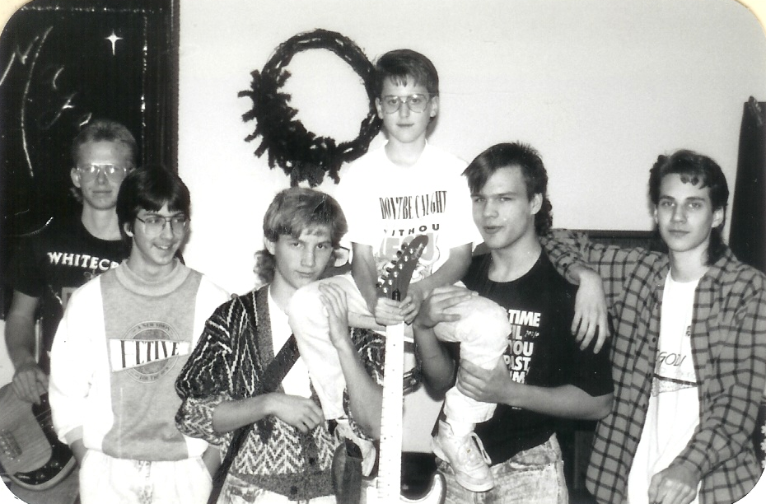

Slide 3
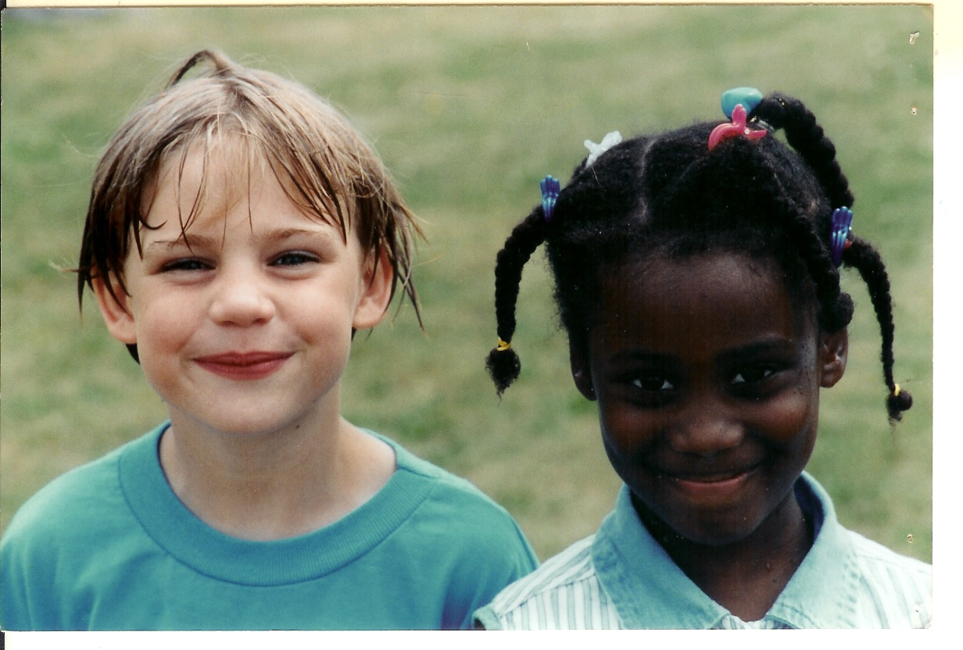

Slide 4
Living For Christ Financially
Living For Christ Series

Slide 5
I. Faith or Fuss
Matthew 6:19-34
Treasures on earth – stolen or destroyed
Treasures in heaven – cannot be stolen or destroyed
Where your treasure is – your heart is
Cannot serve both God and money
1 Timothy 6:10 For the love of money is a root of all sorts of evil, and some by longing for it have wandered away from the faith and pierced themselves with many griefs.

Slide 6
Don’t worry about everyday life - So little faith
God will take care of you
Seek the kingdom of God above all else – he will give you everything you need
Don’t worry about tomorrow

Slide 7
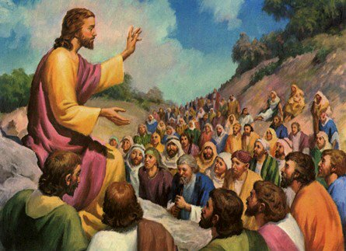

Slide 8
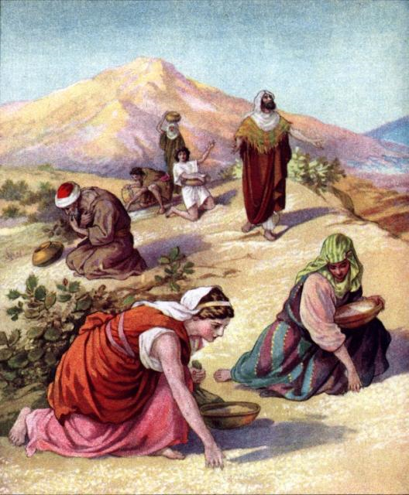

Slide 9
II. Faithful or Flippant
Luke 16:10-13
Faithful or dishonest in little things
Untrustworthy about worldly wealth – who will trust you with the true riches of heaven
Faithful with other people’s things

Slide 10
Malachi 3:8 “Should people cheat God? Yet you have cheated me! “But you ask, ‘What do you mean? When did we ever cheat you?’ “You have cheated me of the tithes and offerings due to me.”

Slide 11
Haggai 1:3 - 6 ³Then the LORD sent this message through the prophet Haggai: ⁴“Why are you living in luxurious houses while my house lies in ruins? ⁵This is what the LORD of Heaven’s Armies says: Look at what’s happening to you! ⁶You have planted much but harvest little. You eat but are not satisfied. You drink but are still thirsty. You put on clothes but cannot keep warm. Your wages disappear as though you were putting them in pockets filled with holes!

Slide 12
Luke 12:16-21
A person is a fool to store up earthly wealth but not have a rich relationship with God
God wants you rich! In relationship with him
1 Timothy 6:17 - 18 ¹⁷Teach those who are rich in this world not to be proud and not to trust in their money, which is so unreliable. Their trust should be in God, who richly gives us all we need for our enjoyment. ¹⁸Tell them to use their money to do good. They should be rich in good works and generous to those in need, always being ready to share with others.
God wants you rich! In good works of sharing

Slide 13
III. Frivolity or Frugality
2 Corinthians 9:6-11 – seed and bread
God will generously provide all you need

Slide 14
Seed for the farmer – don’t eat the seed

Slide 15
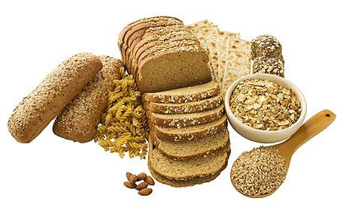
Bread to eat – don’t plant the bread

Slide 16
Discerning and not misappropriating funds
Enriched so you can always be generous

Slide 17
John 12:1-7 – extravagant waste?

Slide 18
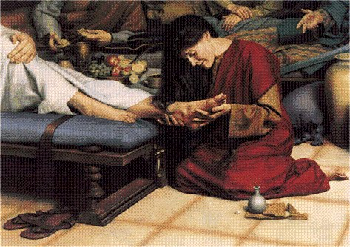
Mary anoints Jesus feet with expensive perfume worth a years wages
Could have been sold and given – or stolen
Leave her alone – she did this for me

Slide 19
Proverbs 21:20 (NASB) There is precious treasure and oil in the dwelling of the wise, But a foolish man swallows it up.
Proverbs 21:20 (NLT) The wise have wealth and luxury, but fools spend whatever they get.
Proverbs 6:6-11

Slide 20
Take a lesson from the ant
Work hard
Gather food for winter
Laziness leads to poverty

Slide 21
Don’t fuss – won’t add one minute to your life
Have faith – God will take care of you, seek him first, he’ll see you have what you need
Don’t have flippant selfishness – not trustworthy with worldly wealth
Be a faithful servant – properly handling that which is the Lord’s
Don’t eat your seed
Don’t plant your bread
Don’t be frivolous – spending everything you have, be ready to use your treasures for the Lord
Be frugal – work hard to harvest for dormant times (winter) – don’t spend whatever you get

Slide 23
IV.

