Slide 2
Functioning in the Church
Living For Christ Series

Slide 3
2 Corinthians 5:14 - 15 ¹⁴Either way, Christ’s love controls us. Since we believe that Christ died for all, we also believe that we have all died to our old life. ¹⁵He died for everyone so that those who receive his new life will no longer live for themselves. Instead, they will live for Christ, who died and was raised for them.

Slide 4
Functioning in the church family – experience the spectrum of loving God and people too and making followers of Jesus
Loving God
and people too
Making followers of Jesus
Praise
Fellowship
Church

Slide 5
Defining – Church
Church universal – all those who have entered into the kingdom of God being born again by the Spirit of God (John 3:3-6)
1 Corinthians 12:13 ...we have all been baptized into one body by one Spirit, and we all share the same Spirit.
Church local – a local gathering of people who have made Jesus their Savior and Lord and are serving him together in likeminded purpose and vision (Acts 2:42-47)

Slide 6
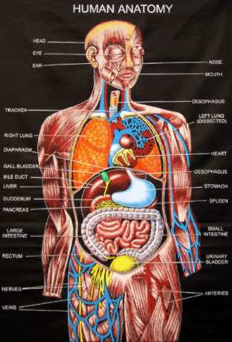
I. Functioning
1 Corinthians 12:12-27
The body of Christ is made of many parts
God has put each part just where he wants it

Slide 7
Cannot say “I am not a part”
Cannot say “I don’t need you”
Members care for one another
All together are Christ’s body and each is a part
1 Corinthians 13 – controlled by Christ’s love

Slide 8
Ephesians 2:10 For we are God’s masterpiece. He has created us anew in Christ Jesus, so we can do the good things he planned for us long ago.
1 Peter 4:10 As each one has received a special gift, employ it in serving one another as good stewards of the manifold grace of God.

Slide 9
II. Equipped
Ephesians 4:11-16
Gifts given for equipping
God’s people to do his work, build up the body
Goal – mature in the Lord, measuring up to the full and complete standard of Christ
Christ, the head, makes the body fit together perfectly
Each part does its own special work – helps the other parts grow – healthy body

Slide 10
Goal – complete in Christ – Colossians 1:24-29
Present them to God perfect (mature, complete) in relationship to Christ

Slide 11
Hebrews 13:17 Obey your spiritual leaders, and do what they say. Their work is to watch over your souls, and they are accountable to God. Give them reason to do this with joy and not with sorrow. That would certainly not be for your benefit.
Obey spiritual leaders
Their work is to watch over your souls
They are accountable to God
Reason to do it with joy not sorrow
For your benefit

Slide 12
Hebrews 10:24-25
Let’s think of ways to motivate one another to acts of love and good works
Don’t neglect our meeting together as some do (NASB – as is the habit of some)
Encourage one another – especially as the day of his return draws near
What would cause me sorrow?

Slide 13
Reason for sorrow
You missing out
Philippians 4:17 Not that I seek the gift itself, but I seek for the profit which increases to your account.
The body missing out from your missing part

Slide 14
My refusal
To fuss about what I can’t control – I can only shepherd those who will allow me to
To be your judge – NEI – you work that out with God
To manipulate with guilt
Difference between discipline and duty
Love of virtue
People here as a discipline is a good thing
People here out of duty and obligation is not a good thing
“We missed you” – does not mean “where were you?”

Slide 15
What I will do
Continue to attempt to impart the value of your part of the body and the value of your assembling for equipping to fulfill your part
Rejoice when you participate

Slide 16
III. Head of the Body
Ephesians 4:15 …growing in every way more and more like Christ who is the head of his body, the church
He gave up his life for her (Eph 5:25)
It’s not about you!!

Slide 17
Romans 12:4-11
Many parts – we all belong to each other
Different gifts for doing certain things well
Don’t pretend – really love others
Take delight in honoring each other (NASB - give preference to one another in honor)
Never be lazy, work hard, serve the Lord enthusiastically
Help to develop an environment where the person you most valued would feel very honored

Slide 20
IV.

