Slide 1
Mission and Purpose
Great Commandment – Matthew 22:37 - 39 ³⁷Jesus replied, “‘You must love the LORD your God with all your heart, all your soul, and all your mind.’ ³⁸This is the first and greatest commandment. ³⁹A second is equally important: ‘Love your neighbor as yourself.’
Who is my neighbor? – Luke 10:30
As yourself

Slide 2
Great Commission - Matthew 28:19 - 20 ¹⁹Therefore, go and make disciples of all the nations, baptizing them in the name of the Father and the Son and the Holy Spirit. ²⁰Teach these new disciples to obey all the commands I have given you. And be sure of this: I am with you always, even to the end of the age.”

Slide 3
Loving Others - Family
Living For Christ Series

Slide 4
Family
Love is a choice, not just a feeling
The real test of living for self or living for Christ

Slide 5
2 Corinthians 5:15 He died for everyone so that those who receive his new life will no longer live for themselves. Instead, they will live for Christ, who died and was raised for them.
What is the motive for no longer living for self?
Commitment to the Lord
Understanding the Lord’s principles

Slide 6
I. Marital – Husband and Wife
Love as Christ loves the church
Ephesians 5:21-33
Submit to one another
Jesus gave up his life
Save life, lose it – give up life to save it (Matthew 16:25)

Slide 7
Husbands witness Jesus to the world by how they treat their wife
2 Corinthians 3:2 You are our letter, written in our hearts, known and read by all men;
Presenting her to himself, glorious

Slide 8
Love wife = love self
Wife respect husband – in word and in deed

Slide 9
1 Peter 3:1-7
Godly wives make for godly husbands
Prioritized adornment – inward
Husbands live with your wife in an understanding way
Treat her right so prayers not hindered

Slide 10
Understanding each other – maybe need the help of Marriage Translators

Slide 11
II. Family – Parents and Children
Ephesians 6:1-3
Children honor and obey parents
Go well with you
Long life
Obedience may come to its conclusion with adulthood and independence – but honor never does

Slide 12
Discipline in love
Hebrews 12:5-7, 11
Fathers who love their children discipline them
Discipline is painful but produces right living
Seed dies before if brings life
Teaching principle of lose life to find it

Slide 13
Proverbs 22:15 A youngster’s heart is filled with foolishness, but physical discipline will drive it far away.
Proverbs 13:24 Those who spare the rod of discipline hate their children. Those who love their children care enough to discipline them.
2 kinds of hate – abuse and neglect
Allowing freedom of foolish self-will is not love
Teaches the principle of save life – lose it
Parents witness Father God to the world by how they discipline their children

Slide 14
III. Choices

Slide 15
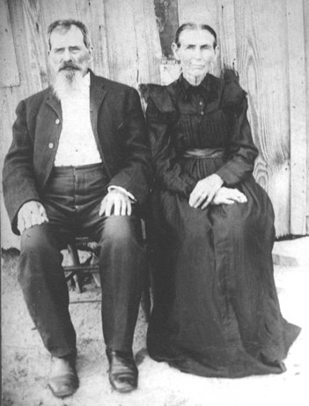
Do you get to choose your parents?

Slide 16
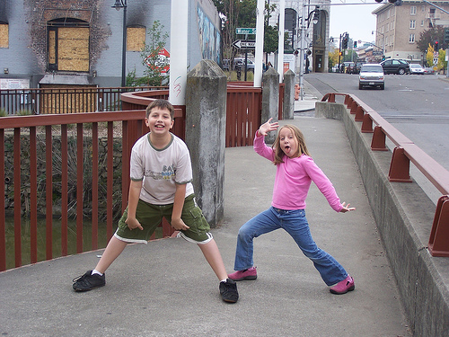
Do you get to choose your kids?
Don’t choose their temperament
Train their temperament

Slide 17
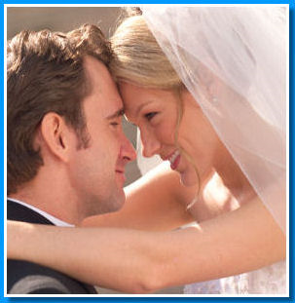
Do you get to choose your spouse?
Be very careful - Discerning
Family relationship – honor?

Slide 18
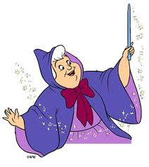
Can you make your spouse change?

Slide 19
What about the things you can’t change?
God grant me the serenity to accept the things I cannot change; courage to change the things I can; and wisdom to know the difference.
Romans 12:18 If possible, so far as it depends on you, be at peace with all men.

Slide 22
IV.

