Slide 1
Fulfilling our mission and purpose – loving God and people too and making followers of Jesus
Friends with God
God took us from the place of utterly helpless, condemned sinners, enemies, far away, separated – to reconciled, new relationship of friendship with God, in his presence holy, blameless and without fault
By the blood of Jesus
Solicits a response

Slide 2
2 Corinthians 5:15 He died for everyone so that those who receive his new life will no longer live for themselves. Instead, they will live for Christ, who died and was raised for them.

Slide 3
Fellowship With God
Living For Christ Series

Slide 4
Fellowship with God is the development of friendship

Slide 5
I. Characteristics of Friends
Various characteristics
Trust – dependable, faithful, graceful
Communication – personal, speaks truth with love (honest), person of their word
Time – accessible, ample time, frequent times
David – Man after God’s own heart - example of relationship

Slide 6
II. Trust
I Corinthians 1:7-9
He will keep you strong until the end
He will keep you free from all blame
Faithful to do what he says
Called into partnership (NASB - fellowship) with Jesus
2 Timothy 2:13 If we are unfaithful, he remains faithful, for he cannot deny who he is.

Slide 7
Proverbs 3:5 - 6 ⁵Trust in the LORD with all your heart; do not depend on your own understanding. ⁶Seek his will in all you do, and he will show you which path to take.

Slide 8
David – a man who can be trusted
1 Samuel 13:14 But now your kingdom must end, for the LORD has sought out a man after his own heart. The LORD has already appointed him to be the leader of his people, because you have not kept the LORD’s command.”
Acts 13:22 But God removed Saul and replaced him with David, a man about whom God said, ‘I have found David son of Jesse, a man after my own heart. He will do everything I want him to do.’

Slide 9
Luke 16:10 “If you are faithful in little things, you will be faithful in large ones. But if you are dishonest in little things, you won’t be honest with greater responsibilities.
Luke 19:17 “‘Well done!’ the king exclaimed. ‘You are a good servant. You have been faithful with the little I entrusted to you, so you will be governor of ten cities as your reward.’

Slide 10
III. Communication
Exodus 33:11 Inside the Tent of Meeting, the LORD would speak to Moses face to face, as one speaks to a friend. Afterward Moses would return to the camp, but the young man who assisted him, Joshua son of Nun, would remain behind in the Tent of Meeting.

Slide 11
Speaking God
And God said…
The Word became flesh…
Hear what the Spirit has to say…
Honest communication
1 Peter 1:25 But the word of the Lord remains forever.” And that word is the Good News that was preached to you.
Hebrews 4:12 For the word of God is alive and powerful. It is sharper than the sharpest two-edged sword, cutting between soul and spirit, between joint and marrow. It exposes our innermost thoughts and desires.

Slide 12
The written word trains our spiritual ears to the spoken word
Ears to hear
Luke 14:35 – anyone with ears to hear should listen and understand
I Kings 19:12 – still small voice, gentle whisper

Slide 13
Not Listening?

Slide 14
Stop interrupting me while I’m ignoring you

Slide 15
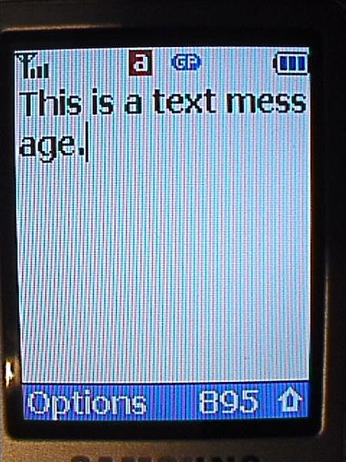
I haven’t been ignoring you, I’ve been prioritizing you.

Slide 16
Excerpts from A. W. Tozer – The Pursuit of God
God and the spiritual world are real. We can reckon upon them with as much assurance as we reckon upon the familiar world around us. Spiritual things are here inviting our attention and challenging our trust. Our trouble is that we have established bad thought habits. We habitually think of the visible world as real and doubt the reality of any other. The world of sense intrudes upon our attention day and night for the whole of our lifetime. It is clamorous, insistent and self-demonstrating. It does not appeal to our faith; it is here, assaulting our five senses, demanding to be accepted as real and final. We must break the habit of ignoring the spiritual.

Slide 17
Psalms 119:148 My eyes anticipate the night watches, That I may meditate on Your word.
Psalms 119:130 The unfolding of Your words gives light; It gives understanding to the simple.
Friends are full of grace
God is very full of grace toward us
How about giving God grace?

Slide 18
David – honest communication
Psalms 13:1 - 6 ¹O LORD, how long will you forget me? Forever? How long will you look the other way? ²How long must I struggle with anguish in my soul, with sorrow in my heart every day? How long will my enemy have the upper hand? ³Turn and answer me, O LORD my God! Restore the sparkle to my eyes, or I will die. ⁴Don’t let my enemies gloat, saying, “We have defeated him!” Don’t let them rejoice at my downfall. ⁵But I trust in your unfailing love. I will rejoice because you have rescued me. ⁶I will sing to the LORD because he is good to me.

Slide 19
IV. Time
Ephesians 5:15 - 17 ¹⁵Therefore be careful how you walk, not as unwise men but as wise, ¹⁶making the most of your time, because the days are evil. ¹⁷So then do not be foolish, but understand what the will of the Lord is.
Prioritizing time with the Lord

Slide 20
I haven’t been ignoring you, I’ve been prioritizing you.

Slide 21
Colossians 1:18 – …he is first in everything
Is he prioritized to the best time of your day?
Ordering Jesus supreme
Matthew 6:33 – seek first the kingdom of God and his righteousness
First Love – Revelation 2:2-5
You don’t love me…as you did at first
Turn back and do the works you did at first

Slide 22
Conclusion – Relationship with God – as friend
Be someone God can trust
Faithful
Obedient
Communication
Listening
Honest
Person of your word
Time
Put him first
Give him quality and ample time
Be accessible to God

