Slide 2
Friends with God
Living For Christ Series

Slide 3
I. Putting Things in Perspective

Slide 4
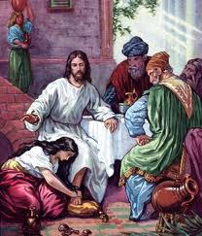
Luke 7:47 “For this reason I say to you, her sins, which are many, have been forgiven, for she loved much; but he who is forgiven little, loves little.”

Slide 5
Romans 5:6-11
Utterly helpless
God showed his great love by sending Jesus to die while we were still sinners
Made right with God by the blood of Jesus
Saved from condemnation
Friendship with God restored
Rejoice in our wonderful new relationship
No matter your condition – God is for you

Slide 6
2 Corinthians 5:15 He died for everyone so that those who receive his new life will no longer live for themselves. Instead, they will live for Christ, who died and was raised for them.

Slide 7
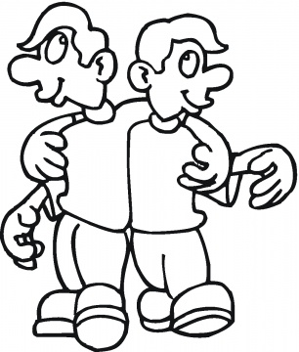
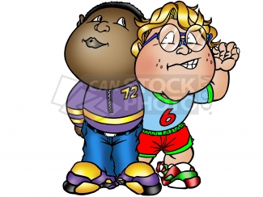
Let’s make up and be friends –
usually the one saying this is the one who faulted the other
Forgive my wrong behavior and lets move on
In God’s case – we are the ones who faulted him but he is the initiator of restoration even when it is farthest from our mind

Slide 8
Struggling with Relationship with God
Don’t understand the things going on in my life
Attempting to trust God, but it keeps getting worse
Why is it taking so long for answers to my prayers – in fact I’m not praying any more
I know I’m not walking with God as I should – so I’m not too cool with trying to get close – feeling guilty
God, you let me down – failed expectations
Attempting to walk in line with the word, but not seeing the fruit

Slide 9
II. Right Side Up
Perspective – right side up or upside down?
Up
Down
Down
Up

Slide 10
Colossians 1:15-23
Christ is supreme over all creation
Christ is head of the church
Christ is supreme of all who raise from the dead
Christ is first in everything
God was pleased to live in Christ
You were enemies, but now reconciled
In his presence holy, blameless, no fault
Continue to stand firm in this truth

Slide 11
Perspective – right side up or upside down?
Jesus supreme or circumstances supreme?
Jesus
Circumstances
Circumstances
Jesus

Slide 12
Perspective – inside out or outside in?
Outside in…
Circumstances
Despair!
Finances
Trouble
Relationships
Work
Packers Could Lose

Slide 13
Perspective – inside out or outside in?
Inside out…
Circumstances
Jesus Supreme
Friend of God
Reconciled and in God’s presence
Finances
Trouble
Relationships
Work

Slide 14
2 Corinthians 5:7 For we live by believing and not by seeing.
Proverbs 3:5 - 6 ⁵Trust in the LORD with all your heart; do not depend on your own understanding. ⁶Seek his will in all you do, and he will show you which path to take.

Slide 15
Putting things in perspective
Putting right side up and seeing inside out
Jesus is #1 in me and I respond to all of life’s issues from that perspective

Slide 17
I put the right side up I’m looking inside out I’m okay with God He’s even given me clout When life gives me cheese I order Jesus supreme Instead of visions of despair I’m making Jesus my dream

Slide 18
http://www.youtube.com/watch?v=pfQ5UA5yvwE&feature=channel
http://www.youtube.com/watch?v=4InqZVJoJD8
http://www.youtube.com/watch?v=vIn1ervARgE&feature=related

Slide 19
III.

Slide 21
IV.

