Slide 2
Living For Christ
Living For Christ Series

Slide 3
Loving God and People too and making followers of Jesus

Slide 4
I. Who’s in Charge?
Who has first place?
Who is in control?

Slide 5
2 Corinthians 5:14-15
Christ’s love controls us
Responding to Jesus as a result of his love for us
Responding to others as a result of his love in us

Slide 6
Christ died for all
We have died to our old life
Those who receive his new life – no longer live for themselves but live for Christ
Examine each area – self or Christ?

Slide 7
Philippians 2:13
God is working in you
Giving you power and desire
Do what pleases him
Pleasing self – or – pleasing God?
AMPLIFIED – [Not in your own strength] for it is God Who is all the while effectually at work in you [energizing and creating in you the power and desire], both to will and to work for His good pleasure and satisfaction and delight.

Slide 8
Pastor Dan – prophetic word
Finish our course – fully accomplish the purpose of what we’ve been put here for

Slide 9
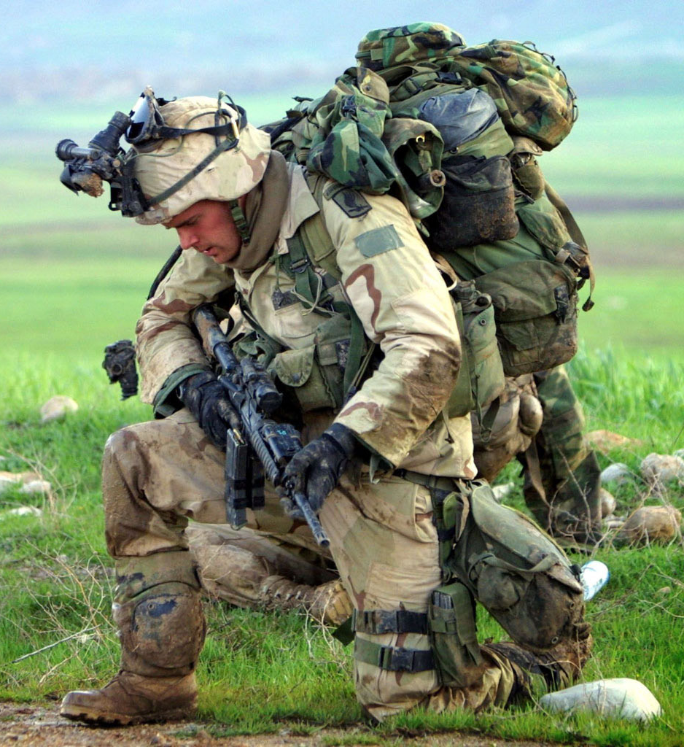
Squaring away your gear
Joy is a force

Slide 10
II. Love’s Expression
John 15:9-17
Remain in my love
Obey my commandments
Told you these things so you will be filled and overflow with joy
My commandment - Love each other the same way I loved you – laying down your life

Slide 11
God working in you – Philippians 2:13
Romans 5:5 And this hope will not lead to disappointment. For we know how dearly God loves us, because he has given us the Holy Spirit to fill our hearts with his love.
Galatians 5:22 - 23 ²²But the Holy Spirit produces this kind of fruit in our lives: love, joy, peace, patience, kindness, goodness, faithfulness, ²³gentleness, and self-control. There is no law against these things!

Slide 12
1 John 4:7-21
God is love
God’s expression of love – sending Jesus to die for us
God’s full expression of love in us – loving each other
Living in God – love grows more perfect
Living like Jesus in this world
Liar – love God, but not brother or sister
His command – love God and people too

Slide 13
III. Loving in all Life’s Parts
Love God – keep his commands
The commands of God are the word of God
Know the word regarding areas of struggle
Tough love – that your joy may be full

Slide 14
2 Timothy 4:2 - 4 ²Preach the word of God. Be prepared, whether the time is favorable or not. Patiently correct, rebuke, and encourage your people with good teaching. ³For a time is coming when people will no longer listen to sound and wholesome teaching. They will follow their own desires and will look for teachers who will tell them whatever their itching ears want to hear. ⁴They will reject the truth and chase after myths.
Follow their own desires – living for self or living for Christ?
Truth = freedom = joy
Myths = deception = sorrow

Slide 15
Our life in all its parts
Squaring away our gear

Slide 21
IV.

