Slide 1
John 5:37-38 (NLT) ³⁷And the Father who sent me has testified about me himself. You have never heard his voice or seen him face to face,³⁸and you do not have his message in your hearts, because you do not believe me—the one he sent to you.

Slide 2
God Loves Children
Knowing God Through Jesus Series

Slide 3
I. Receiving Children

Slide 4
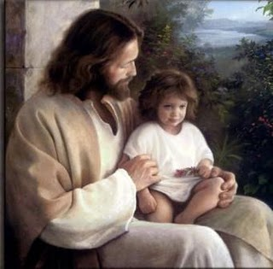
Mark 9:33-37

Slide 5
To be great – be a servant

Slide 6
Welcome (receive) a child – receive Jesus, receive God

Slide 7
Mark 9:36 - 37 (TMSG) ³⁶He put a child in the middle of the room. Then, cradling the little one in his arms, he said, ³⁷“Whoever embraces one of these children as I do embraces me, and far more than me—God who sent me.”

Slide 8
Parental
Luke 1:17 He will be a man with the spirit and power of Elijah. He will prepare the people for the coming of the Lord. He will turn the hearts of the fathers to their children, and he will cause those who are rebellious to accept the wisdom of the godly.
Genesis 18:19 I have singled him out so that he will direct his sons and their families to keep the way of the LORD by doing what is right and just. Then I will do for Abraham all that I have promised.

Slide 9
Ephesians 6:1-4
Commandment with a promise – honor father and mother
Things will go well
Long life on earth
Fathers – discipline and instruction from the Lord

Slide 10
Community – The disciples, The Church
“Embrace these children as I do…”
Opportunity
Interaction – love on them, correction
Teaching – nursery, Sunday kids church, Wednesday nights
85% of people in the US who receive the Lord do so between ages 5-14

Slide 11
II. Like a Child

Slide 12
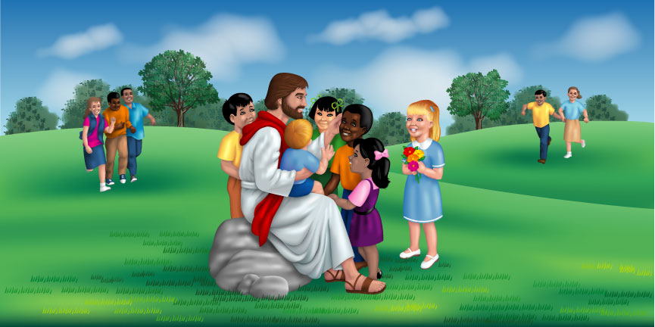
Mark 10:13-15

Slide 13
Let the children come to me

Slide 14
The kingdom of God belongs to those who are like these

Slide 15
Receive the kingdom like a child

Slide 16
Child-like attributes
Carefree
Uninhibited
Faith
Simple
Forgiveness - Don’t hold grudges
Dad is great!

Slide 17
John 1:12 But to all who believed him and accepted him, he gave the right to become children of God.

Slide 18
III. No Cause for Stumbling
Matthew 18:1-10
If you cause one of these little ones to stumble (fall into sin) - Millstone drown
Sorrow awaits the person who does the tempting
Don’t look down on any of these little ones
Their angels are always before the Father

Slide 20
The Pastor’s Stump Feature Just for fun and discovery– asking questions that arise as you read the gospels

Slide 21
In the Psalms David says “you have made him a little lower than the angels” (Elohim – God), but when Paul quotes David he uses “angels” Aggelos, not God. What’s up with that?

Slide 22
Psalms 8:4-5 ⁴what are people that you should think about them, mere mortals that you should care for them? ⁵Yet you made them only a little lower than God and crowned them with glory and honor.

Slide 23
God – Hebrew ELOHYM - el-o-heem‘ - gods in the ordinary sense; but specifically used (in the plural thus, especially with the article) of the supreme God; occasionally applied by way of deference to magistrates; and sometimes as a superlative:—angels, X exceeding, God (gods) (-dess, -ly), X (very) great, judges, X mighty.
Same Hebrew word in Genesis 1:26 Then God said, “Let us make human beings in our image, to be like ourselves…”

Slide 24
Hebrews 2:6 - 9 ⁶For in one place the Scriptures say, “What are people that you should think of them, or a son of man that you should care for him? ⁷Yet you made them only a little lower than the angels and crowned them with glory and honor. ⁸You gave them authority over all things.” Now when it says “all things,” it means nothing is left out. But we have not yet seen all things put under their authority. ⁹What we do see is Jesus, who was given a position “a little lower than the angels”; and because he suffered death for us, he is now “crowned with glory and honor.”

Slide 25
Greek - AGGELOS ang'-el-os; a messenger; especially an “angel”; by implication a pastor:—angel, messenger.

Slide 26
So the real question(s) is/are…
Is there a discrepancy between being created a little lower that God or a little lower than angels?
Are we a little lower than God or a little lower than angels?
Jesus was made “a little lower than the angels” but has been crowned with glory and honor
We have been crowned with glory and honor and have been given authority over all things
Angels are servants, spirits sent to care for the people who will inherit salvation (Hebrews 1:14)

Slide 27
IV.

