Slide 1
John 17:3 (NLT) ³And this is the way to have eternal life—to know you, the only true God, and Jesus Christ, the one you sent to earth.

Slide 2
God the Gardener
Knowing God Through Jesus Series

Slide 3
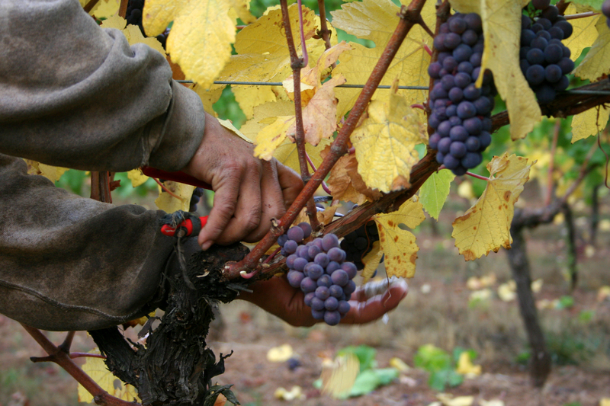
John 15:1-8
Jesus – vine
Father – Gardener
You – branches

Slide 4
Fruitful branches
Remain attached
Pruned

Slide 5
Unfruitful
Severed – withered
burned

Slide 6
I. Gardener

Slide 7
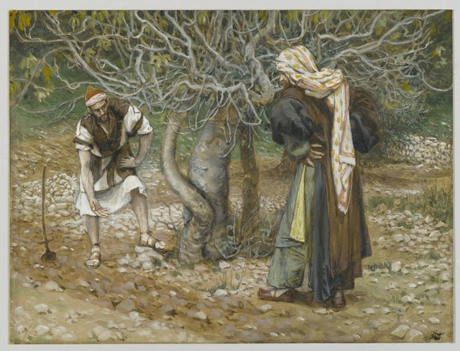
Luke 13:6-9
Patience and persistence
Special attention
realistic

Slide 8
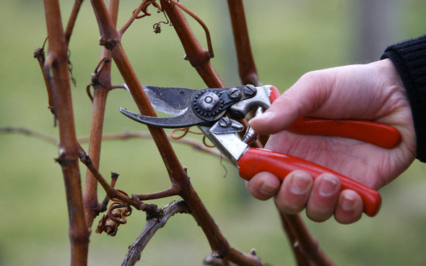
II. Pruned
Pruned by the message I have given you

Slide 9
2 Timothy 3:16-17
All scripture is inspired by God
Useful to teach us what is right
Corrects us when we are wrong

Slide 10
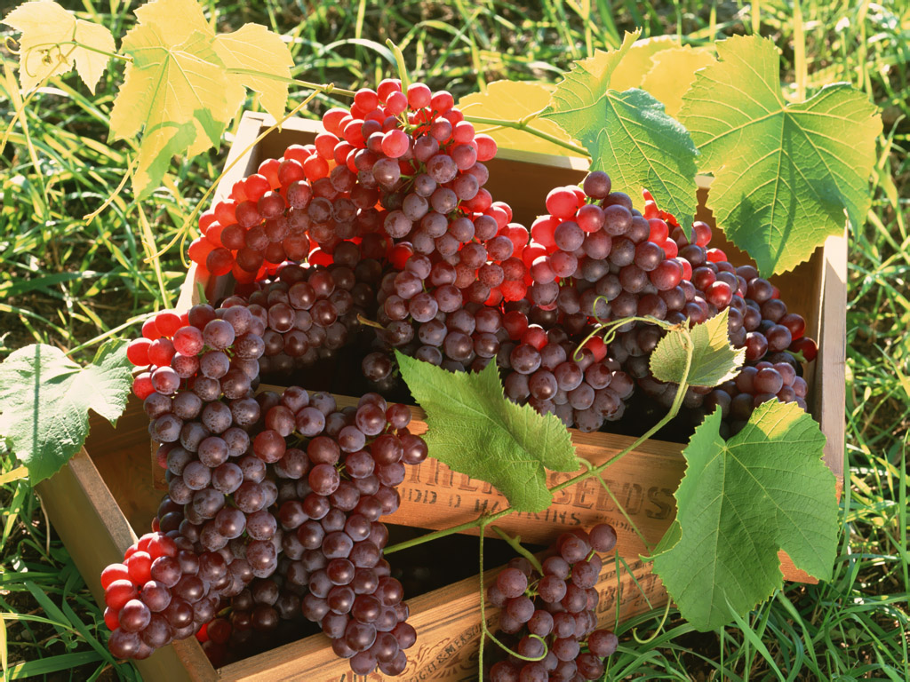
Equips us for every good work (fruitful)

Slide 11
Hebrews 12:5-11
Encouraging words – the Lord disciplines
Always good – share in his character (holiness)
Not enjoyable when it is happening

Slide 12
Result – harvest of right living (fruitful)

Slide 13
III. Remain
John 15:4 - 7 ⁴Remain in me, and I will remain in you… ⁵…Those who remain in me, and I in them, will produce much fruit… ⁶Anyone who does not remain in me is thrown away like a useless branch and withers… ⁷But if you remain in me and my words remain in you, you may ask for anything you want, and it will be granted!

Slide 14
Remain - Greek MENO men'-o - A primary verb; to stay (in a given place, state, relation or expectancy):—abide, continue, dwell, endure, be present, remain, stand, tarry (for), X thine own.

Slide 15
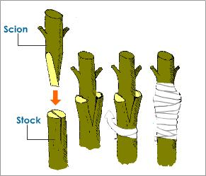
Romans 11:17-24 – Gardener Grafter
Grafted in to receive the blessings
Branches broken off because they didn’t believe
You are grafted in because you do believe

Slide 16
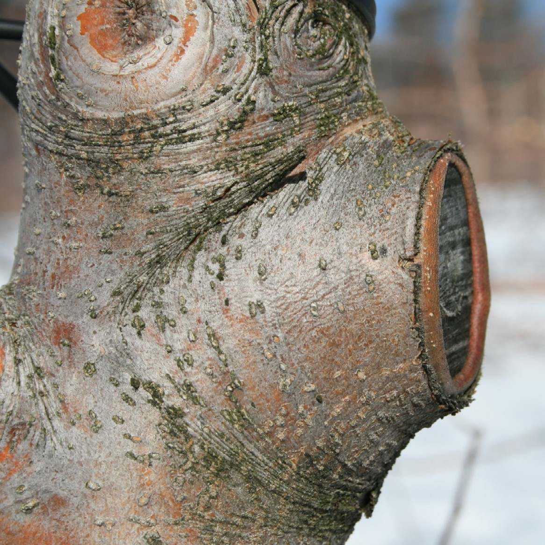
If you stop trusting you will be cut off

Slide 17
Remaining – abiding – staying attached is based on trust
God is kind to those who trust
God is severe to those who disobey

Slide 18
IV. Fruitful
John 15:8 When you produce much fruit, you are my true disciples. This brings great glory to my Father.
Equipped for every good work
The fruit of right living
The fruit of God’s character
The fruit of answered prayer – ask for anything you want (according to God’s will – 1 John 5:14-15)

Slide 19
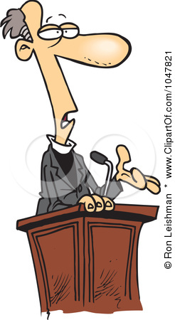
The Pastor’s Stump Feature Just for fun and discovery– asking questions that arise as you read the gospels

Slide 20
In the Psalms David says “you have made him a little lower than the angels” (Elohim – God), but when Paul quotes David he uses “angels” Aggelos , not God. What’s up with that?

Slide 21
Psalms 8:4-5 ⁴what are people that you should think about them, mere mortals that you should care for them? ⁵Yet you made them only a little lower than God and crowned them with glory and honor.

Slide 22
God – Hebrew ELOHYM - el-o-heem‘ - gods in the ordinary sense; but specifically used (in the plural thus, especially with the article) of the supreme God; occasionally applied by way of deference to magistrates; and sometimes as a superlative:—angels, X exceeding, God (gods) (-dess, -ly), X (very) great, judges, X mighty.
Same Hebrew word in Genesis 1:26 Then God said, “Let us make human beings in our image, to be like ourselves…”

Slide 23
Hebrews 2:6 - 9 ⁶For in one place the Scriptures say, “What are people that you should think of them, or a son of man that you should care for him? ⁷Yet you made them only a little lower than the angels and crowned them with glory and honor. ⁸You gave them authority over all things.” Now when it says “all things,” it means nothing is left out. But we have not yet seen all things put under their authority. ⁹What we do see is Jesus, who was given a position “a little lower than the angels”; and because he suffered death for us, he is now “crowned with glory and honor.”

Slide 24
Greek - AGGELOS ang'-el-os; a messenger; especially an “angel”; by implication a pastor:—angel, messenger.

Slide 25
So the real question(s) is/are…
Is there a discrepancy between being created a little lower that God or a little lower than angels?
Are we a little lower than God or a little lower than angels?
Jesus was made “a little lower than the angels” but has been crowned with glory and honor
We have been crowned with glory and honor and have been given authority over all things
Angels are servants, spirits sent to care for the people who will inherit salvation (Hebrews 1:14)

