Slide 2
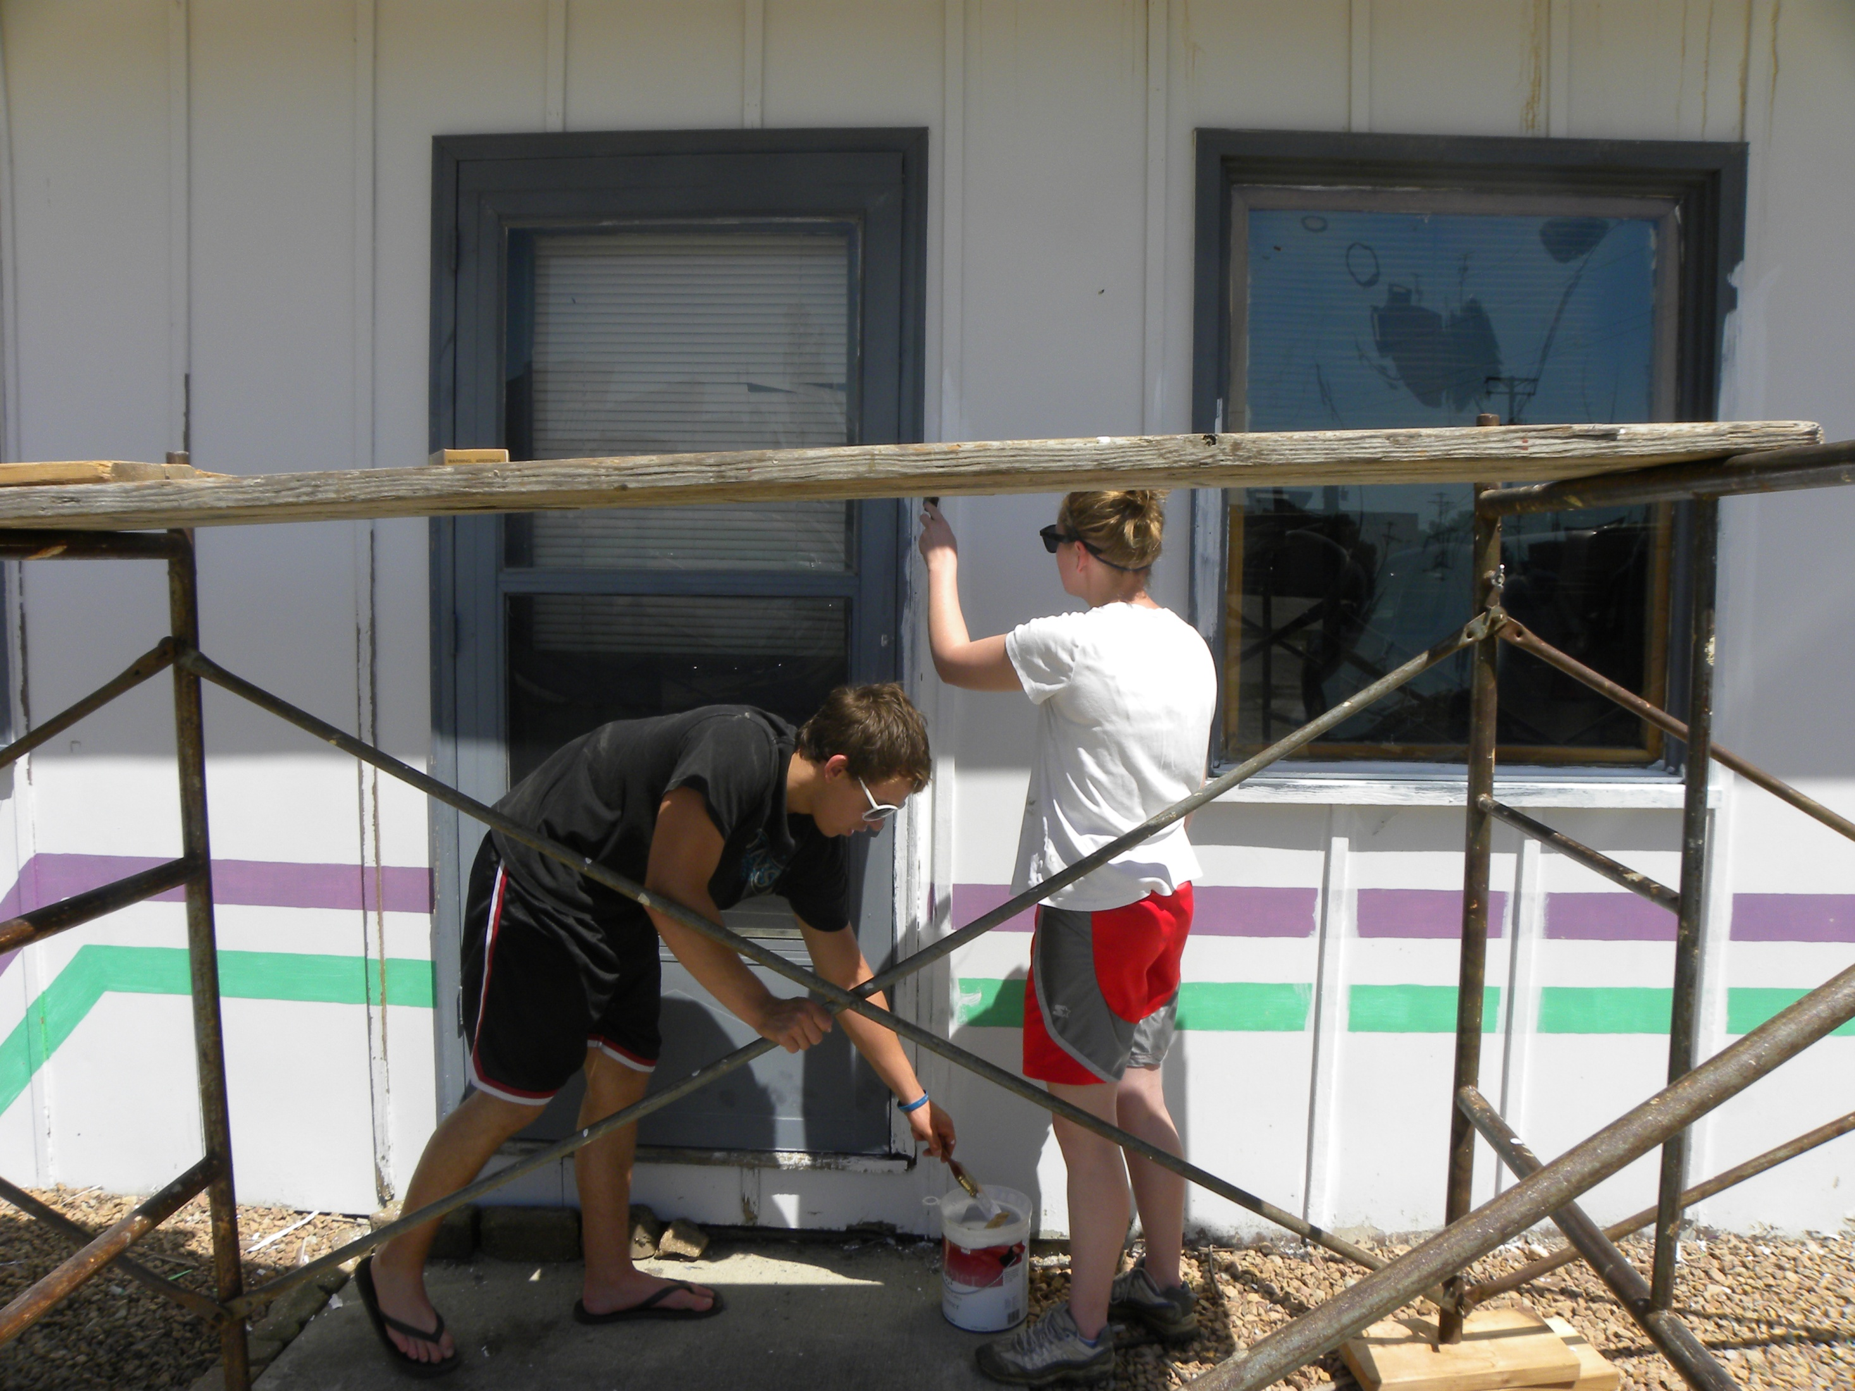

Slide 3
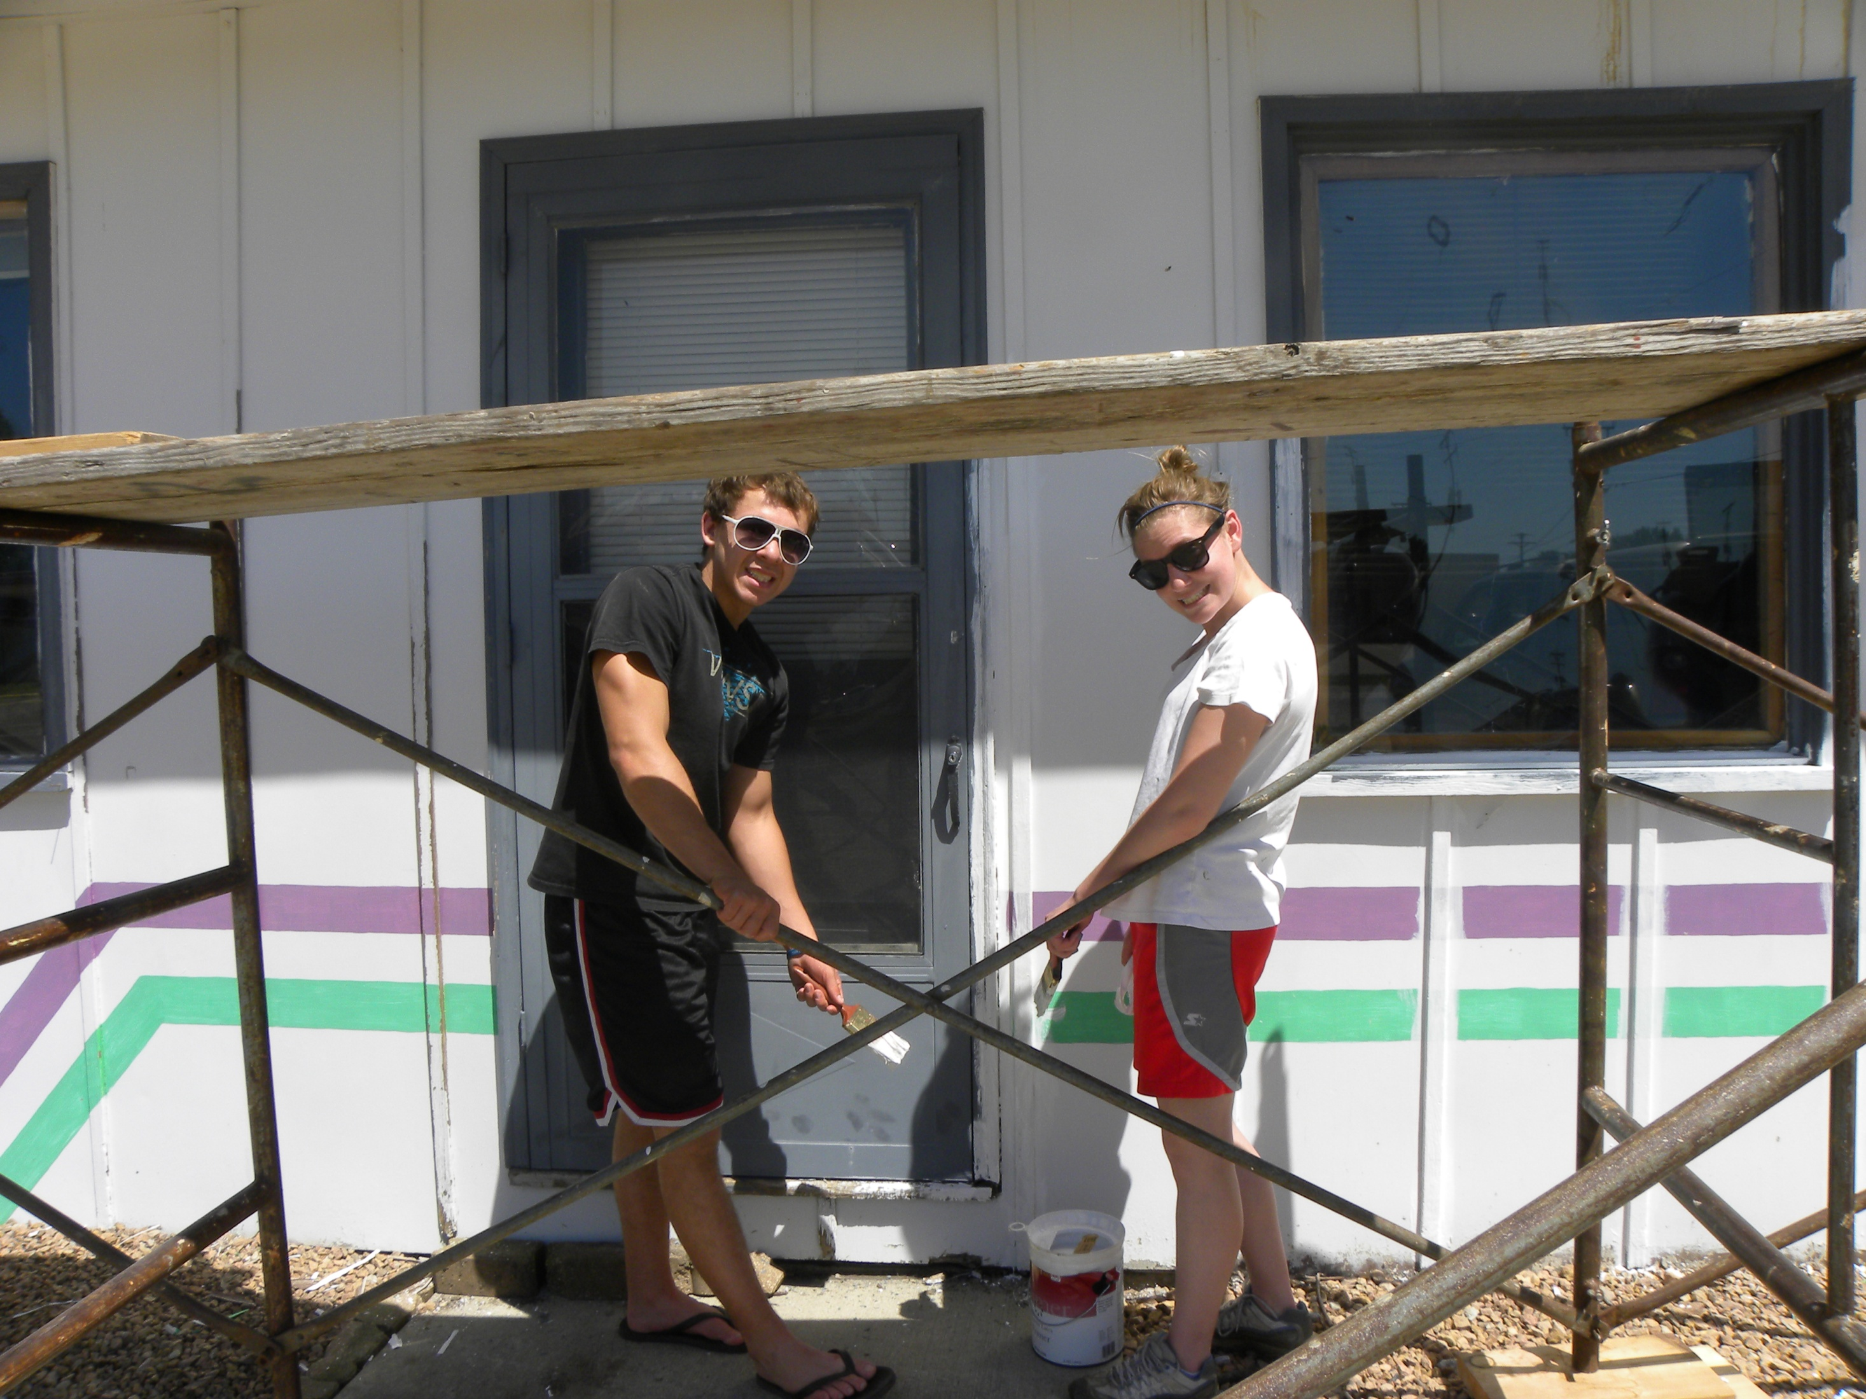

Slide 4
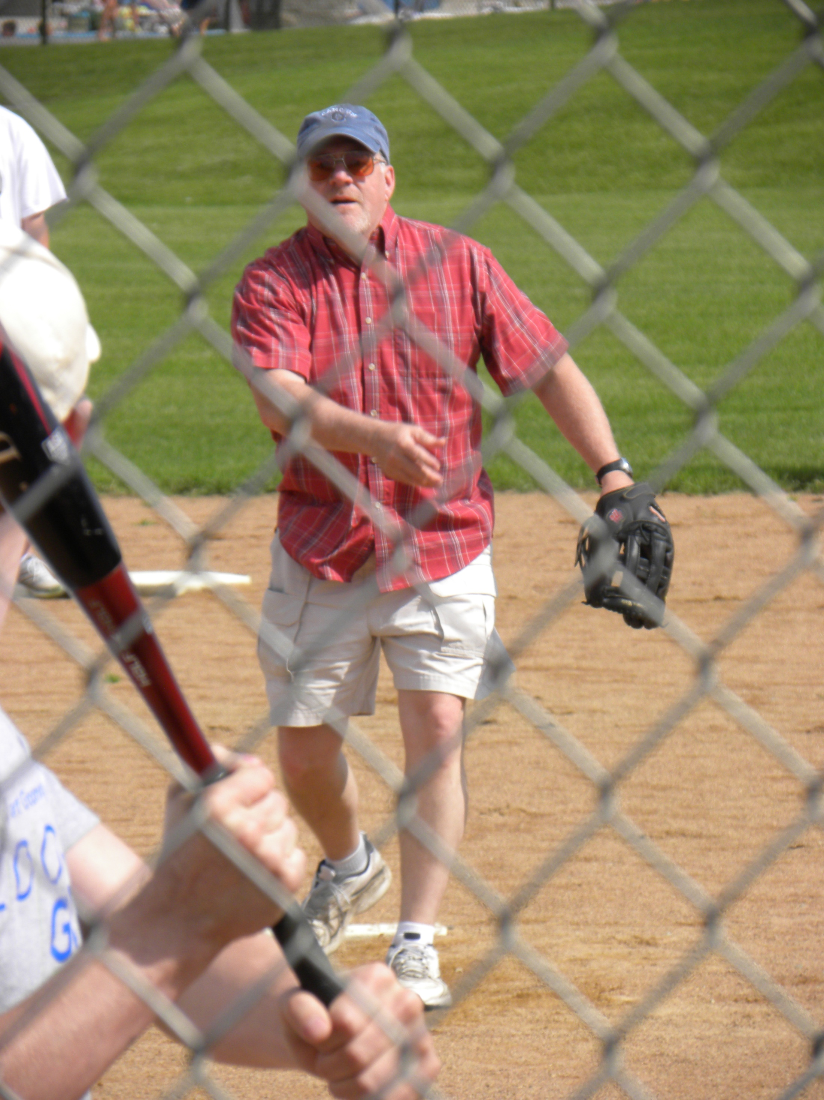

Slide 5
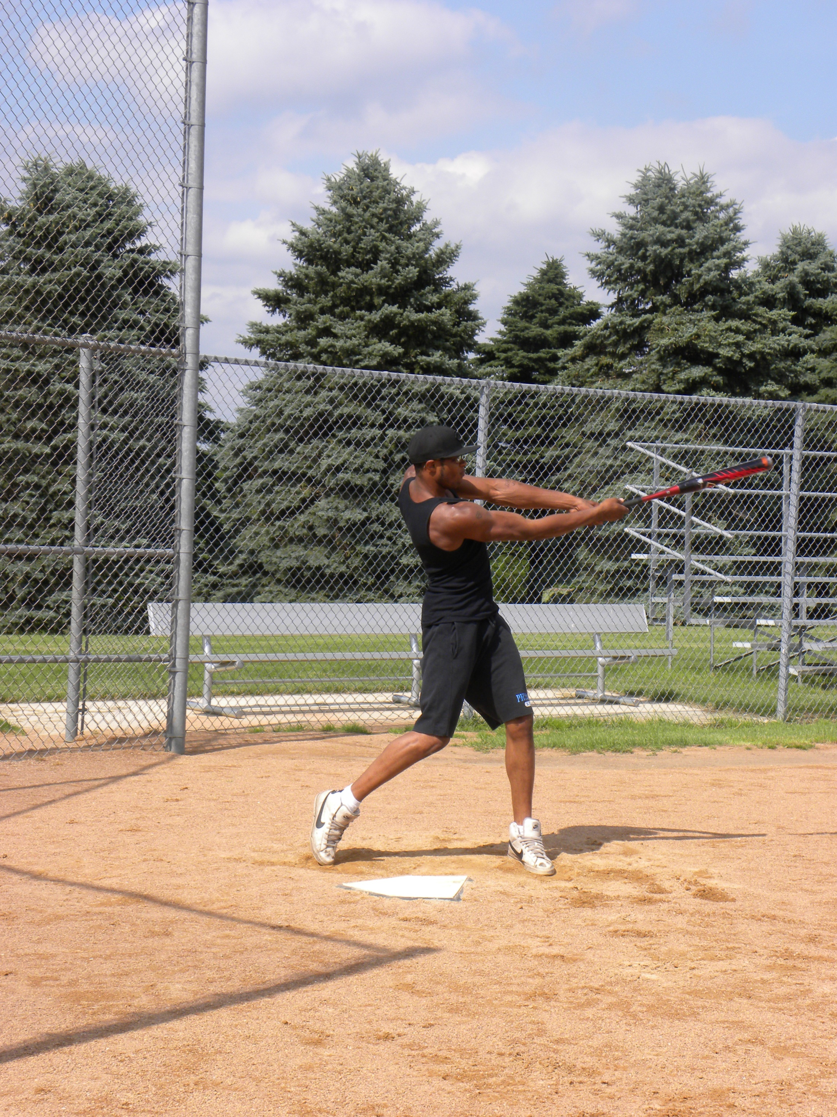

Slide 6
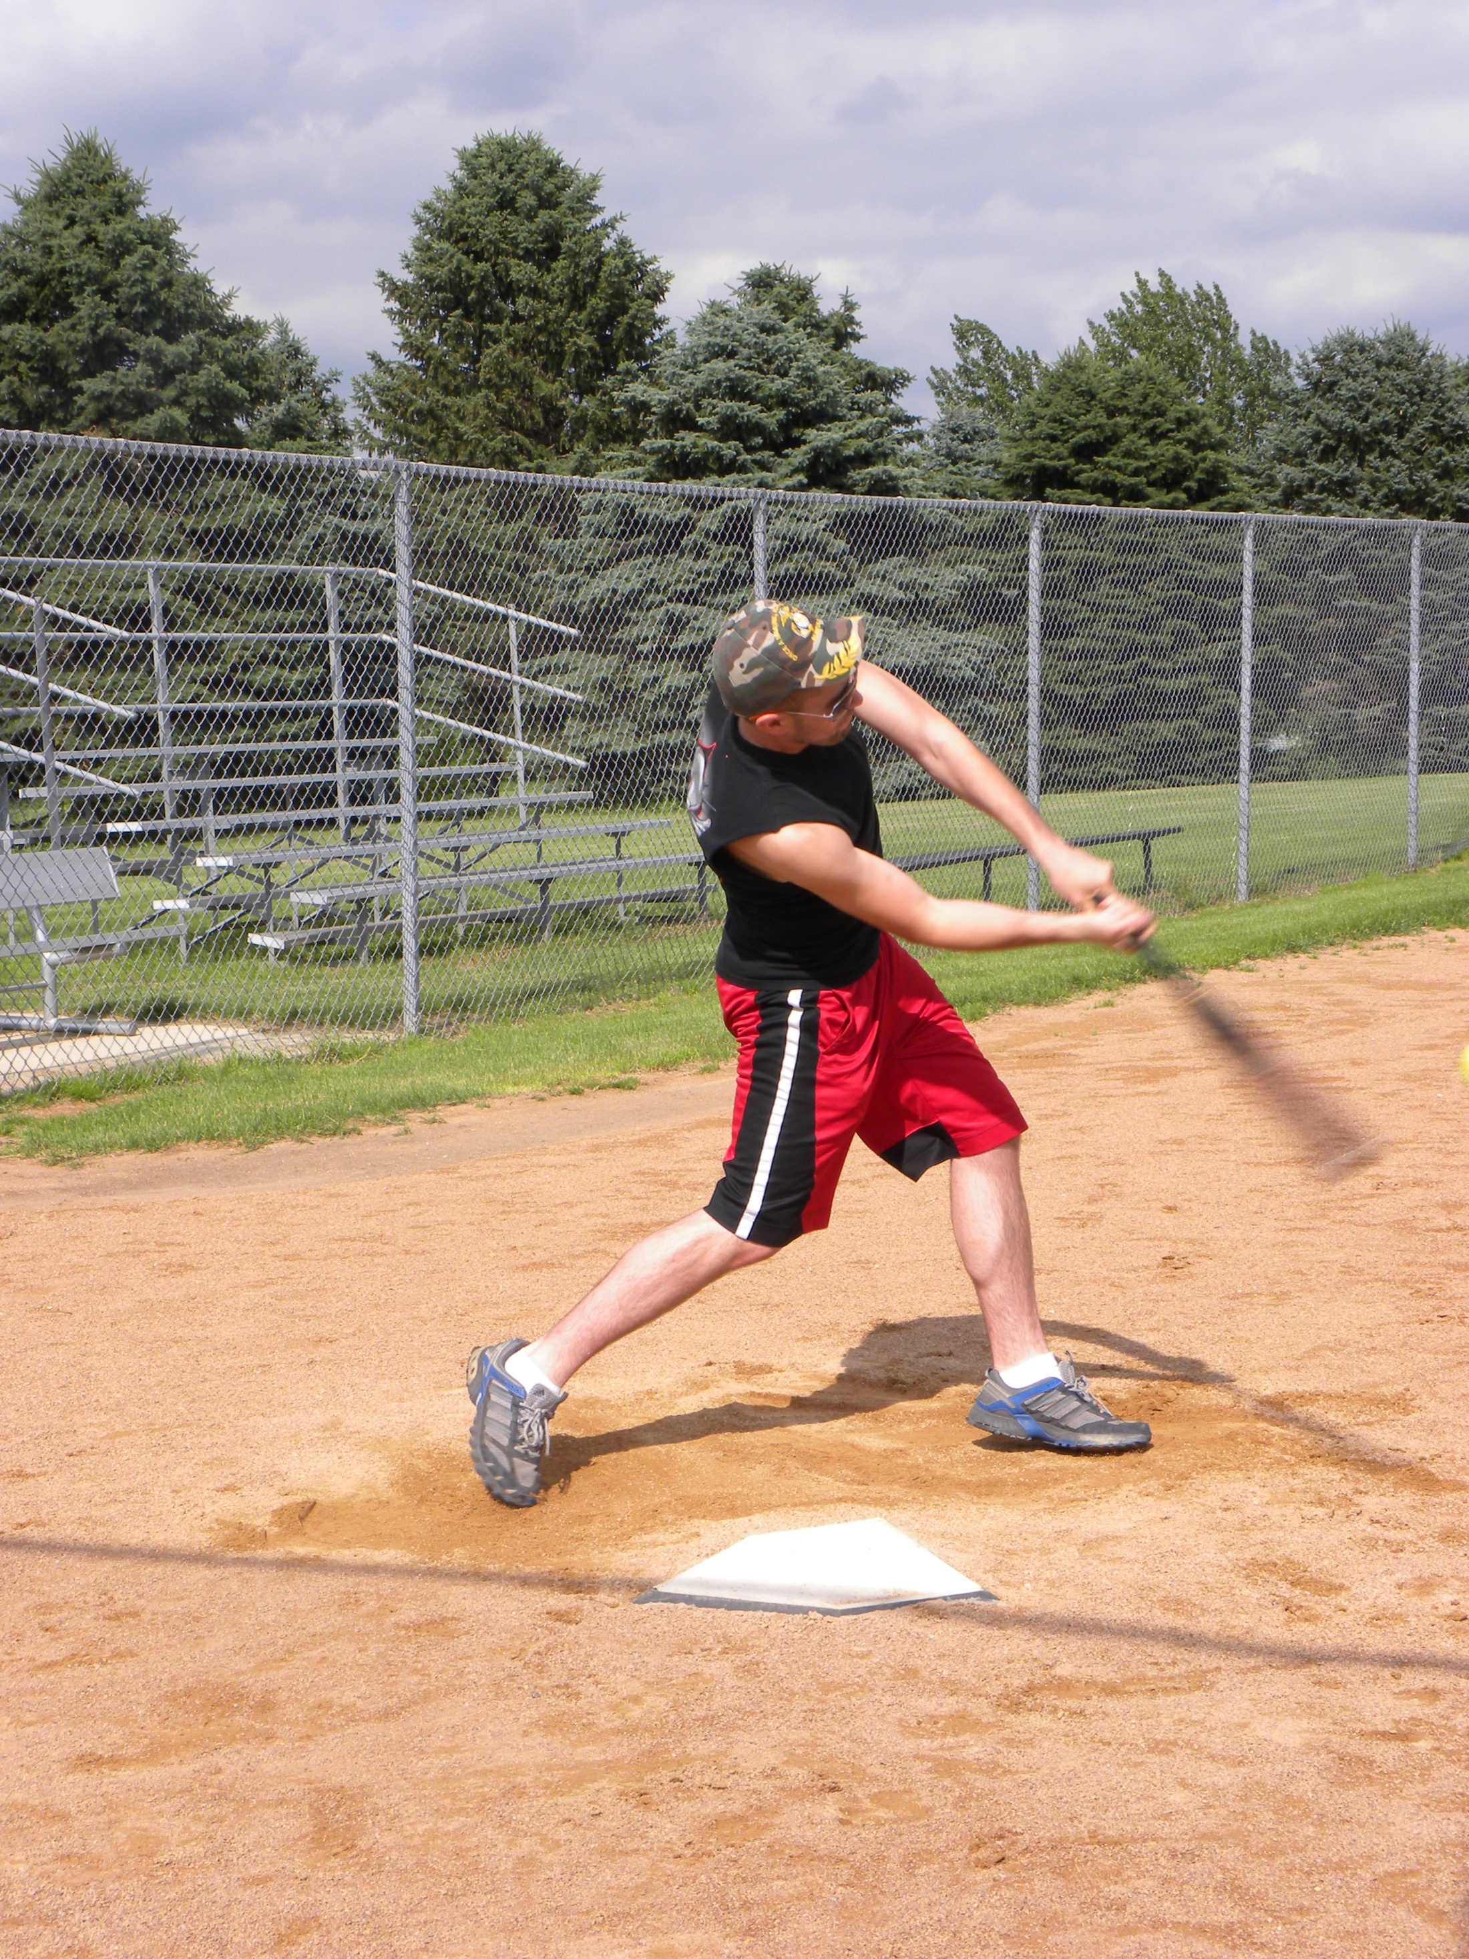

Slide 7
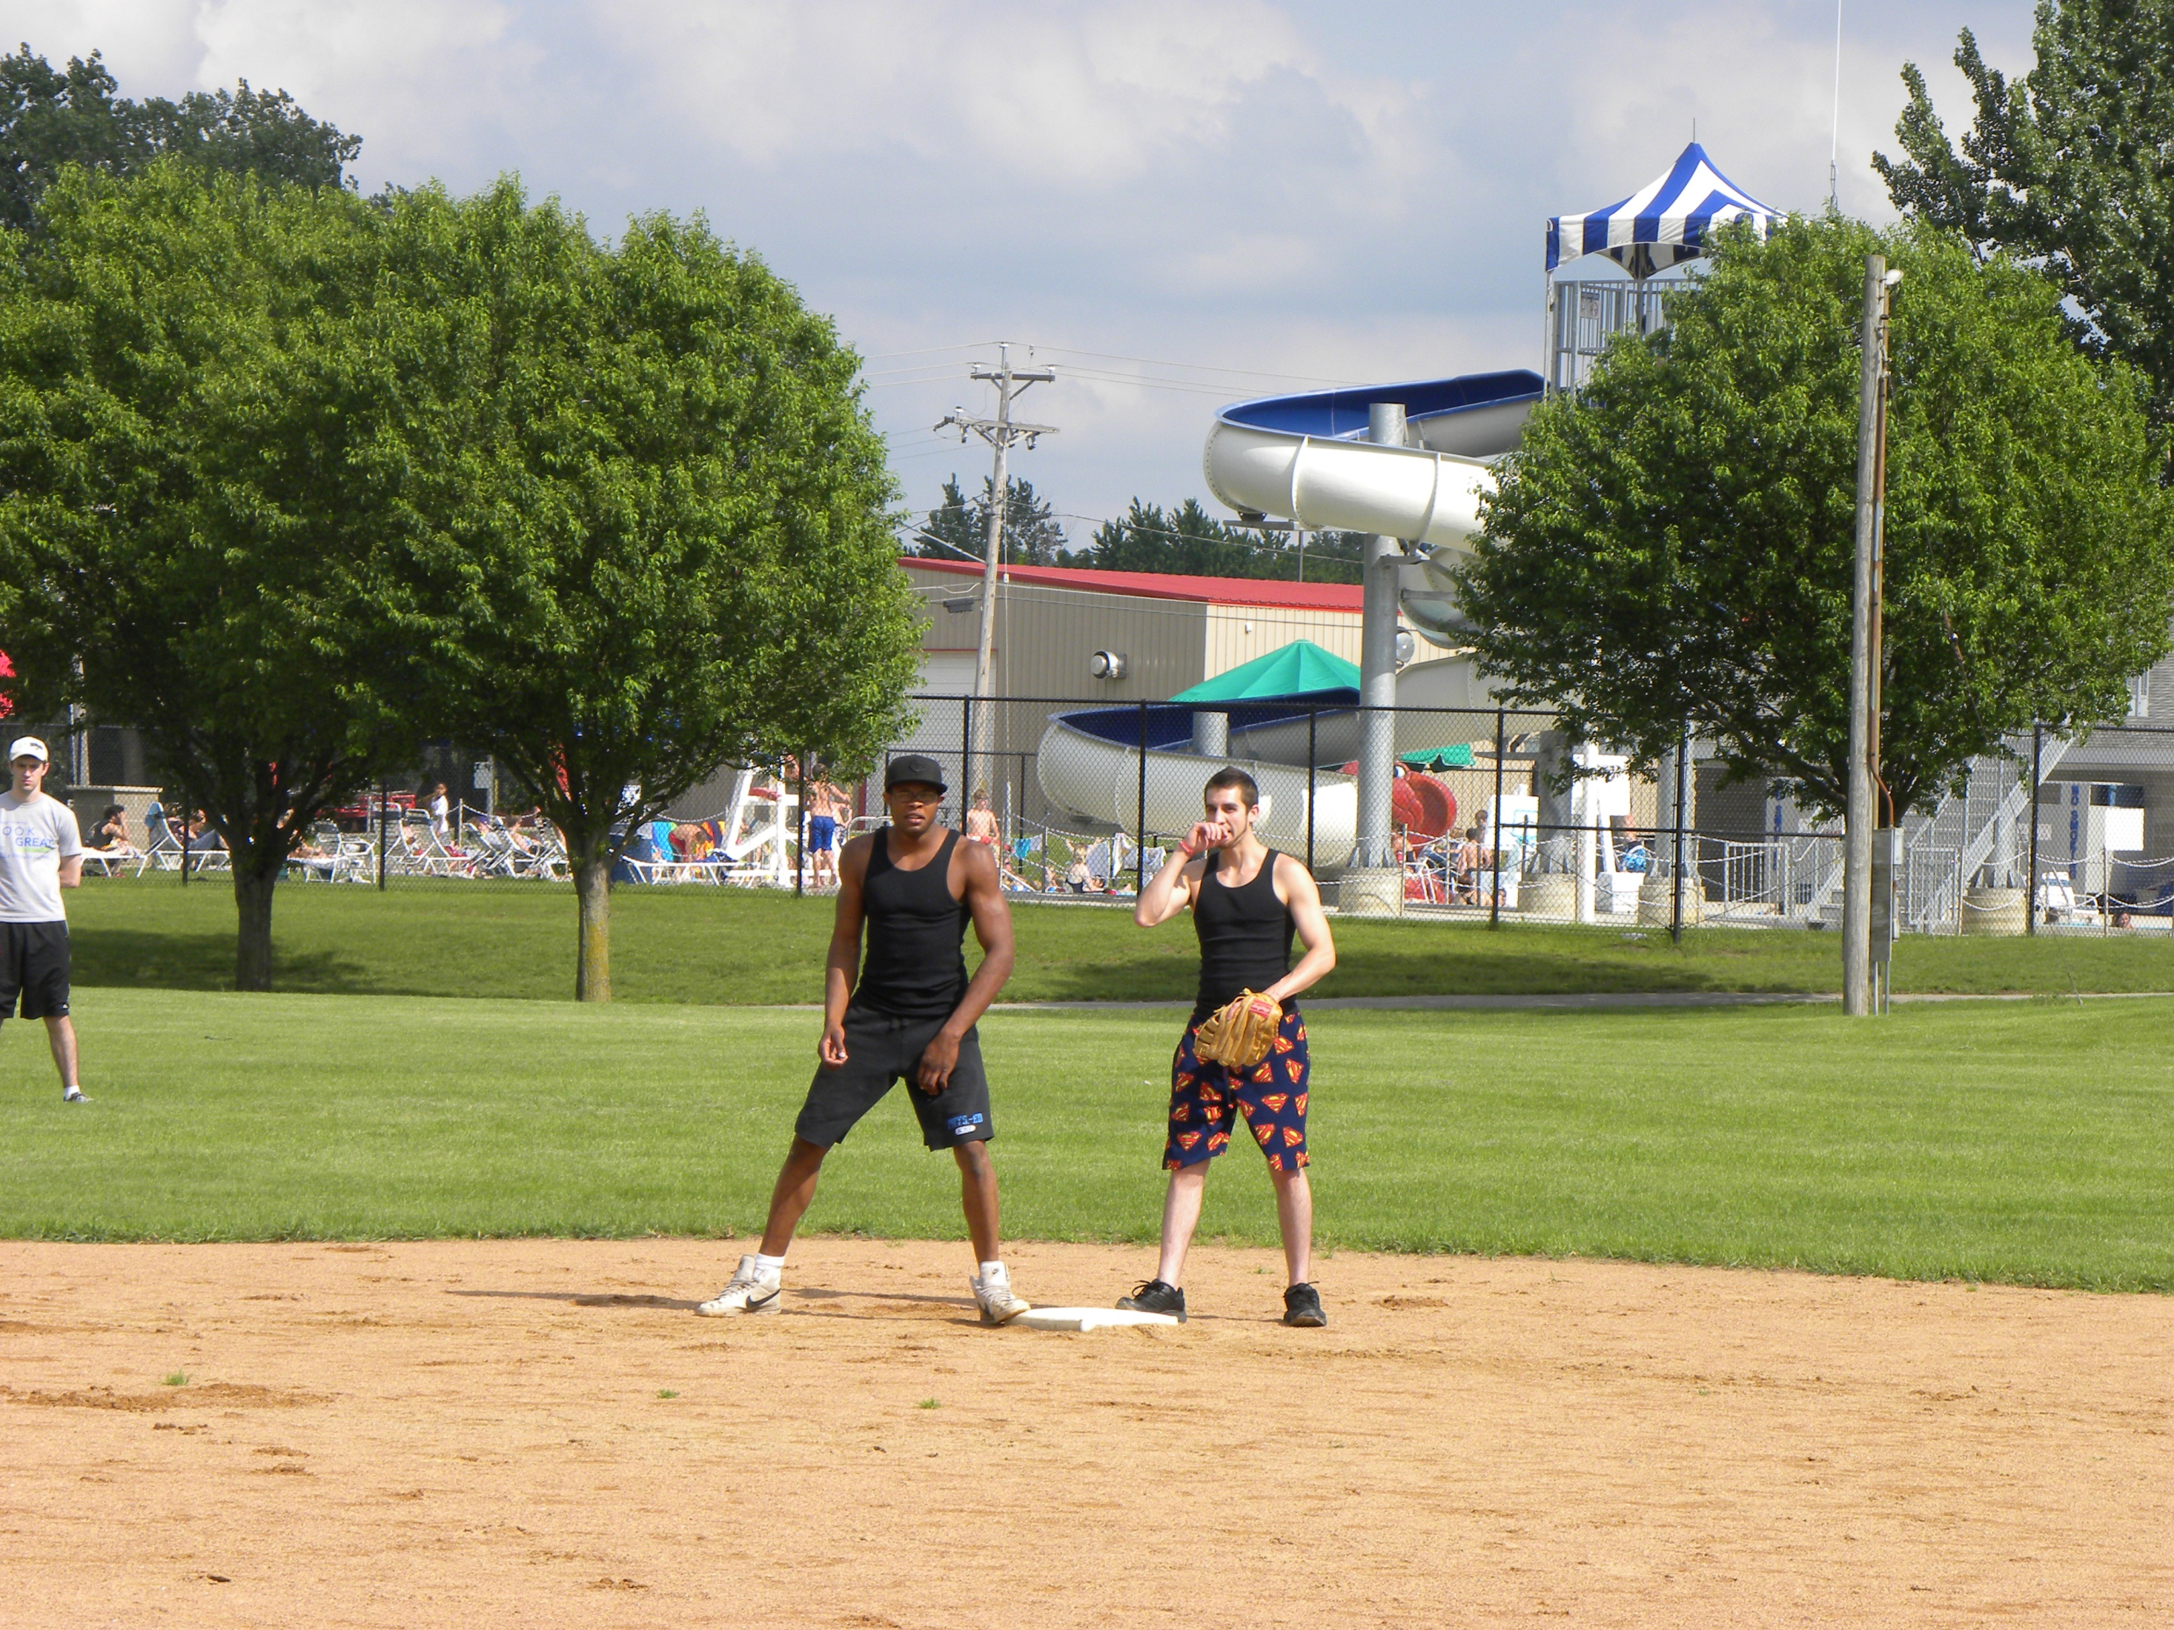

Slide 8
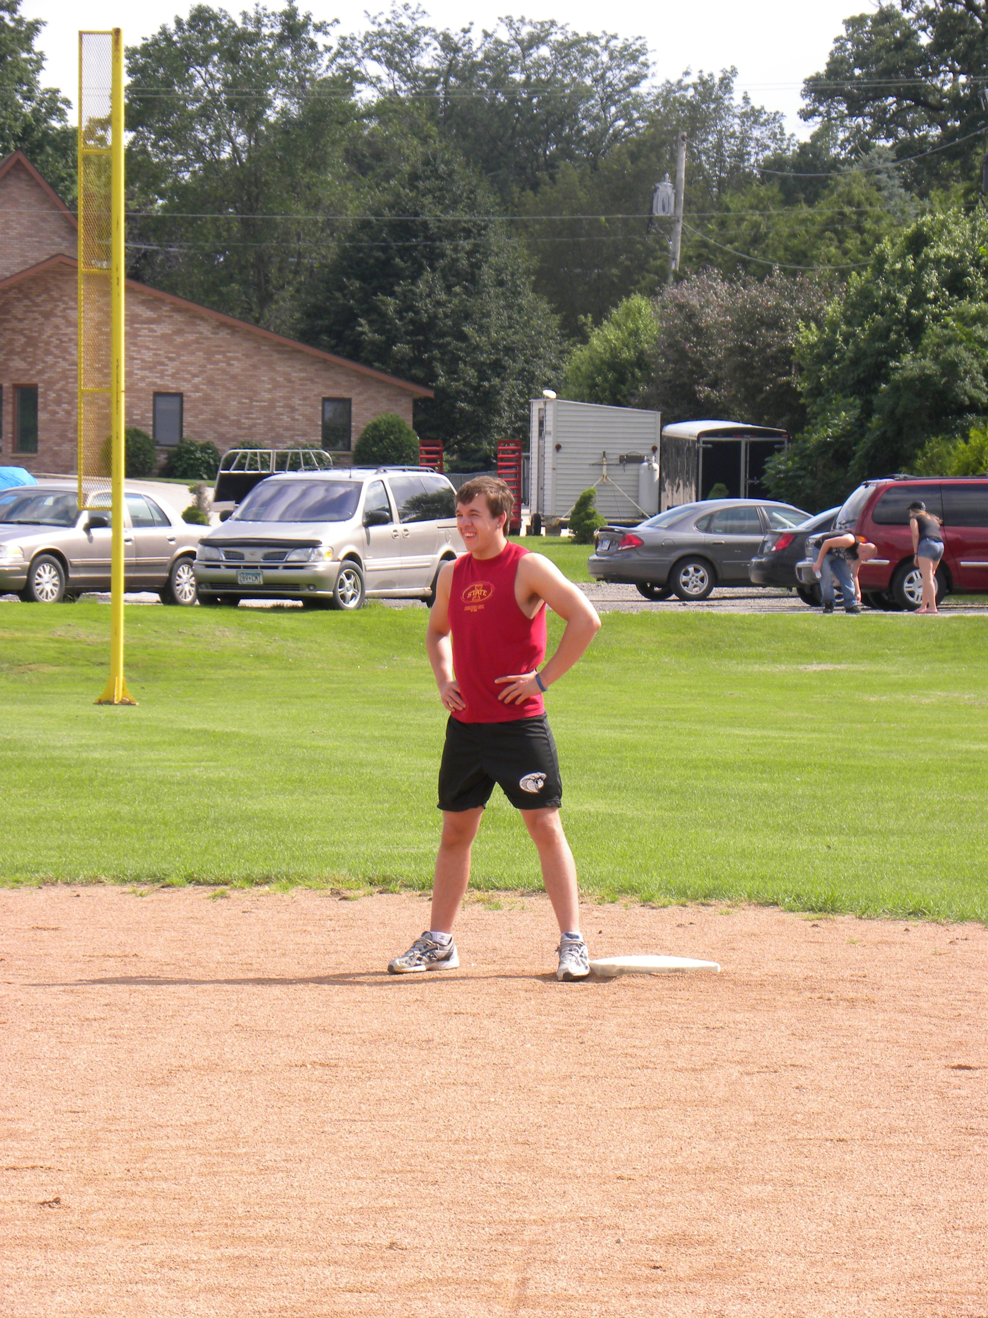

Slide 9
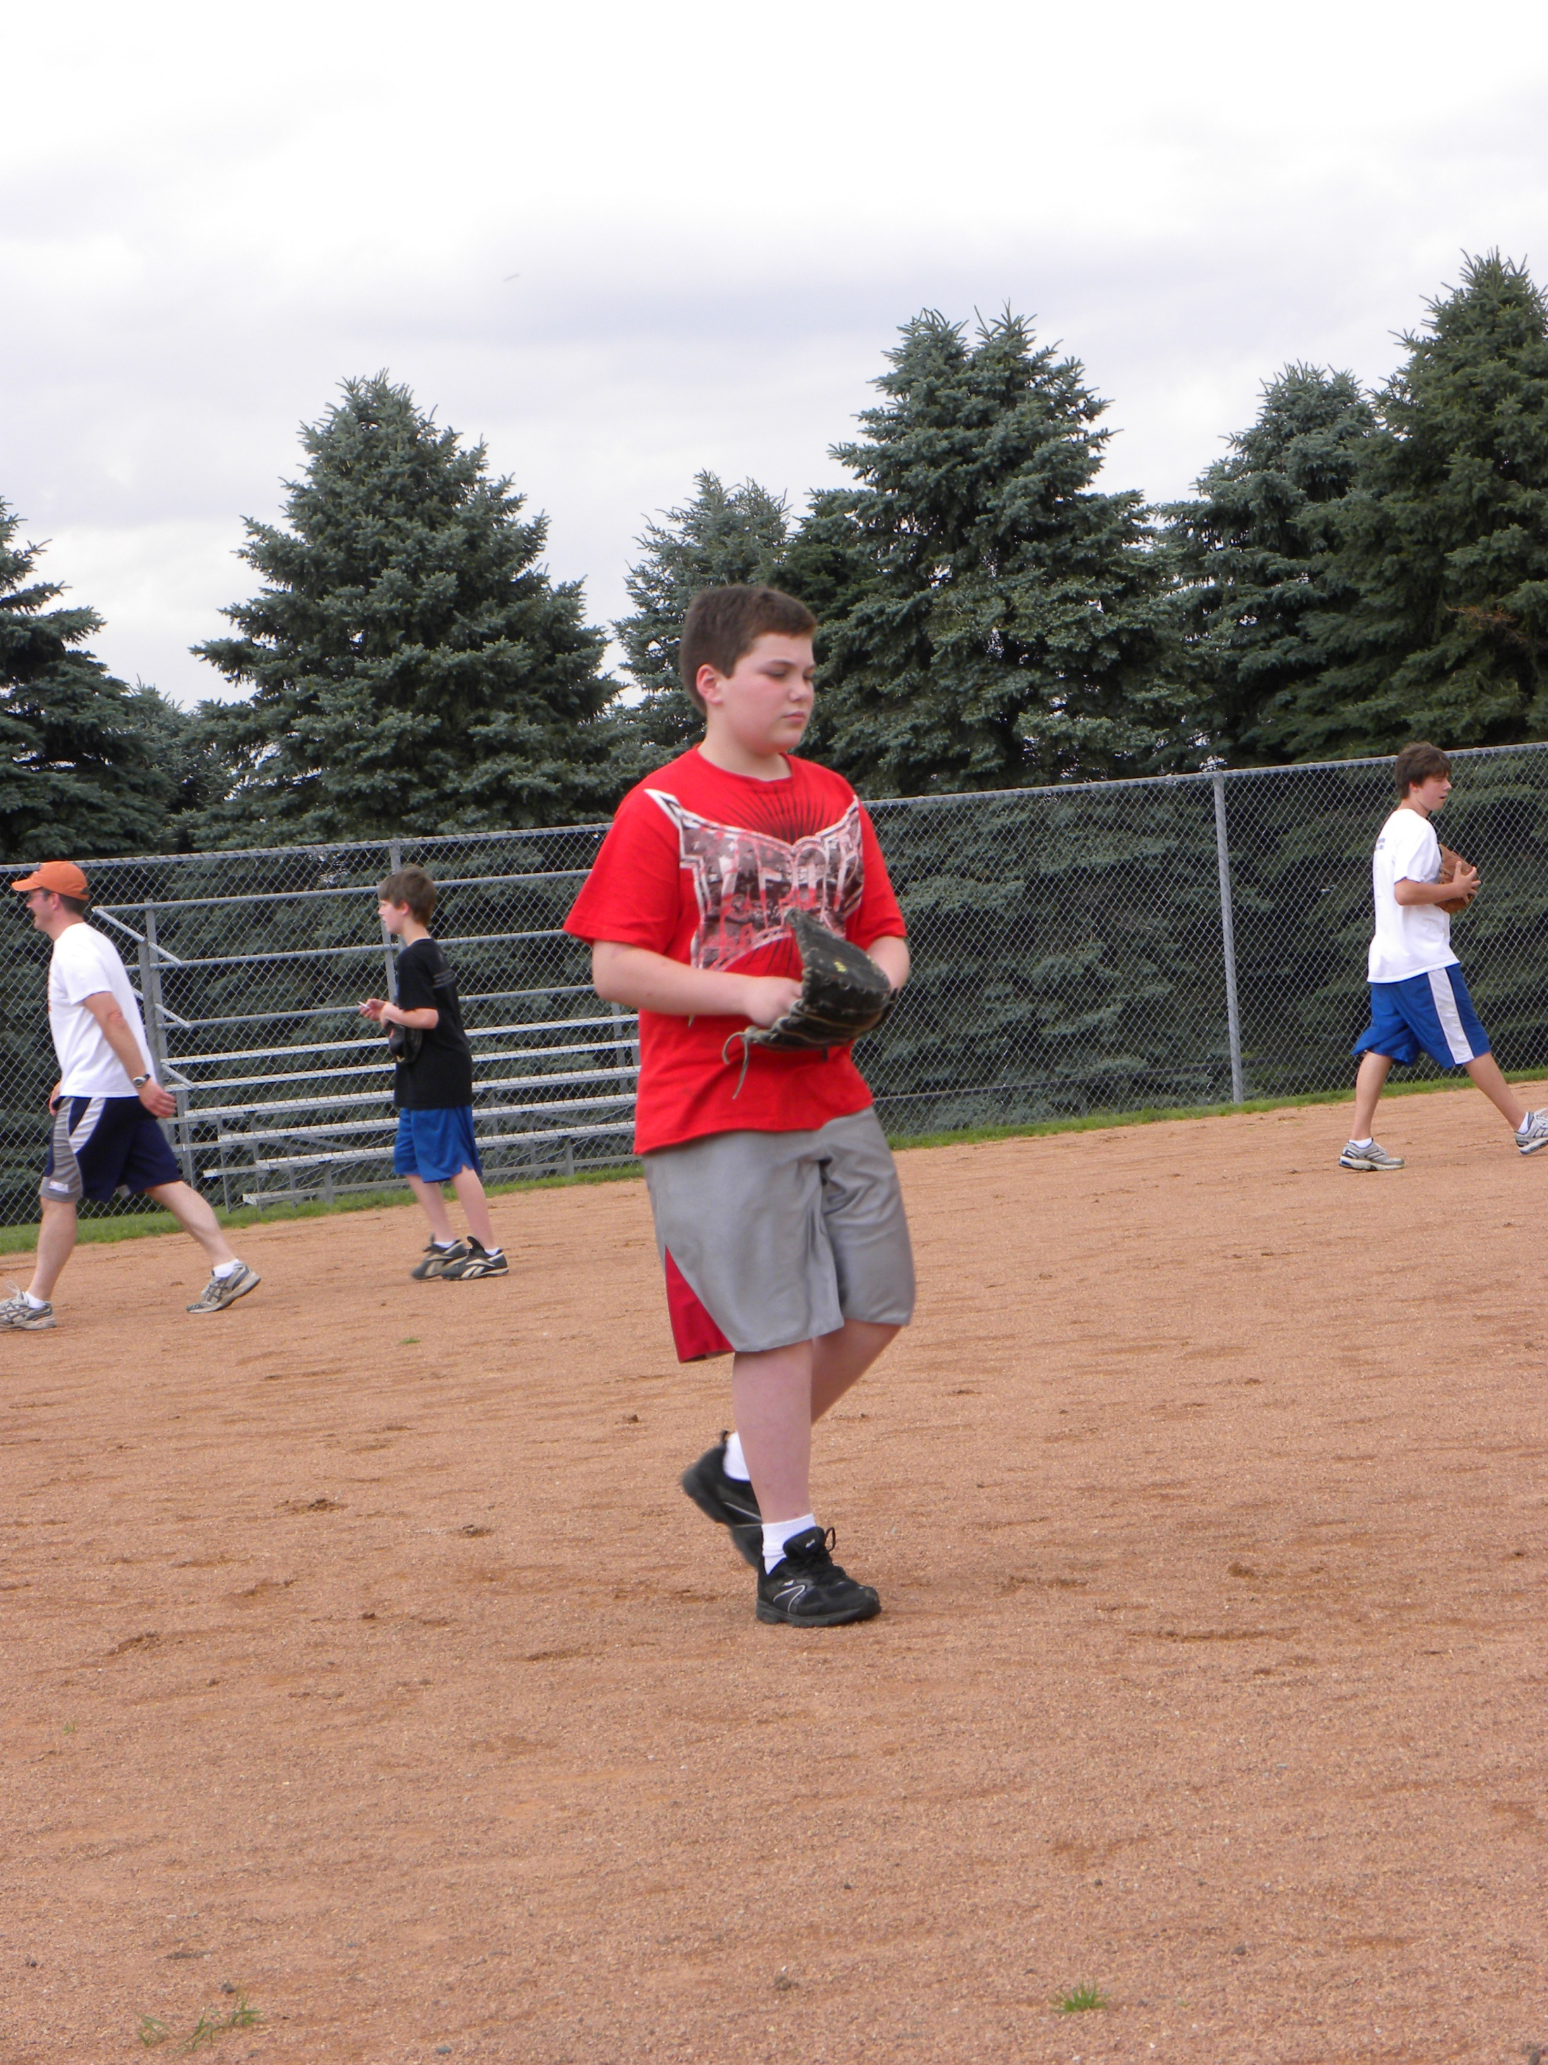

Slide 10
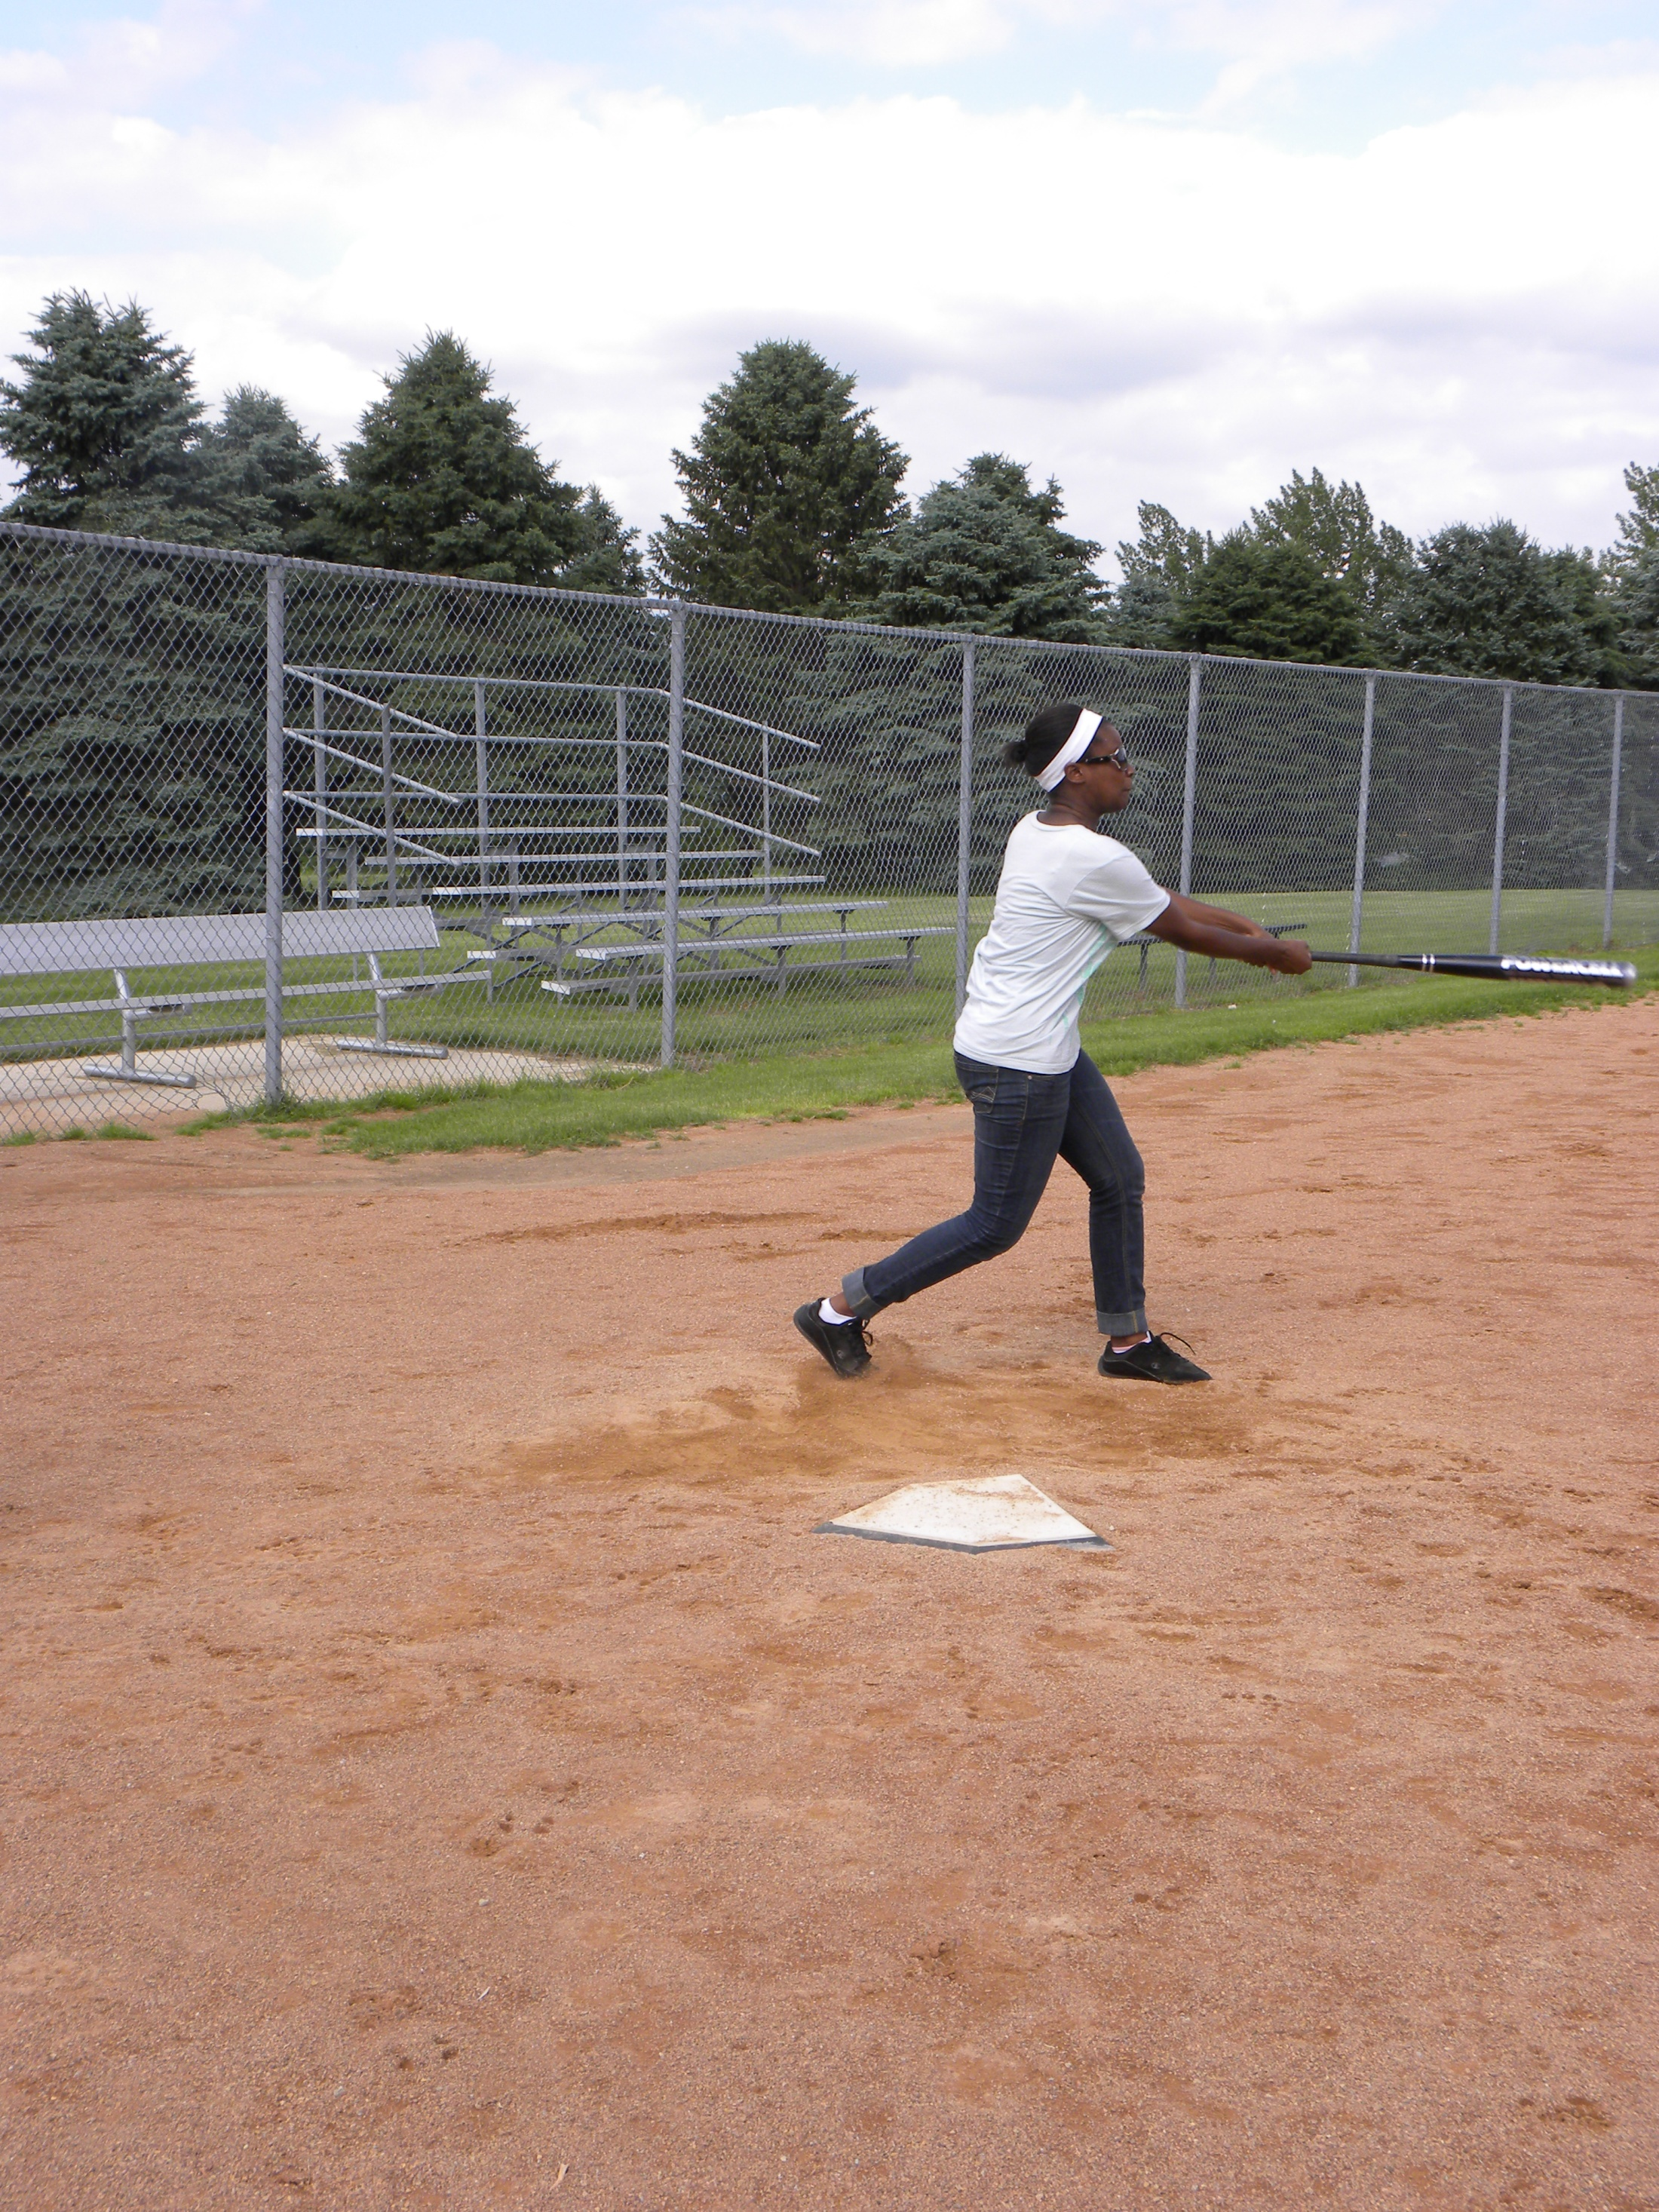

Slide 11
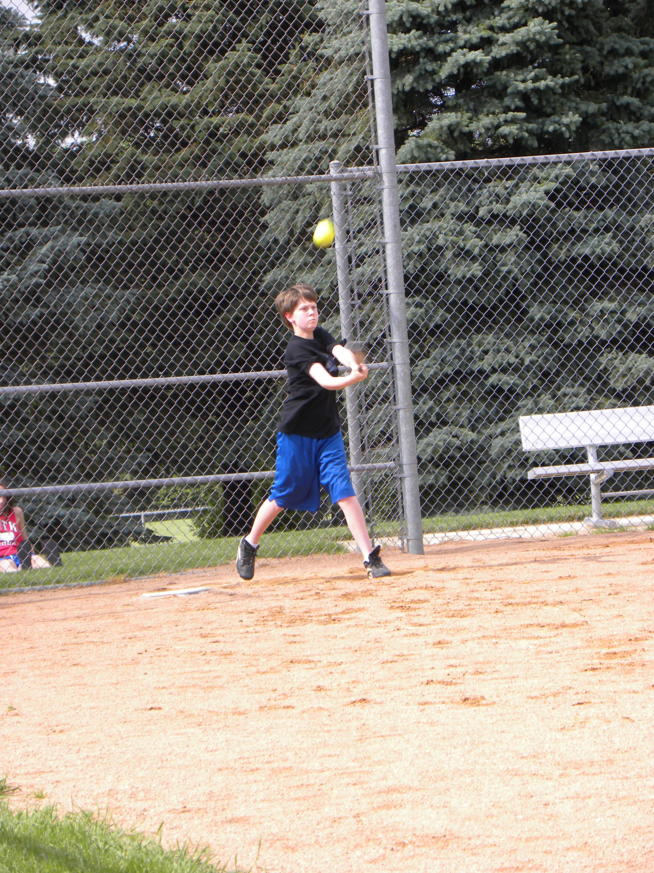

Slide 12
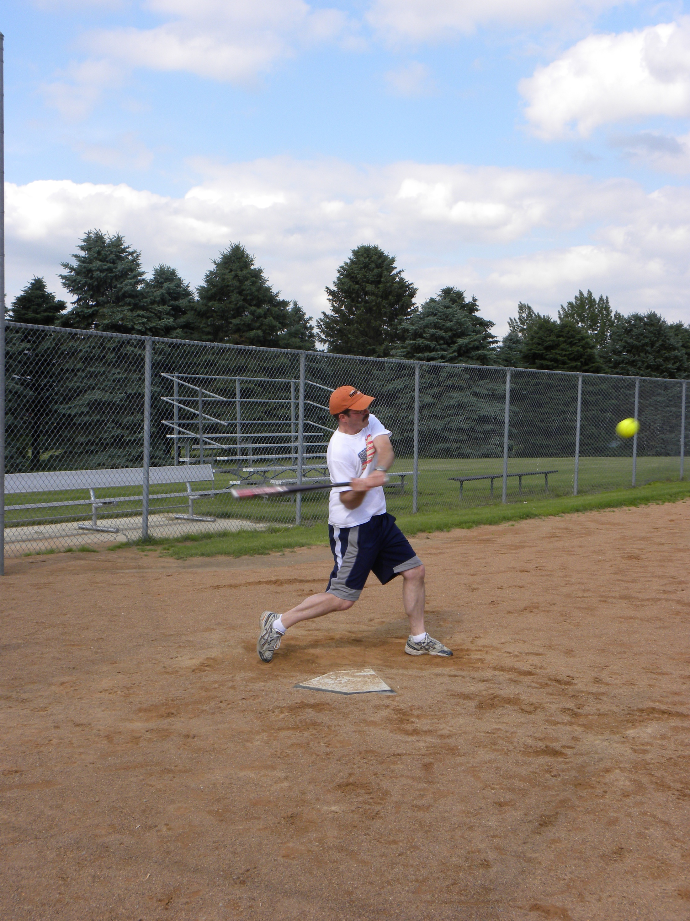

Slide 13
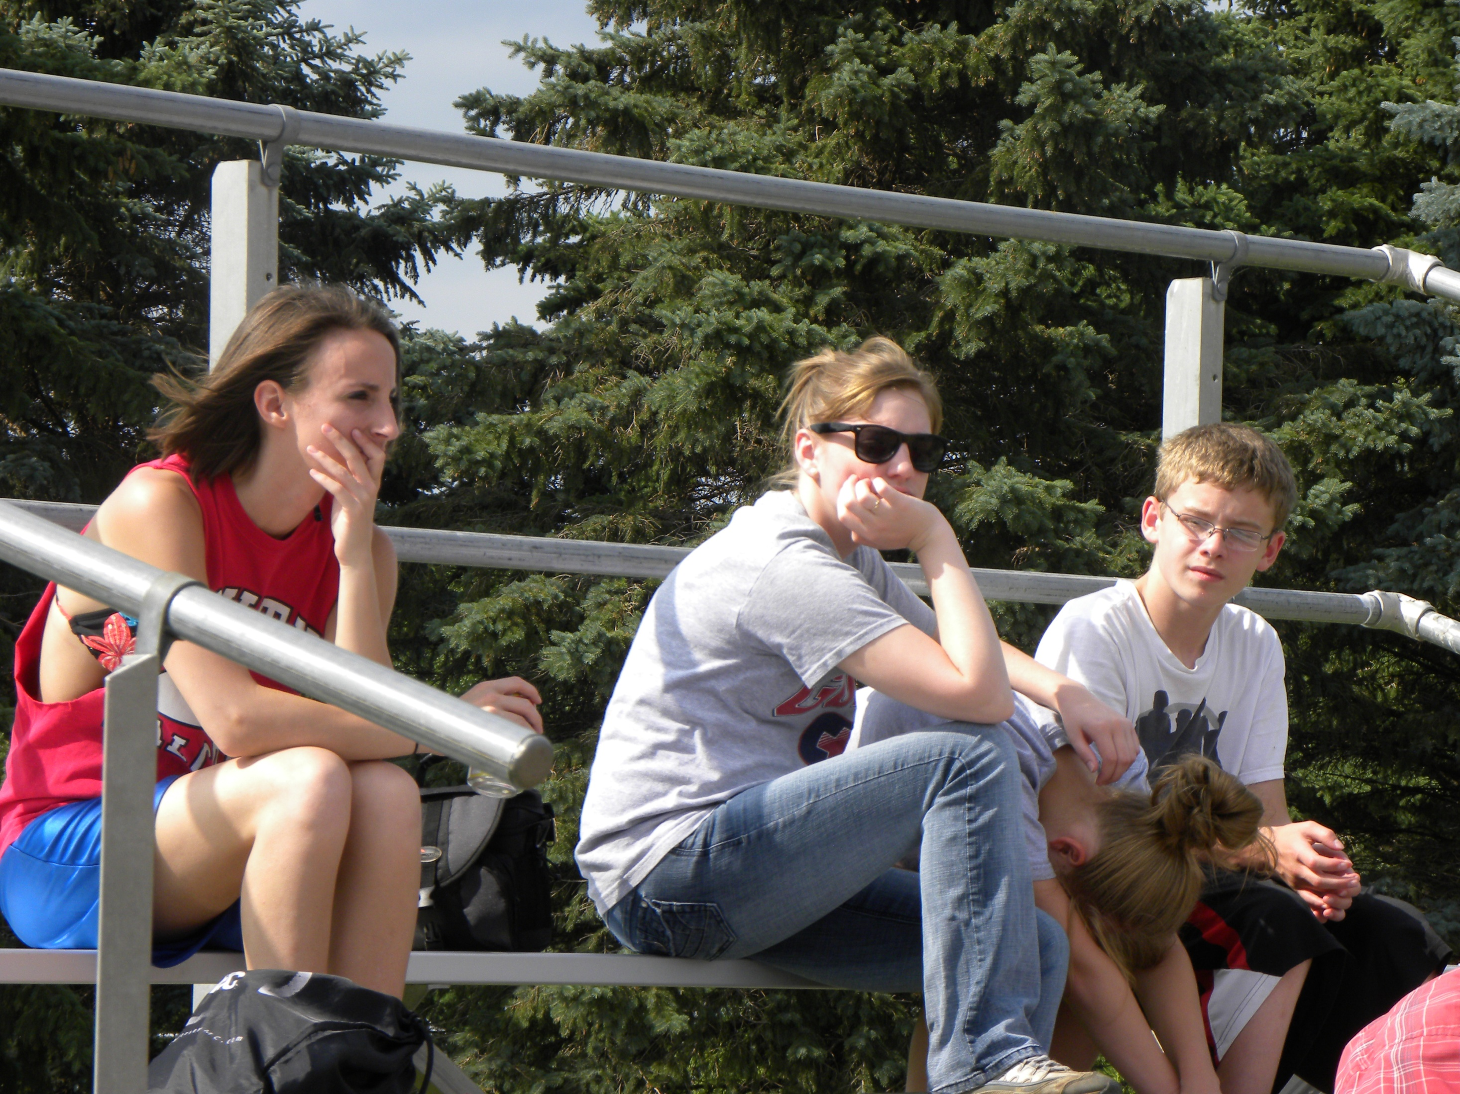

Slide 14
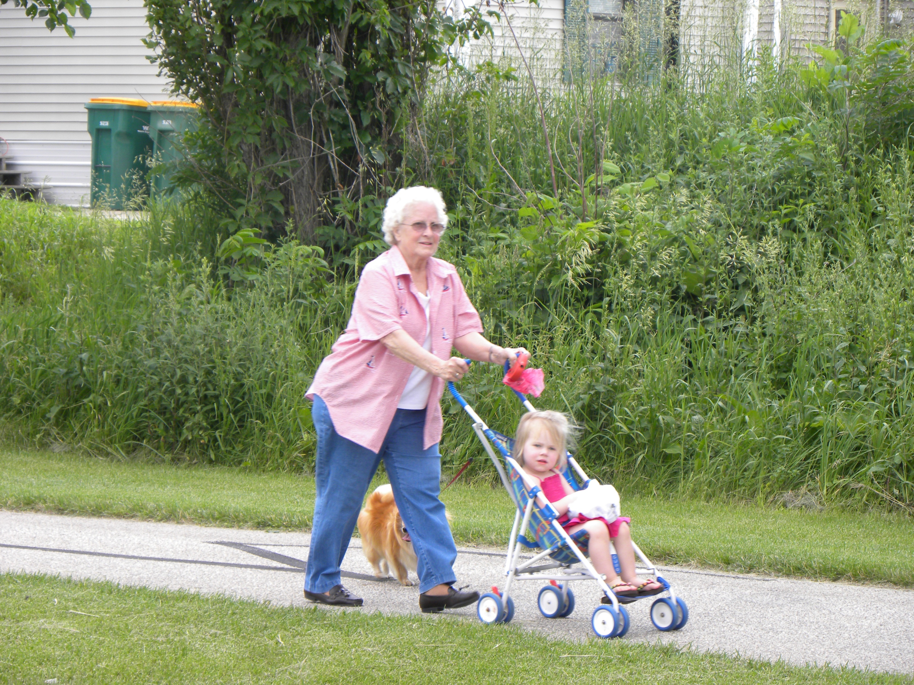

Slide 15
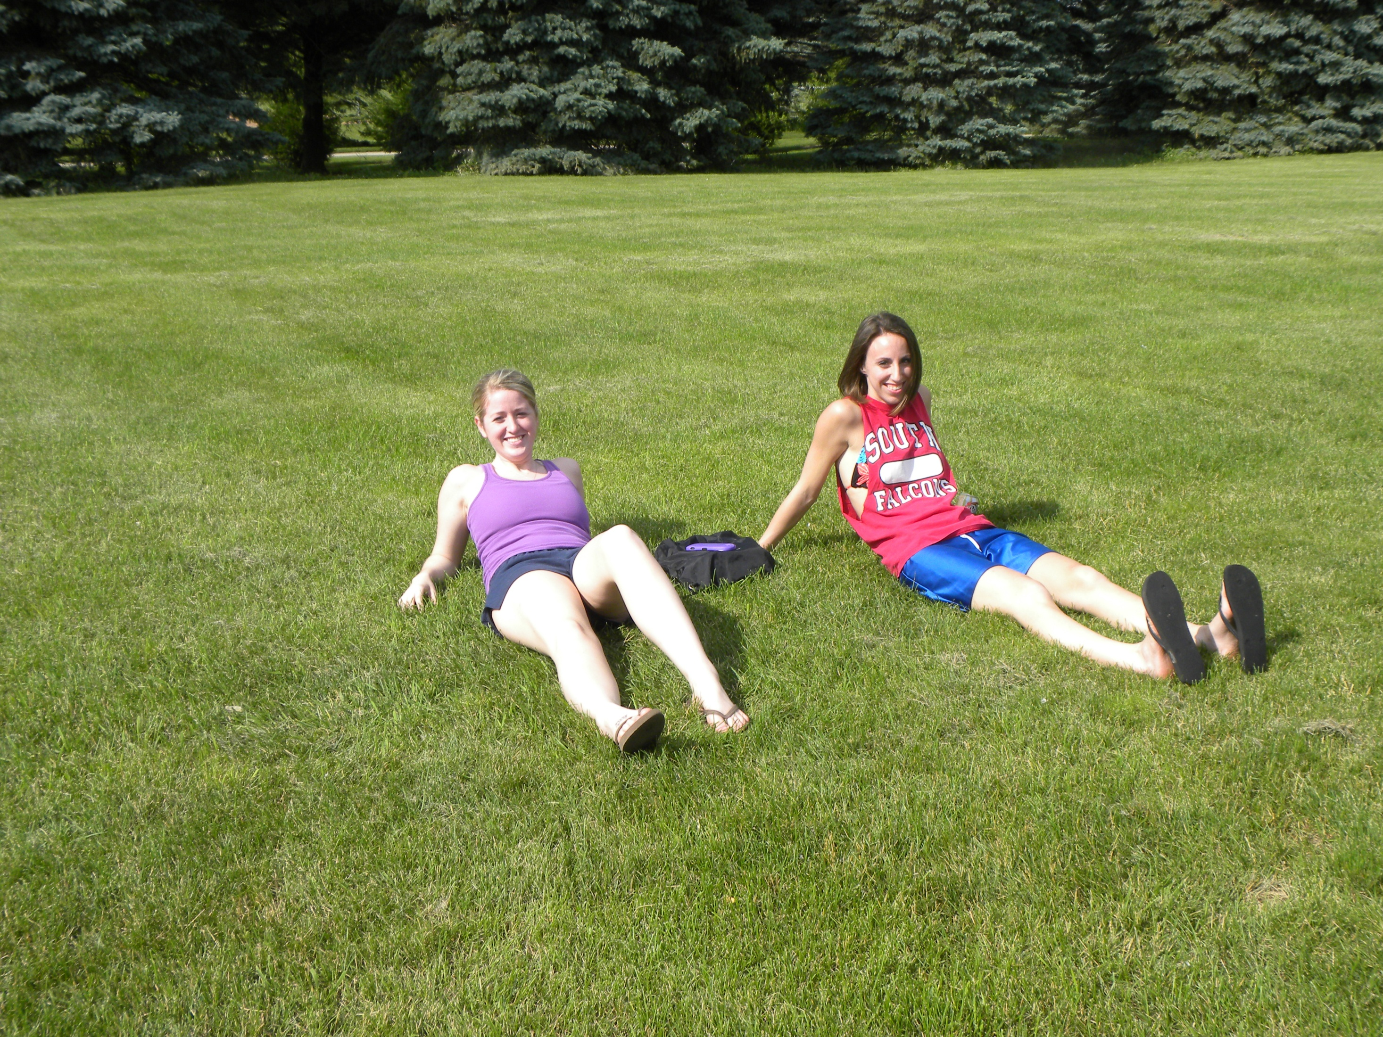

Slide 16
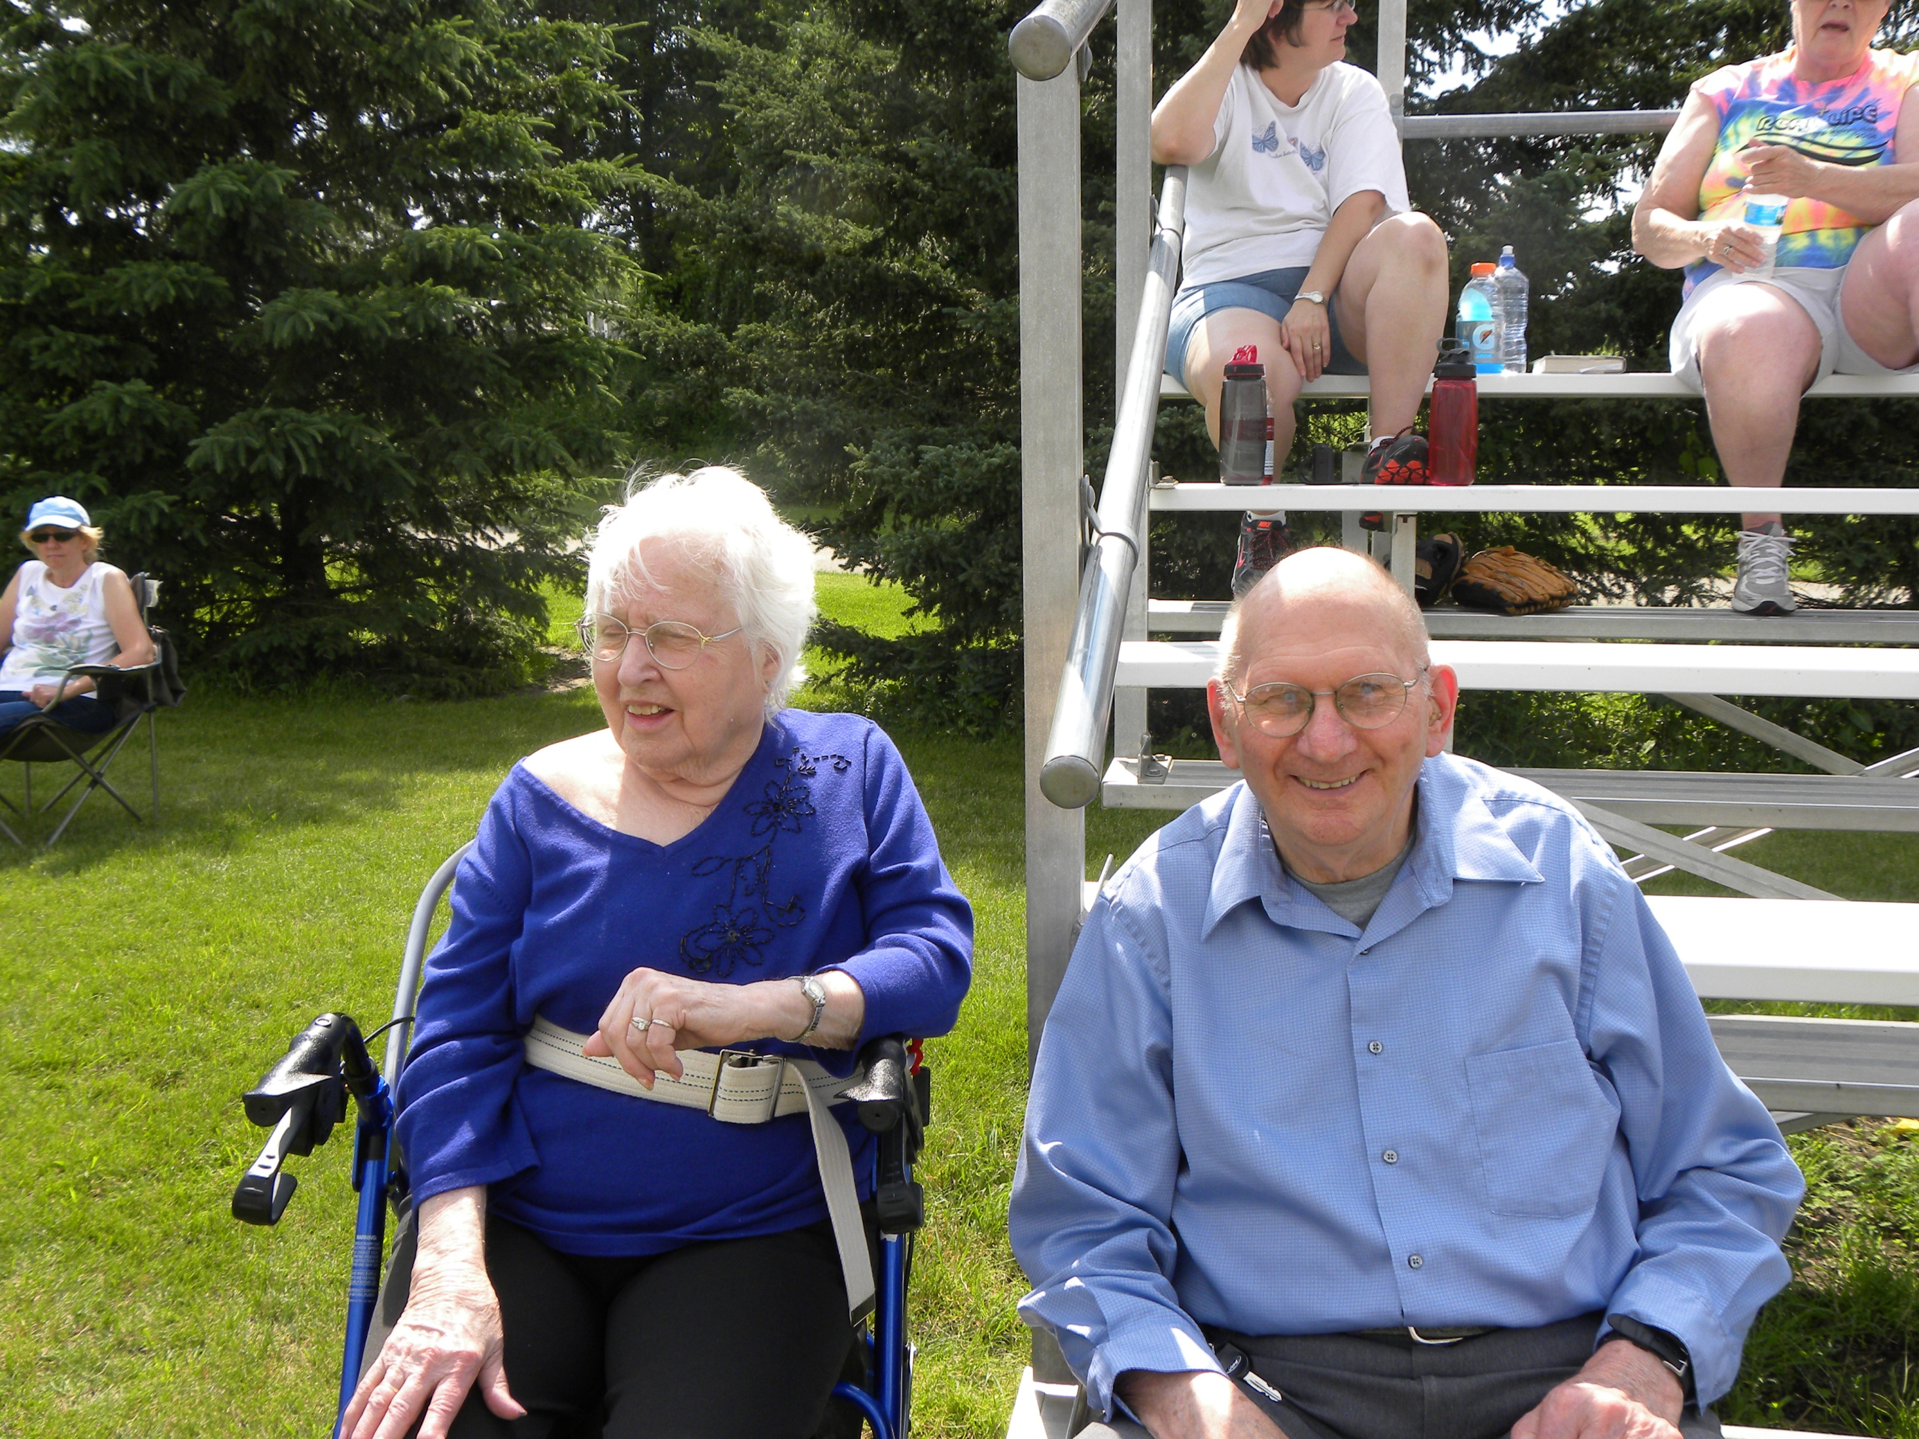

Slide 17
John 5:37-38 (NLT) ³⁷And the Father who sent me has testified about me himself. You have never heard his voice or seen him face to face,³⁸and you do not have his message in your hearts, because you do not believe me—the one he sent to you.
John 7:24 (TMSG) ²⁴Don’t be nitpickers; use your head—and heart!—to discern what is right, to test what is authentically right.”

Slide 18
God is True
Knowing God Through Jesus Series

Slide 19
Knowing God through Jesus – by John
John 3:27-36
We of earth speak earthly things
Jesus is from heaven and testifies of heavenly things (what he has seen and heard)
Anyone who accepts this testimony can affirm God is true
Believe in God’s son – have eternal life
Don’t obey the son – no eternal life (judgment)

Slide 20
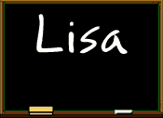
Deductive Reasoning
If a=b then –a=-b
If a=b and c=b then a=c
If believing = eternal life then no believing = no eternal life
If no obeying = no eternal life and no believing = no eternal life, then no obeying = no believing

Slide 21
John 5:31-40
John’s testimony about me was true
A greater witness than John – my teachings and my miracles – prove God sent me.
You do not have his message in your heart because you do not believe me
Scriptures point to me, but you refuse to come to me to receive life

Slide 22
I. Only True God
John 17:3
Eternal life – to know you the only true God
John 7:28
The one who sent me is true, and you don’t know him

Slide 23
True and Truth
True – Greek ALETHINOS – (al-ay-thee-nos‘) truthful:—true.
Truth – Greek ALETHEIA – (al-ay'-thi-a) truth:—true, X truly, truth, verity.
Truth is the result of True
Truth is based on true

Slide 24
True–adjective
real; genuine; authentic
firm in allegiance; loyal; faithful; steadfast: a true friend.
exact; precise; accurate; correct: a true balance.
reliable, unfailing, or sure: a true sign.
honest; honorable; upright.

Slide 25
navigation (of a bearing, course, etc.) determined in relation to true north.

Slide 26
True-noun
exact or accurate formation, position, or adjustment: to be out of true.
the true, something that is true; truth.

Slide 27
Contrast of True - John 8:44 (NLT) ⁴⁴For you are the children of your father the devil, and you love to do the evil things he does. He was a murderer from the beginning. He has always hated the truth, because there is no truth in him. When he lies, it is consistent with his character; for he is a liar and the father of lies.
Know Jesus, Know Truth
No Jesus, No Truth

Slide 28
II. The Freedom of Truth
John 8:31 - 32
Disciples – faithful (true) to his teachings
Know truth – set free

Slide 29
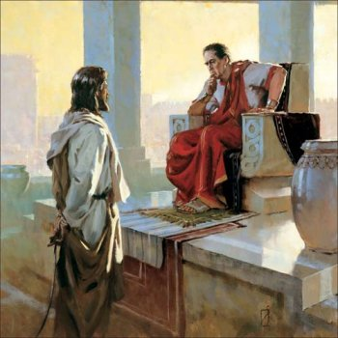
John 18:37 ³⁷Pilate said, “So you are a king?” Jesus responded, “You say I am a king. Actually, I was born and came into the world to testify to the truth. All who love the truth recognize that what I say is true.”

Slide 30
John 14:17
Holy Spirit leads into all truth
The world wont receive him, but you know him
John 15:26
I will send you the Advocate—the Spirit of truth
He will testify all about me.
John 16:13
The Spirit of truth will guide you into all truth
He will tell you about the future.

Slide 31
III. The Foundation of Truth
Matthew 7:24-28
When storms come
Stand strong – the wise who listen and follow Jesus’ teaching
Mighty crash – the foolish who hears but doesn’t obey the teaching of Jesus

Slide 32
John 12:48 (NLT) ⁴⁸But all who reject me and my message will be judged on the day of judgment by the truth I have spoken.

Slide 33
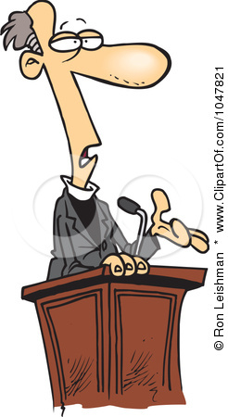
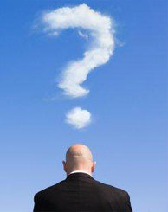
The Pastor’s Stump Feature Just for fun and discovery– asking questions that arise as you read the gospels

Slide 34
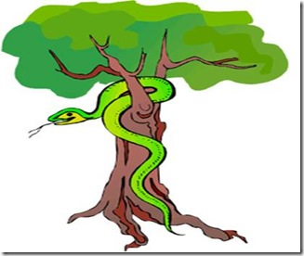
If Eve was created to be a helpmate for Adam, what was she doing spending time with the snake? And what was she doing hanging around the tree with the forbidden fruit?

Slide 35
Genesis 2:18 – not good for man to be alone, I will make a helper for him
2:15 – God placed man in the garden to tend and watch over it
2:9 – God placed the tree of life and the tree of the knowledge of good and evil in the middle of the garden
No sin yet – obedience would dictate Eve was helping Adam tend the garden.
Devil hates truth and waits for opportune time – hungry? About to eat of tree of life?
3:4 - Liar – “you won’t die”
3:6 - Adam with her – reject passivity

Slide 37
In the Psalms David says “you have made him a little lower than the angels” (Elohim – God), but when Paul quotes David he uses “angels” Aggelos , not God. What’s up with that?
Greek - AGGELOS ang'-el-os; a messenger; especially an “angel”; by implication a pastor:—angel, messenger.

Slide 38
God – Hebrew ELOHYM - el-o-heem‘ - gods in the ordinary sense; but specifically used (in the plural thus, especially with the article) of the supreme God; occasionally applied by way of deference to magistrates; and sometimes as a superlative:—angels, X exceeding, God (gods) (-dess, -ly), X (very) great, judges, X mighty.

Slide 39
So the real question is … are we a little lower than God or a little lower than angels?
Jesus was made “a little lower than the angels” but has been crowned with glory and honor
We have been crowned with glory and honor and have been given authority over all things
Angels are servants, spirits sent to care for the people who will inherit salvation

Slide 40
IV.

