Slide 2
John 17:3 (NLT) ³And this is the way to have eternal life—to know you, the only true God, and Jesus Christ, the one you sent to earth.
Properly responding to God
Properly representing God to others

Slide 3
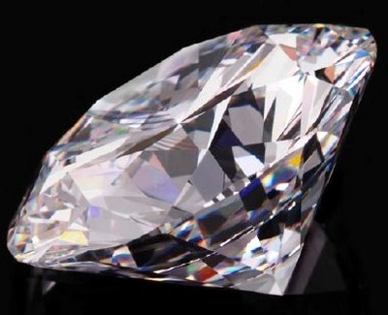
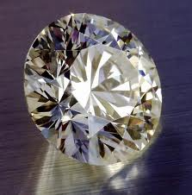

Slide 4
Faith in God’s Faithfulness
Knowing God Through Jesus Series

Slide 5
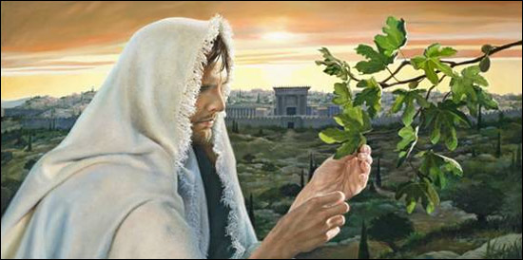
I. God’s Faith
Mark 11:12-25
Cursed fig tree
Jesus expresses God’s anger regarding misuse of his house

Slide 6
Fig tree dead
Say to the mountain
Believe it will happen without a doubt
Pray – believe you received – it will be yours

Slide 7
Faith and Faithful
Greek word “PISTIS” – fidelity
Romans 3:3 – the faithfulness of God
Mark 11:22 – have faith in God
Faith – English translated from Latin – “FIDES” – the sense of personal honor and mutual loyalty attaching to the pledged word
Fidelity - strict observance of promises, duties, etc.: think of marriage fidelity
Trust, the result of faith in fidelity

Slide 8
“Have faith in God” – (Albert Barne’s Notes on the New Testament) Literally, “Have the faith of God.” This may mean, have strong faith, or have confidence in God; a strong belief that he is able to accomplish things that appear most difficult with infinite ease, as the fig-tree was made to wither away by a word.
Faith in and faithfulness to the word spoken - God’s fidelity or faithfulness to his word enables us to put faith in his word – to speak it and believe it and it come to pass

Slide 9
Hebrews 11:3 By faith we understand that the entire universe was formed at God’s command, that what we now see did not come from anything that can be seen.

Slide 10
II. Degrees of Faith
Matthew 8:5-13 – faith of the Roman officer
Just say the word and my servant will be healed
I haven’t seen such (NASB – great faith) in all Israel
Because you believed it has happened

Slide 11
Syrophoenician woman – Matthew 15:28 – great is your faith
Storm tossed disciples – Mark 4:40 – where is your faith?
Woman with hemorhage – Mark 5:34 – your faith has made you whole
Blind man – Matthew 9:28-29 – According to your faith be it done to you
Jesus’ home town – Matthew 13:58 – Unable to do miracles because of their unbelief
Peter sinking – Matthew 14:31 – man of little faith, why did you doubt

Slide 12
III. Believe and Speak
2 Corinthians 4:13 But we continue to preach because we have the same kind of faith the psalmist had when he said, “I believed in God, so I spoke.”
The psalmist believed so he spoke
We have the same kind of faith
We believe so we speak (preach)

Slide 13
Matthew 12:33-37
Good or bad fruit
Good or bad treasure
Whatever is in your heart determines what you say

Slide 14
Choice of words heard and choice of words spoken
Romans 10:17 Faith comes by hearing and hearing by the Word
Out of the abundance of the heart the mouth speaks
Proverbs 18:21 The tongue can bring death or life; those who love to talk will reap the consequences.

Slide 15
Faith in and faithfulness to the word spoken - God’s fidelity or faithfulness to his word enables us to put faith in his word – to speak it and believe it and it come to pass

Slide 17
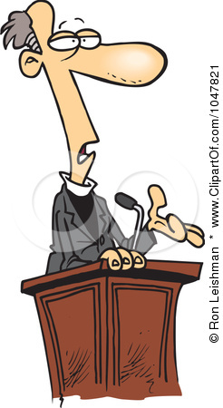
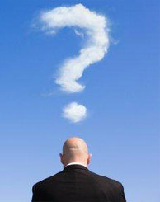
The Pastor’s Stump Feature Just for fun and discovery– asking questions that arise as you read the gospels

Slide 19
IV.

