Slide 2
John 5:37-38 (NLT) ³⁷And the Father who sent me has testified about me himself. You have never heard his voice or seen him face to face,³⁸and you do not have his message in your hearts, because you do not believe me—the one he sent to you.

Slide 3
Hebrews 1:1 - 3 (NASB) ¹God, after He spoke long ago to the fathers in the prophets in many portions and in many ways, ²in these last days has spoken to us in His Son, whom He appointed heir of all things, through whom also He made the world. ³And He is the radiance of His glory and the exact representation of His nature, and upholds all things by the word of His power. When He had made purification of sins, He sat down at the right hand of the Majesty on high,

Slide 4
The Righteousness of God
Knowing God Through Jesus Series

Slide 5
I. Jesus Revealing God
John 17:25-26
Oh righteous Father
The world doesn’t know you
I know you
I have revealed you to these disciples
Your love for me will be in them
God’s message in our hearts

Slide 6
The Righteousness of God
The virtue of Right-ness
Dikaios - dik'-ah-yos equitable (in character or act); by implication innocent, holy (absolutely or relatively):—just, meet, right (-eous).
Something that is possessed by God – he is the sum and the source of righteousness

Slide 7
Romans 3:23-28 – God’s demonstration of His righteousness (fair, just)
We all fall short of God’s standard
God’s demonstration of Righteousness made a way for us to be right with God (righteous) through faith in Jesus
Not made right with God by obeying the law
Possessed by God, it is imparted to man, with every expectation that the imparted virtue be lived out pursuing that which is right in God’s sight

Slide 8
2 Corinthians 5:21 (NLT) ²¹For God made Christ, who never sinned, to be the offering for our sin, so that we could be made right with God through Christ.
2 Corinthians 5:21 (NASB) ²¹He made Him who knew no sin to be sin on our behalf, so that we might become the righteousness of God in Him.

Slide 9
Righteousness – a prevailing virtue - Jesus’ Sermon on the mount
Blessed are those who hunger and thirst
Blessed are those persecuted
Surpasses that of the scribes and Pharisees
Beware practicing before men
Seek first His kingdom and His righteousness

Slide 10
Attempt by others to exemplify righteousness
To the point of righteous – having bad connotation – as in self righteous, holier than thou
Uprightness - adherence or conformity to an established norm

Slide 11
II. Self Righteous

Slide 12
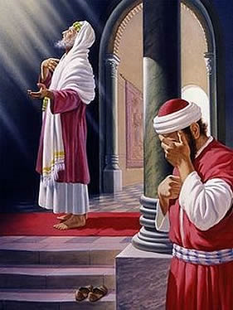
Luke 18:9-14 – Jesus teaching in parables
Pharisee – confident in his own righteousness
Tax collector – humble repentance

Slide 13
Matthew 23:27-28
Outward – look righteous, whitewashed
Inward – death, impurity, hypocrisy, lawless
Matthew 5:20 (NASB) “For I say to you that unless your righteousness surpasses that of the scribes and Pharisees, you will not enter the kingdom of heaven.
Isaiah 64:6 …And all our righteous deeds are like a filthy garment;

Slide 14
Philippians 3:8-9
No longer count on my own righteousness through obeying the law
God’s way of making us right depends on faith

Slide 15
III. The Rightness of God with Us?
God has made us to be right with him, but is he right with you?

Slide 16
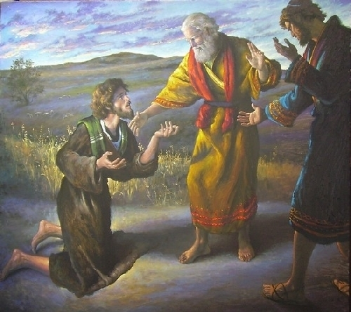
Older brother angry…you never gave me___________...yet this one comes back after riotous living and you ______________

Slide 17
Mark 2:16 - 17 ¹⁶But when the teachers of religious law who were Pharisees saw him eating with tax collectors and other sinners, they asked his disciples, “Why does he eat with such scum?” ¹⁷When Jesus heard this, he told them, “Healthy people don’t need a doctor—sick people do. I have come to call not those who think they are righteous, but those who know they are sinners.”

Slide 18
Luke 6:36 You must be compassionate, just as your Father is compassionate.
John 7:24 ²⁴Look beneath the surface so you can judge correctly.”
Luke 7:36-50

Slide 19
Parable of wheat and weeds - Matthew 13:43 Then the righteous will shine like the sun in their Father’s Kingdom. Anyone with ears to hear should listen and understand!

Slide 20
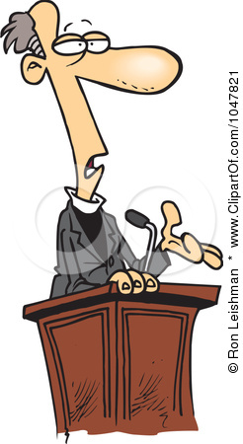
The Pastor’s Stump Feature Just for fun and discovery– asking questions that arise as you read the gospels

Slide 23
IV.

