Slide 2
John 17:3 (NLT) ³And this is the way to have eternal life—to know you, the only true God, and Jesus Christ, the one you sent to earth.
John 5:37-38 (NLT) ³⁷And the Father who sent me has testified about me himself. You have never heard his voice or seen him face to face,³⁸and you do not have his message in your hearts, because you do not believe me—the one he sent to you.

Slide 3
Hebrews 1:1 - 3 (NASB) ¹God, after He spoke long ago to the fathers in the prophets in many portions and in many ways, ²in these last days has spoken to us in His Son, whom He appointed heir of all things, through whom also He made the world. ³And He is the radiance of His glory and the exact representation of His nature, and upholds all things by the word of His power. When He had made purification of sins, He sat down at the right hand of the Majesty on high,

Slide 4
Knowing God as King
Knowing God Through Jesus Series

Slide 5
I. Kings and Kingdoms
God as king – 1 Samuel 8
God ruling through prophets and judges
Misrepresentation by Samuel’s sons
Give us a king like all the other nations
Do as they say, they don’t want me to be their king any longer
Consequences of earthly king
Warned – we still want a king
Once a Theocracy, now a Monarchy

Slide 6
Israel’s history as a kingdom
As the king so the kingdom
Jesus’ restoring the kingdom
Not political, but the rule of God in the hearts of people

Slide 7
II. The Gospel of the Kingdom
Matthew 3:1-2 – John the Baptist – “repent,… the kingdom of Heaven is near”
About to be revealed
Matthew 4:17 – Jesus – “repent, …the kingdom of heaven is near”
Matthew 4:23 – Jesus – traveling announcing the Good News (Gospel) about the kingdom
Matthew 6:10 – praying for the rule of God

Slide 8
III. Living as Citizens
Philippians 3:20 But we are citizens of heaven, where the Lord Jesus Christ lives. And we are eagerly waiting for him to return as our Savior.

Slide 9
Matthew 13
Mysteries of the Kingdom in the form of parables – permitted to know the secrets
Understand the kingdom and understand the king – his message in our hearts
Living as citizens, understanding the governing principles of the kingdom of your citizenship
Those with hardened hearts will not understand

Slide 10
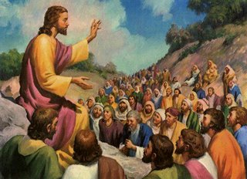
Eight Parables of the Kingdom
Four to the multitudes

Slide 11
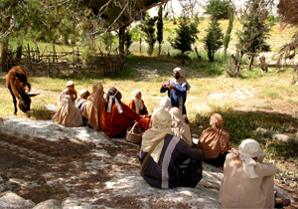
Four to the disciples

Slide 12
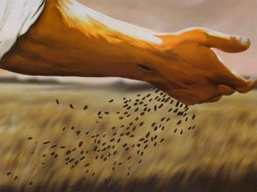
Farmer scattering seed 13:3-9, 18-23
Foundation for understanding all parables – Mark 4:13
God having given his Word to people of different heart conditions

Slide 13
Fruitless to those who do not receive it or to those who let it go
Fruitful to those who receive it (hear and understand)

Slide 14
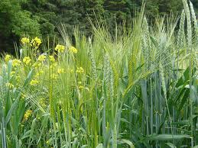
Wheat and Weeds 13:24-30, 36-43
The reality of the enemy’s activities among God’s people and the impending judgment

Slide 15
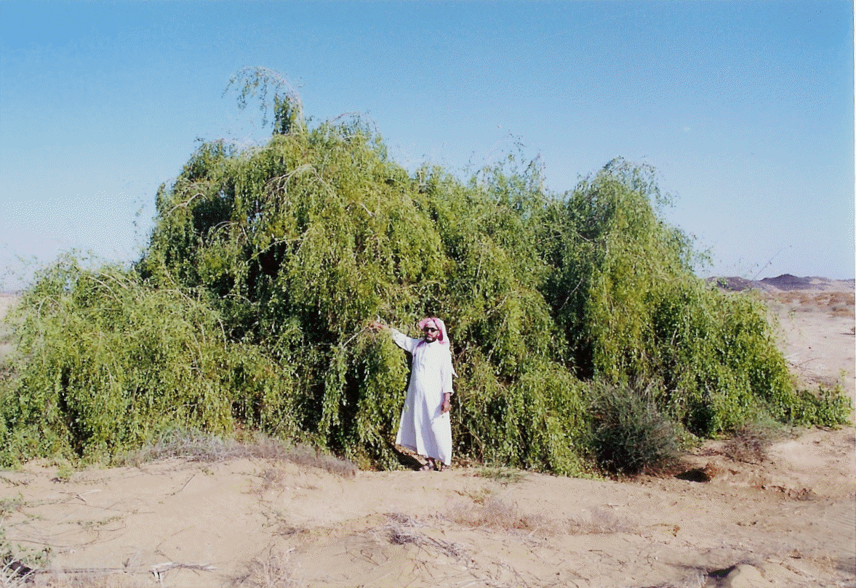
Mustard Seed 13:31-32
Progress of the Kingdom of God under the idea of living growth

Slide 16
Yeast 13:33
Corruption of the kingdom under the idea of contagious spreading

Slide 17
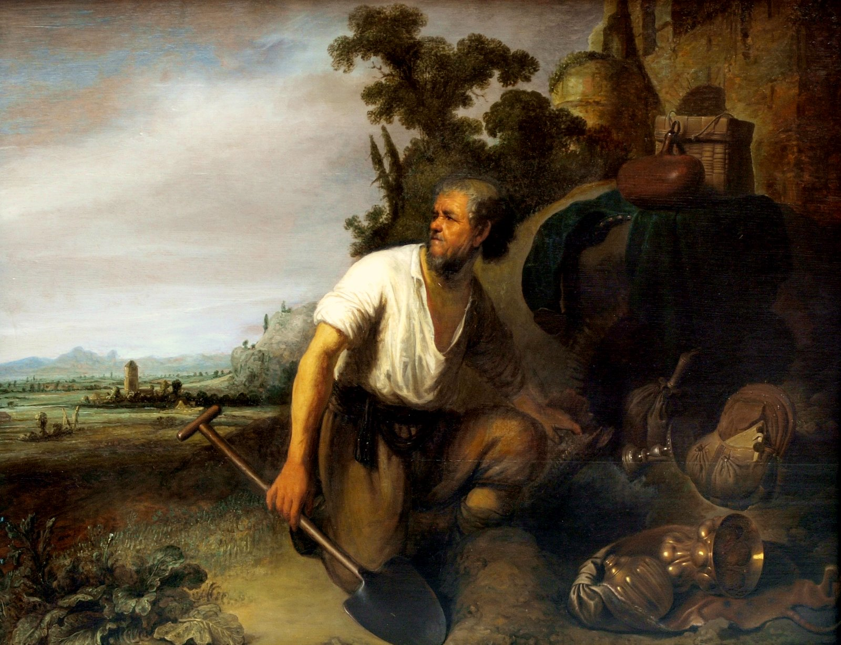
Hidden Treasure 13:44

Slide 18
Choice Pearl 13:45
The great value of the kingdom and its discovery

Slide 19
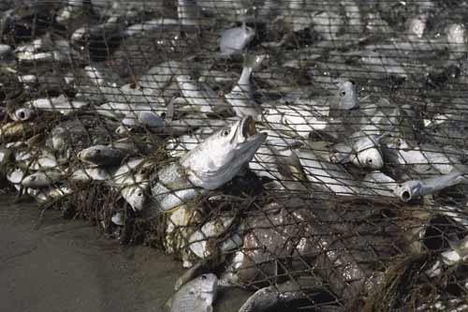
Fishing Net 13:47-51
Separation of good and evil at the time of judgment

Slide 20
Gems of Truth 13:52
Teachers of religious law becoming a disciple in the kingdom
Saul/Paul – Acts 26
Truth from storehouse – new as well as old
The law – a tutor to bring us to Faith in Jesus

Slide 21
1 Timothy 1:12 - 17 ¹²I thank Christ Jesus our Lord, who has strengthened me, because He considered me faithful, putting me into service, ¹³even though I was formerly a blasphemer and a persecutor and a violent aggressor. Yet I was shown mercy because I acted ignorantly in unbelief; ¹⁴and the grace of our Lord was more than abundant, with the faith and love which are found in Christ Jesus. ¹⁵It is a trustworthy statement, deserving full acceptance, that Christ Jesus came into the world to save sinners, among whom I am foremost of all. ¹⁶Yet for this reason I found mercy, so that in me as the foremost, Jesus Christ might demonstrate His perfect patience as an example for those who would believe in Him for eternal life. ¹⁷Now to the King eternal, immortal, invisible, the only God, be honor and glory forever and ever. Amen.

Slide 22
King Settling Accounts – Matthew 18:23-35
The King Prepares a Wedding Feast for His Son – Matthew 22:2-14

Slide 23
III. Conflict of Kingdoms
Delivered - Colossians 1:13 - 14 ¹³For he has rescued us from the kingdom of darkness and transferred us into the Kingdom of his dear Son, ¹⁴who purchased our freedom and forgave our sins.

Slide 24
Spiritual warfare – Ephesians 6:10-18
Fighting against evil rulers of the unseen world
Put on every piece of God’s armor
Able to resist the enemy and stand firm

Slide 25
The Pastor’s Stump Feature Just for fun and discovery– asking questions that arise as you read the gospels

Slide 27
IV.

