Slide 2
John 17:3 (NLT) ³And this is the way to have eternal life—to know you, the only true God, and Jesus Christ, the one you sent to earth.
John 5:37-38 (NLT) ³⁷And the Father who sent me has testified about me himself. You have never heard his voice or seen him face to face,³⁸and you do not have his message in your hearts, because you do not believe me—the one he sent to you.

Slide 3
Hebrews 1:1 - 3 (NASB) ¹God, after He spoke long ago to the fathers in the prophets in many portions and in many ways, ²in these last days has spoken to us in His Son, whom He appointed heir of all things, through whom also He made the world. ³And He is the radiance of His glory and the exact representation of His nature, and upholds all things by the word of His power. When He had made purification of sins, He sat down at the right hand of the Majesty on high,

Slide 4
Knowing God As Father
Knowing God Through Jesus Series

Slide 5
Jesus’ frequent use of “Father”
189 times in the gospels
124 of those in John
Sometimes – Our, your, my, or just Father
Spoke to the paternal aspect of God
Comparative with earthly father – can be both good and bad, but Jesus made distinction

Slide 6
I. Introduction of Father
Luke 2:41-50

Slide 7
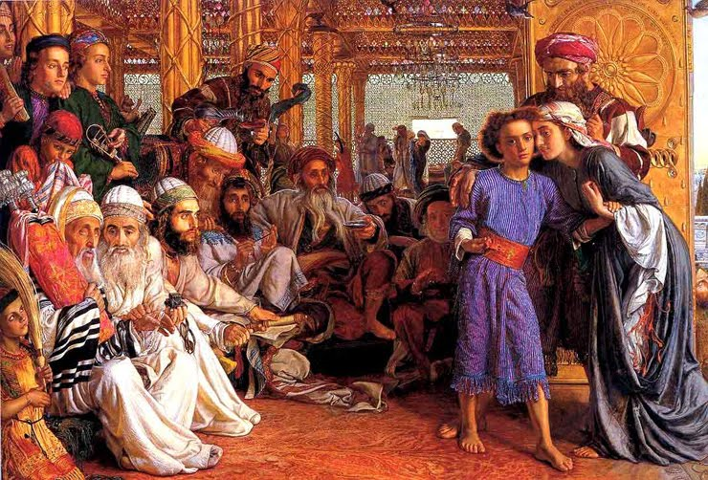
I must be about my Father’s business
They did not understand

Slide 8
John 5:16-18
Leaders upset with Jesus calling God his father
Making himself to be equal with God
Philippians 2:6 - 7 ⁶Though he was God, he did not think of equality with God as something to cling to. ⁷Instead, he gave up his divine privileges; he took the humble position of a slave and was born as a human being. When he appeared in human form,

Slide 9
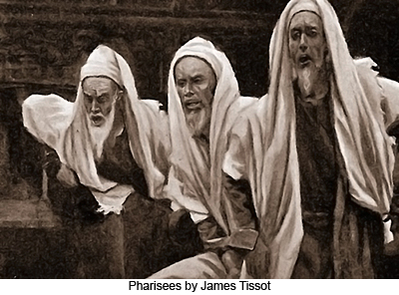
John 8:12-58 – contrast father of Jesus and father of Pharisees
8:38 – telling what I saw with my father – you are following the advice of your father
8:41 – imitating your real father
8:44 – children of your father the devil

Slide 10
II. Paternal Father
Matthew 5-7 – sermon on the mount
5:43-48 - acting as true children of your father in heaven – be perfect even as your father
6:8-9 – Father knows exactly what you need – pray like this – our Father…
6:32-33 – Father already knows all your needs – he will give you everything you need
7:11 – sinful people give good gifts to children – how much more will your heavenly father give good gifts to those who ask

Slide 11
Mark 14:35-36 – Abba, Father
“Abba” is the *Aramaic word for “Papa,” a term of great intimacy and affectionate respect. It was normally the first word a child would utter, but adults could use it for their fathers as well, and students sometimes used it of their teachers. Perhaps because it implied such intimacy, Jewish people never used it of God (though they did call him a heavenly father)

Slide 12
Parable of the prodigal’s father – Luke 15:11-32
Younger son – notorious sinners
Older son – “faithful” slave of obligation

Slide 13
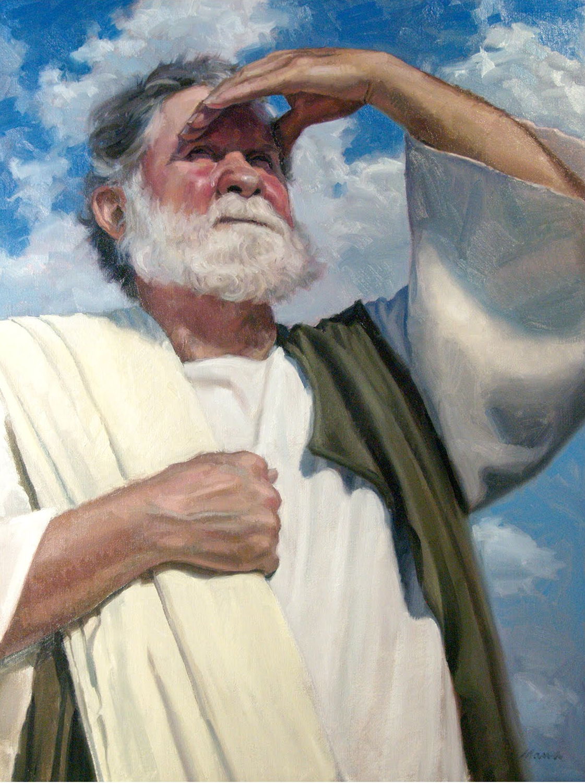
Father

Slide 14
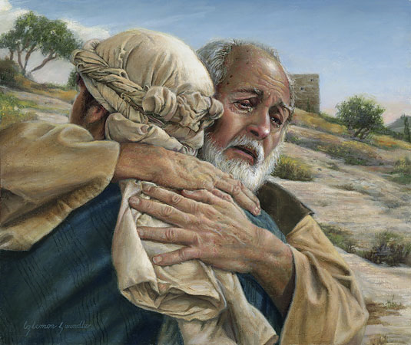
All about forgiveness, redemption, and provision for younger son (notorious sinners)

Slide 15
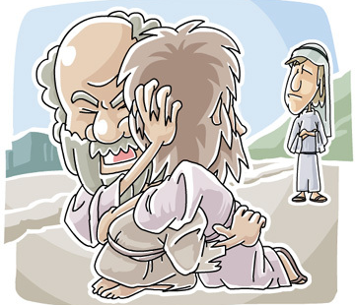
All about correcting perception of older son to get out of their slavery of obligation (religious people)

Slide 16
Romans 8:15 - 17 ¹⁵So you have not received a spirit that makes you fearful slaves. Instead, you received God’s Spirit when he adopted you as his own children. Now we call him, “Abba, Father.” ¹⁶For his Spirit joins with our spirit to affirm that we are God’s children. ¹⁷And since we are his children, we are his heirs. In fact, together with Christ we are heirs of God’s glory. But if we are to share his glory, we must also share his suffering.

Slide 17
The Pastor’s Stump Feature Just for fun and discovery– asking questions that arise as you read the gospels

Slide 21
III. Head of the Body

Slide 24
IV.

