Slide 2
Jesus and His Bride

Slide 3
I. Jesus The Bridegroom
John 3:28 - 30 ²⁸“You yourselves are my witnesses that I said, ‘I am not the Christ,’ but, ‘I have been sent ahead of Him.’ ²⁹“He who has the bride is the bridegroom; but the friend of the bridegroom, who stands and hears him, rejoices greatly because of the bridegroom’s voice. So this joy of mine has been made full. ³⁰“He must increase, but I must decrease.

Slide 4
Isaiah 62:5 ⁵… And as the bridegroom rejoices over the bride, So your God will rejoice over you.

Slide 5
II. Jesus Loves his Bride

Slide 6
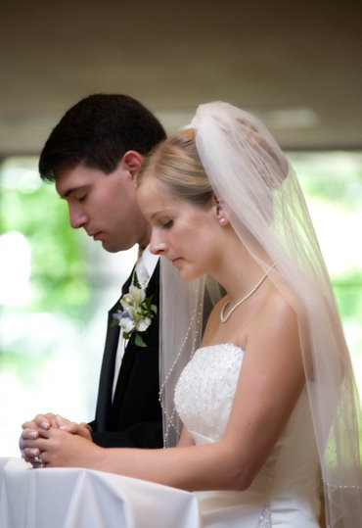
Ephesians 5:31 - 32 ³¹As the Scriptures say, “A man leaves his father and mother and is joined to his wife, and the two are united into one.” ³²This is a great mystery, but it is an illustration of the way Christ and the church are one.

Slide 7
Genesis 2:21 - 24 ²¹So the LORD God caused the man to fall into a deep sleep. While the man slept, the LORD God took out one of the man’s ribs and closed up the opening. ²²Then the LORD God made a woman from the rib, and he brought her to the man. ²³“At last!” the man exclaimed. “This one is bone from my bone, and flesh from my flesh! She will be called ‘woman,’ because she was taken from ‘man.’” ²⁴This explains why a man leaves his father and mother and is joined to his wife, and the two are united into one.

Slide 8
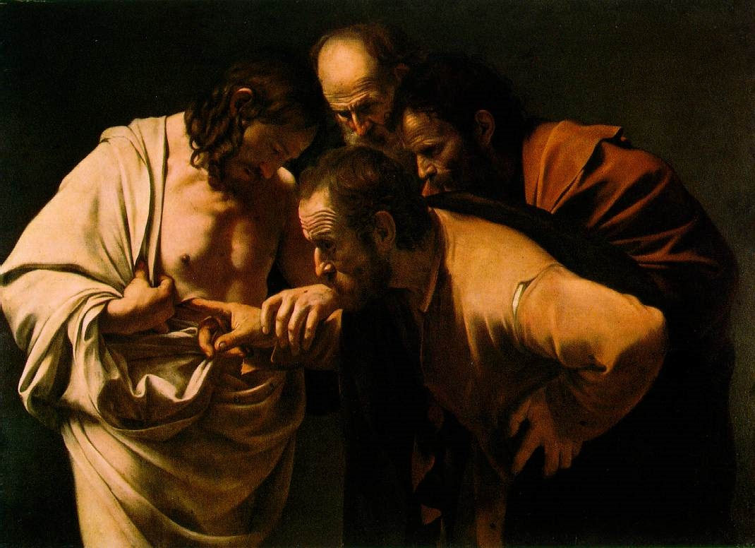

Slide 9
Marriage is an example of Jesus and his church
Jesus and his church are an example for the husband and wife

Slide 10
How Jesus loves his bride Ephesians 5:25-29
Submission –to one another v. 21
Philippians 2:5 - 8 ⁵You must have the same attitude that Christ Jesus had. ⁶Though he was God, he did not think of equality with God as something to cling to.

Slide 11
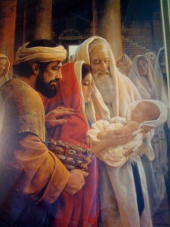
⁷Instead, he gave up his divine privileges; he took the humble position of a slave and was born as a human being.

Slide 12
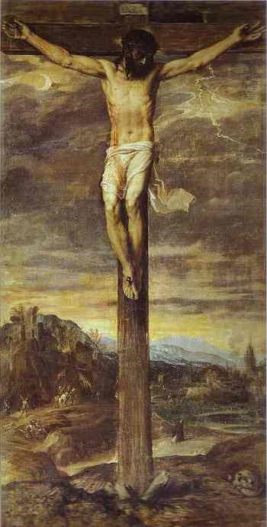
When he appeared in human form, ⁸he humbled himself in obedience to God and died a criminal’s death on a cross.

Slide 13
The church submits to Christ – Ephesians 5:22-24
V. 21 submit to one another
Submit to your husbands in everything (Col. 3:18 – as is fitting for those who belong to the Lord)

Slide 14
Who has the greater responsibility?
Romans 5:8 ⁸…in that while we were yet sinners, Christ died for us.

Slide 15
2 Corinthians 5:14 - 15 ¹⁴For the love of Christ controls us, having concluded this, that one died for all, therefore all died; ¹⁵and He died for all, so that they who live might no longer live for themselves, but for Him who died and rose again on their behalf.

Slide 16
III. The Consummation

Slide 17
Revelation 19:7 - 9 ⁷Let us be glad and rejoice, and let us give honor to him.

Slide 18
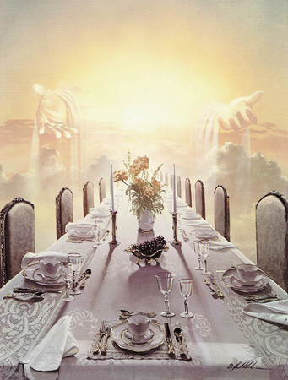
For the time has come for the wedding feast of the Lamb, and his bride has prepared herself.

Slide 19
⁸She has been given the finest of pure white linen to wear.” For the fine linen represents the good deeds of God’s holy people.

Slide 20
⁹And the angel said to me, “Write this: Blessed are those who are invited to the wedding feast of the Lamb.” And he added, “These are true words that come from God.”

Slide 30
IV.

Slide 33
V.

