Slide 2
Praise Fellowship Church
Introductions Class

Slide 3

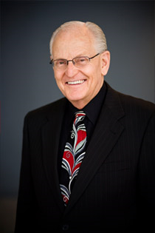
Part of the Association of Faith Churches and Ministers (AFCM)

Slide 4
I. Our Mission and Purpose
To love God and people too and to make followers of Jesus
  The Great Commandment – Matthew 22:36-40
  The Great Commission – Matthew 28:19-20

Slide 5
To love God
  Through worship and praise
  Through practice of the scriptures
To love people too
  Through sharing the gospel
  Through community in the body
To make followers of Jesus
  By discipling others
  By training and equipping

Slide 6
II. Foundational Beliefs

Slide 7
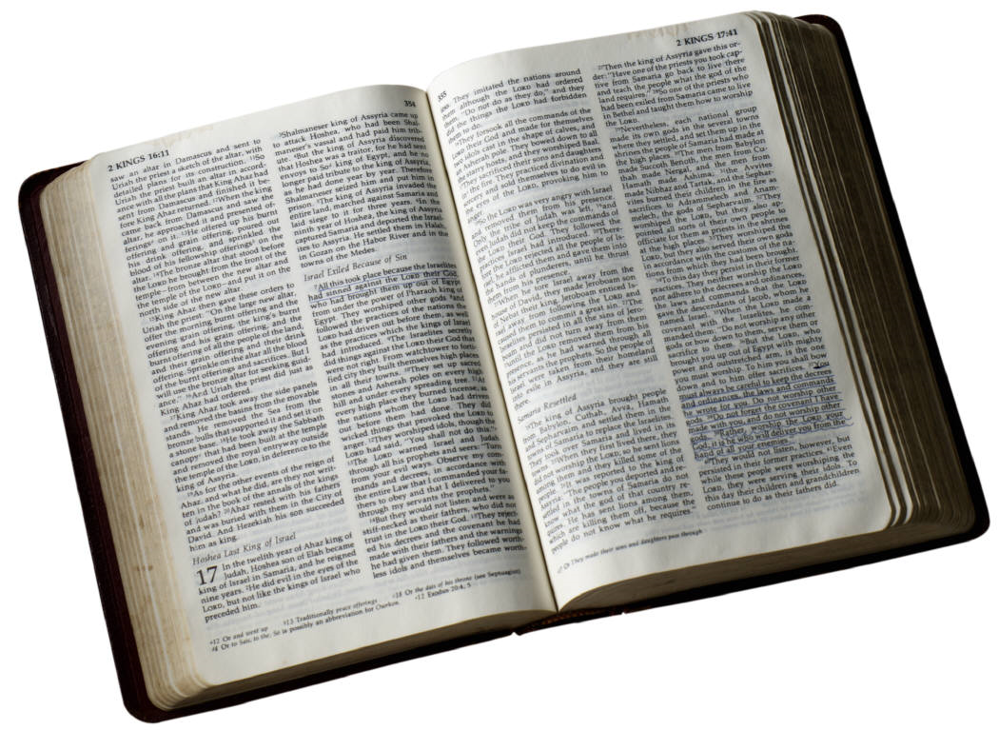
The Bible is the inspired word of God
  A revelation from God to man
  The infallible rule of faith and conduct

Slide 8
The One True Godhead
  God the Father
  God the Son – Jesus Christ – God manifest in the flesh
  God the Holy Spirit

Slide 9
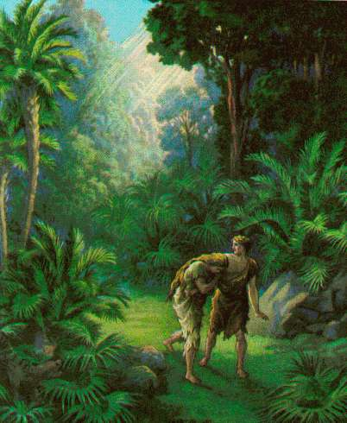
The Fall of Man
  Man was created in the image of God
  Man, by voluntary sin, fell from his position of being right with God
  Man’s only hope of reconciliation with God is through Jesus Christ

Slide 10
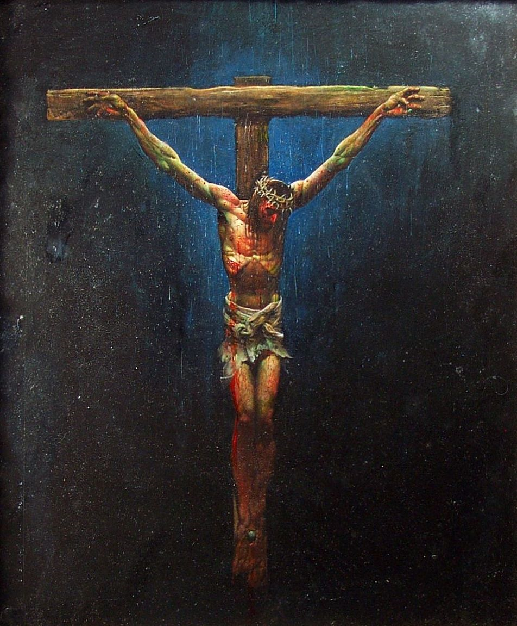
The Salvation of Man
  On the cross, Jesus became the sin sacrifice for man paying the price for salvation
  By grace we are saved through faith
  The evidence of salvation
    The inward witness of the Holy Spirit
    The fruit of repentance
    Works that follow real faith

Slide 11
Water Baptism
  An outward expression of an inward experience of the grace of God
  Believers Baptism – following conversion
  Mode – immersion

Slide 12
  baptized into Jesus death

Slide 13
  buried with him in baptism
  united with him in the likeness of his death

Slide 14
  united with him in the likeness of his resurrection

Slide 15
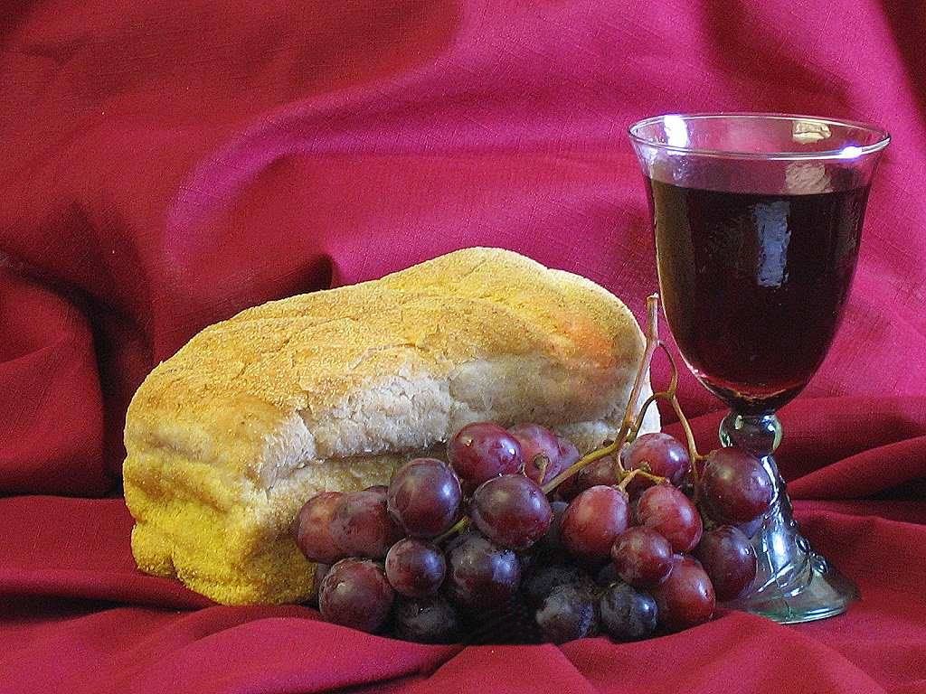
The Lord’s Supper – Communion
  Celebration of the covenant made with Jesus’ blood
  Done in remembrance of the supreme sacrifice of Jesus
  To be partaken in a worthy manner

Slide 16
Baptism of the Holy Spirit
  A present day reality
  Given for power for life and service
  Resulting in manifestations of the fruit of the Spirit
  Resulting in manifestations of the gifts of the Spirit

Slide 17
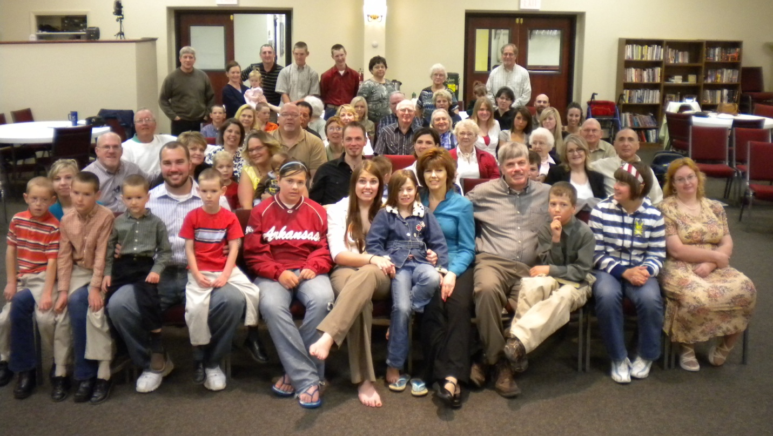
The Church
  The body of Christ
  The manifestation of Jesus in the world today
  A dwelling of God in the Spirit
  Commissioned by God to go into all the world and make followers of Jesus

Slide 18

The Return of Jesus
  Jesus is coming back for his bride, the church
  All who receive salvation, making Jesus Lord and Savior will live with him for eternity
  He will come to judge the living and the dead

Slide 19
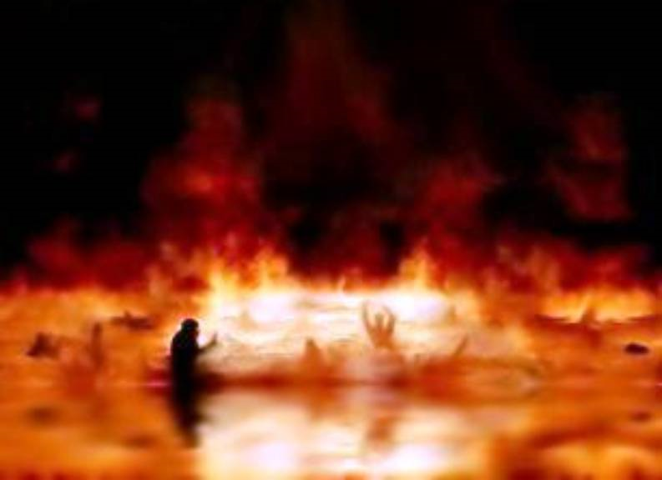
Eternal Judgment
  The second death for all who do not accept Jesus as their Lord and Savior
  Anyone whose name is not written in the Lamb’s book of life shall be consigned to everlasting punishment in the lake of fire, separated from God for eternity

Slide 20
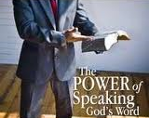
The Word of Faith
  The word is near you in your heart and in your mouth
  Faith in the promises of God
  Confession of the promises of God
  The abundant life that Jesus came to give

Slide 21
III. Governing Structure of PFC
Theocracy – of God and for the people
  Contrast to democracy – of the people and for the people
  Jesus – the head of the church
  Pastors, Elders – receive a delegated authority from the Spirit of God to give oversight to the church

Slide 22
Jesus
PFC Board
Roger
Melanie
Dan Gassler
Andy Spurlin
Pastor Roger
AFCM
Jim Kasemen

Slide 23
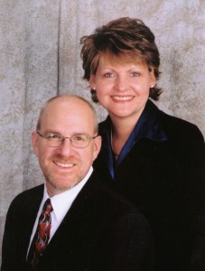
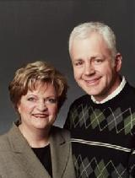

Slide 24
Jesus
PFC Board
Roger
Melanie
Dan Gassler
Andy Spurlin
Pastor Roger
AFCM
Jim Kasemen
Ministry
Leaders

Slide 25
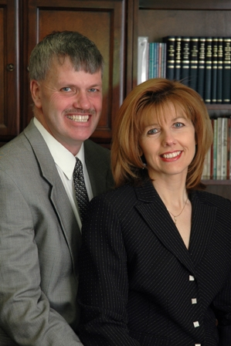
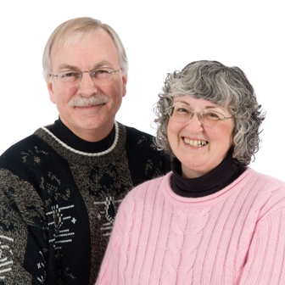
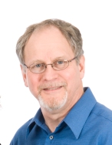
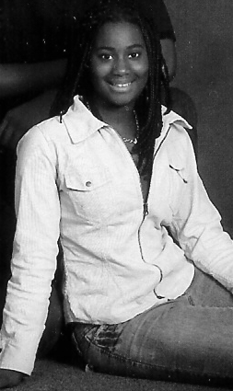
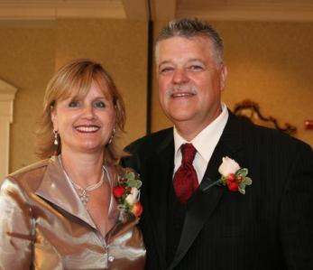
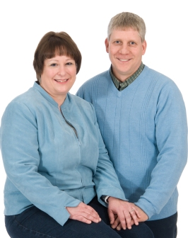
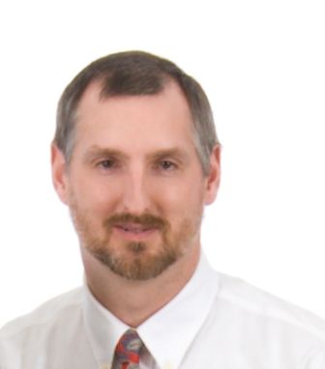

Slide 26
Jesus
PFC Board
Roger
Melanie
Dan Gassler
Andy Spurlin
Pastor Roger
AFCM
Jim Kasemen
Ministry
Leaders
Ministry
Helpers

Slide 27
…whoever wishes to be great among you shall be your servant
Ministry
Helpers
Ministry
Leaders
PFC Board
Roger
Melanie
Dan Gassler
Andy Spurlin
Pastor Roger
AFCM
Jim Kasemen
Jesus

Slide 28
Following God’s delegated authority
  Hebrews 13:17 Obey your leaders and submit to them, for they keep watch over your souls as those who will give an account. Let them do this with joy and not with grief, for this would be unprofitable for you.
  Comes from an earned trust not a demanded submission

Slide 29
IV. Gift-Based Ministry
Functions in the church body based on recognized gifts and seasons, not on elected terms
Gifts for equipping – Ephesians 4:7-8, 11-16
  To prepare God’s people for works of service
  The whole body held together by what every joint supplies

Slide 30
God’s placement – 1 Corinthians 12:14-18
  The body has many members
  God has placed each one as he desires
Employing gifts – 1 Peter 4:10
  Each one has received a special gift
  Employ it serving one another as good stewards of the grace of God
Your field of assignment – 2 Corinthians 10:13 NIV

Slide 31
V. Membership
Connecting with the family
Invitation
  Come join the family
Introduction
  Meet Father (God)
  Meet the rest of the family
Interaction
  Join us in the family room
  Small group activities

Slide 32
Household chores
  Fulfill your part in the family
Let’s invite the neighbors – making adjustment to Let’s serve the neighbors

Slide 33
Difference between members and attenders
  Attenders – those who may or may not be in a relationship with the Lord, searching for their place – welcome here
God has placed the members as is pleases him
Helping people find their place
Two-way commitment
  Members to the church
  Church to the members

Slide 34
Members commitment
  To have established a relationship of being reconciled to God
  To continue in the process of being made complete in Christ as a follower of Jesus
  To participate in the ministry of the church with the gifts that God has given you
  To press for unity in the body and not stir strife
    Walking in love
    Dealing with offenses in a biblical manner
  To support the church in tithes and offerings

Slide 35
Church’s commitment
  To provide a spiritual covering for its members
  To provide community where each person can find acceptance and can develop and grow
  To spiritually feed and nurture those that God has called here
  To equip each believer to become an able minister of the grace of Jesus Christ
  To provide vision and direction so the body can work together

