Slide 2
God So Loved Series
John 3:16 For God so loved (dearly prized) the world that He gave His only begotten Son, that whoever believes in (trusts in, clings to, relies on) Him should not perish but have everlasting life.

Slide 3
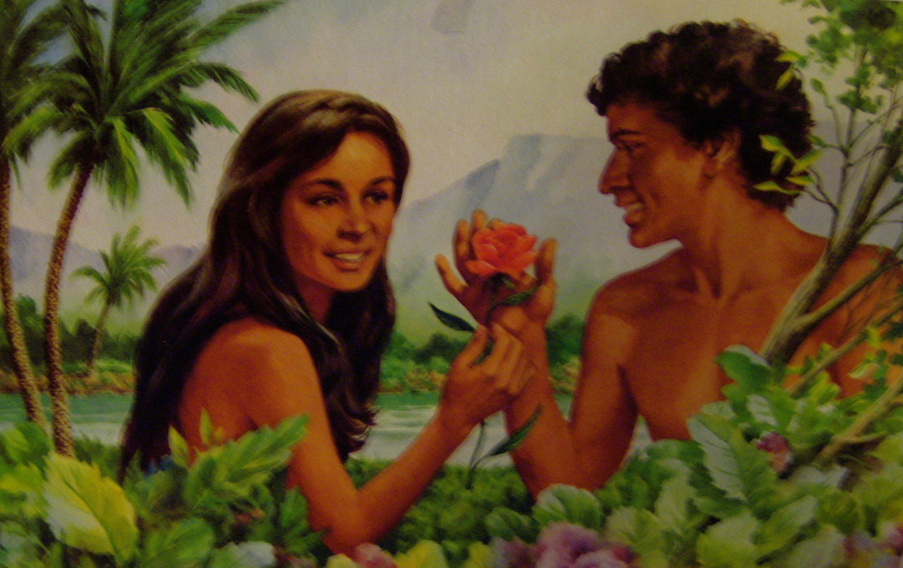

Slide 4
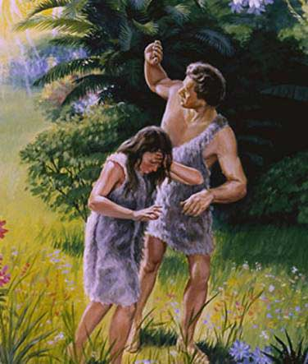

Slide 5
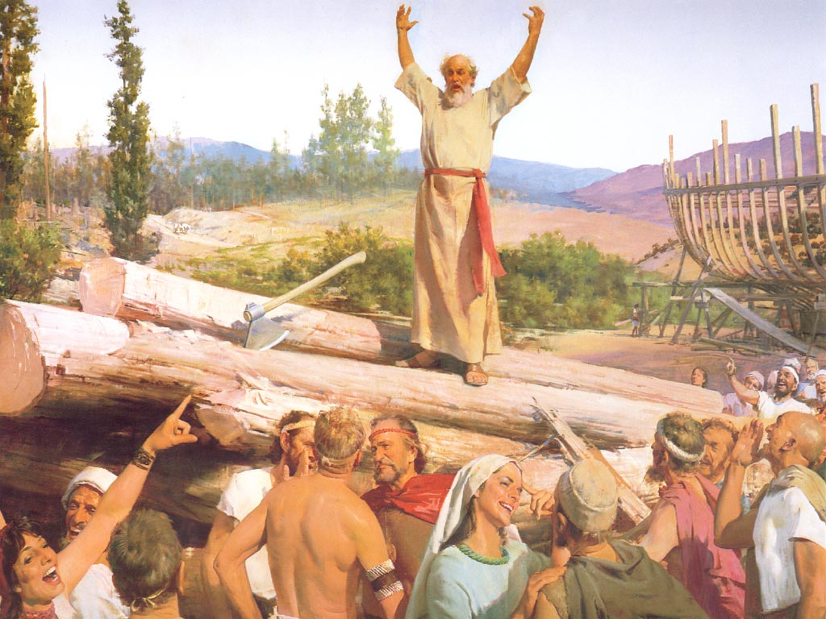

Slide 6
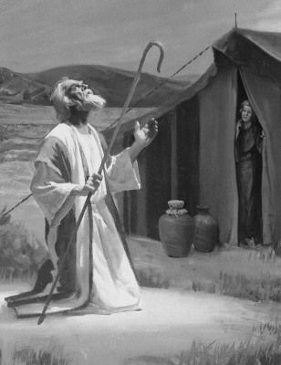
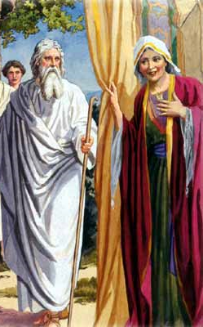

Slide 7
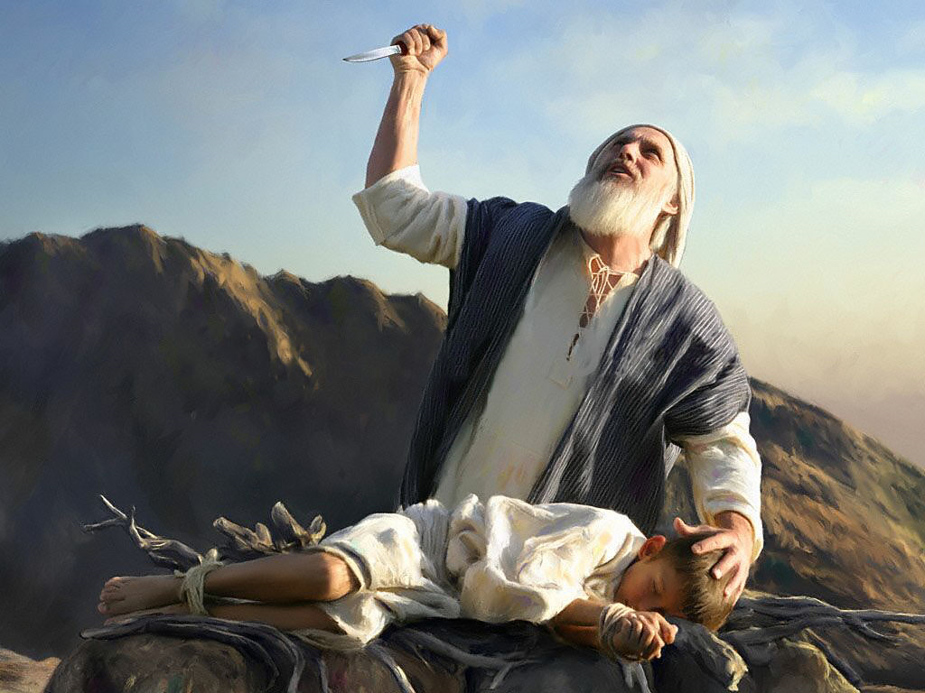

Slide 8
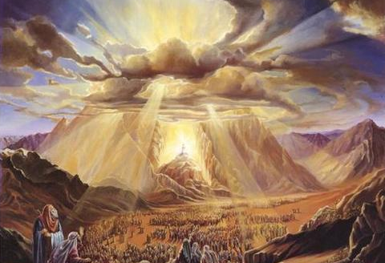

Slide 9
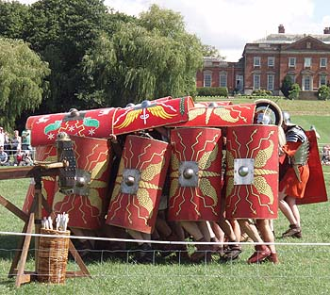

Slide 10
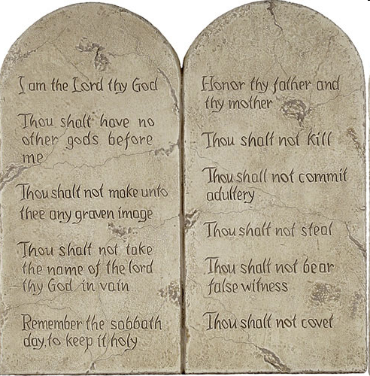
1-4 Love the Lord your God
5-10 Love your neighbor as yourself

Slide 11
The New Covenant
God So Loved Series

Slide 12
I. The Promise of a New Covenant
Jeremiah 31:31-34
Formula of an unconditional covenant – “I will…”
Make a new covenant with Israel
Instructions written on their hearts
All know me
Forgive their wickedness
Never again remember their sins
Notes:
unconditional

Slide 13
Jeremiah 33:14-16
I will raise up a righteous descendant from King David
Jerusalem’s name will be The Lord is Our Righteousness

Slide 14
II. A Better Covenant
Hebrews 8:6-13
Jesus, mediator of a far superior covenant
First covenant faults – the people – the law weak in the flesh
Curse of disobedience – Deuteronomy 28:15

Slide 15
Galatians 3:13 - 14 (NLT) ¹³But Christ has rescued us from the curse pronounced by the law. When he was hung on the cross, he took upon himself the curse for our wrongdoing. For it is written in the Scriptures, “Cursed is everyone who is hung on a tree.” ¹⁴Through Christ Jesus, God has blessed the Gentiles with the same blessing he promised to Abraham, so that we who are believers might receive the promised£ Holy Spirit through faith.

Slide 16
A faulty priesthood – Hebrews 7:18-22
New covenant – first one is expired (8:13)
Not abolished or nullified but fulfilled

Slide 17
III. A Blood Covenant
Hebrews 9-10
The first covenant – high priest entered most holy place once a year
Offered blood for his and people’s sins
Christ is now the High Priest
Entered heaven’s most holy place with his own blood
Secured our redemption forever

Slide 18
Christ died once for all time – a sacrifice to take away people’s sin
Coming again to bring salvation to all who wait for him
First covenant cancelled to put the second into effect
God’s will – for us to be made holy
Hold tightly to the hope – God can be trusted to keep his promise
Not trampling on the Son of God, treating the blood of the covenant as common and unholy
Suffering for the sake of Christ

Slide 19
Better things waiting that will last for eternity
Patient endurance is what you need now
Continue to do God’s will
Receive all that he has promised

Slide 20
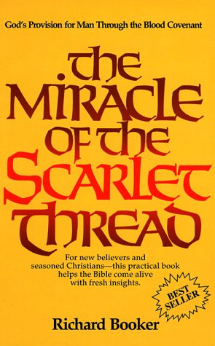
Blood Covenant, much more in depth in AFCMITC – Module 1 – Fall 2011

