Slide 2
God So Loved Series
John 3:16 For God so loved (dearly prized) the world that He gave His only begotten Son, that whoever believes in (trusts in, clings to, relies on) Him should not perish but have everlasting life.

Slide 3
Living the Fulfillment of the Law
God So Loved Series

Slide 4
Review
Matthew 5:17 (NLT) “Don’t misunderstand why I have come. I did not come to abolish the law of Moses or the writings of the prophets. No, I came to accomplish (fulfill) their purpose.
Shadow vs. Substance – the law was a shadow, Jesus is the substance

Slide 5
Letter vs. Spirit – letter kills, Spirit gives life
Matthew 23:4 (Teachers of religious law and Pharisees) ⁴They crush people with impossible religious demands and never lift a finger to ease the burden.

Slide 6
I. That Which God has Cleansed
Leviticus 11:1-12
Land animals – split hooves and chew the cud

Slide 7
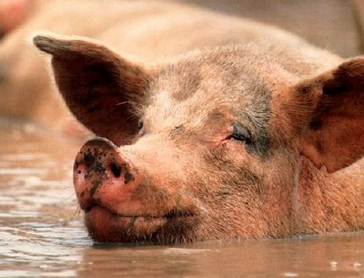
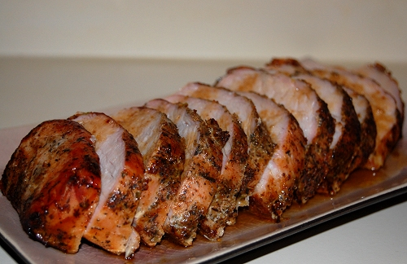
The pig is unclean

Slide 8
Marine animals – both fins and scales

Slide 9
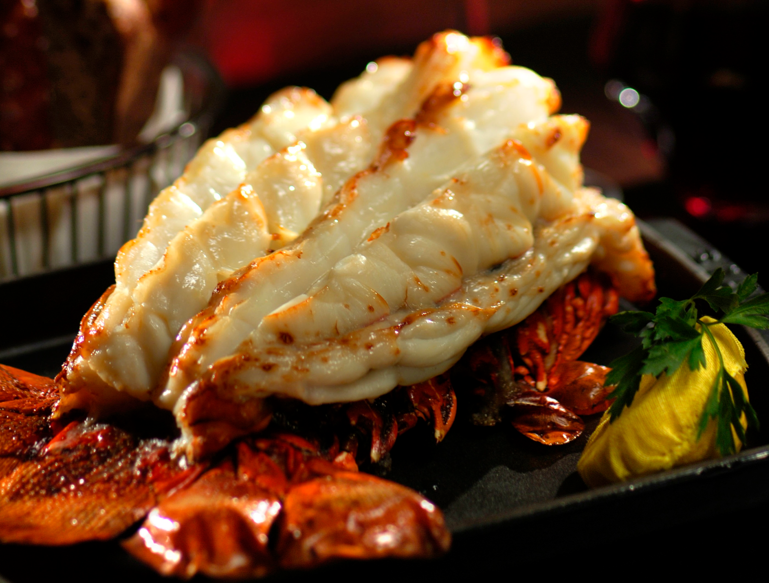
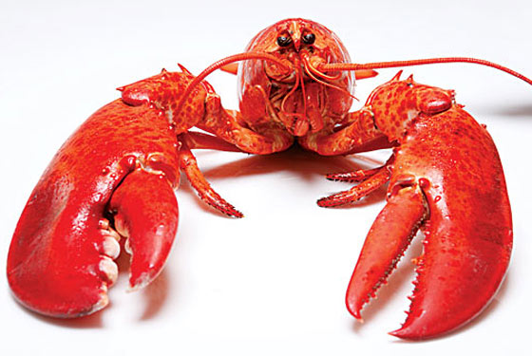
If no fins and scales it is detestable

Slide 10
Mark 7:18 - 19 (NASB) ¹⁸And He said* to them, “Are you so lacking in understanding also? Do you not understand that whatever goes into the man from outside cannot defile him, ¹⁹because it does not go into his heart, but into his stomach, and is eliminated?” (Thus He declared all foods clean.)

Slide 11
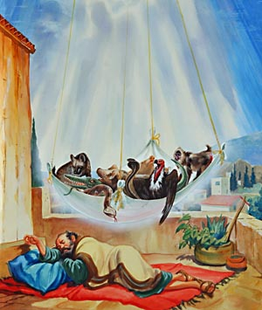
Acts 10 – Peter’s Vision of Unclean Animals
Kill and eat
Jewish laws declared impure and unclean

Slide 12
Do not call something unclean if God has made it clean
God has shown me I should no longer think of anyone as impure or unclean
Peter’s Reproof – Galatians 3:11-16

Slide 13
1 Timothy 4:3-4
Some say it is wrong to eat certain foods
Everything God created is good
Not reject any of it, but receive it with thanks
Romans 14:1-13
One believes it’s alright to eat anything
Another will eat only vegetables
Eat or not eat – to please the Lord
Don’t condemn but live so as to not cause another to stumble

Slide 14
II. The True Circumcision
Started with Abraham as a sign of his covenant with God – then became a part of the law
Leviticus 12:3 On the eighth day the boy’s foreskin must be circumcised.

Slide 15
The Spirit of the Law - Deuteronomy 30:6 (NASB) “Moreover the LORD your God will circumcise your heart and the heart of your descendants, to love the LORD your God with all your heart and with all your soul, so that you may live.

Slide 16
Romans 2:25-29
Break the law = uncircumcised
True circumcision is not obeying the letter of the law
True circumcision is of the heart by the Spirit

Slide 17
Galatians 5:1-6
Freedom vs. slavery
Circumcised to be right with God? – then Christ will be of no benefit for you
No benefit in circumcision or uncircumcision – only faith expressed in love
V.12 - I just wish those trouble makers would mutilate themselves

Slide 18
III. Sabbath Rest
Instituted at creation – God rested from all his works – Genesis 2:1-3
Commanded observance under the law – Exodus 20:8-11

Slide 19
Purpose of Observance
Exodus 31:12-17
A day of complete rest
A sign of the covenant
Know I am the Lord that makes you holy
Deuteronomy 5:15
Remember deliverance from slavery
Colossians 2:16,17
A shadow of things to come (AMP – only symbolic value)

Slide 20
Foreshadows Christ and is symbolic
The Lord makes you holy
Ceasing from labor
Deliverance from slavery

Slide 21
There remains a Sabbath rest for the people of God – Hebrews 4
Is it a Seventh Day Sabbath? – No - Israelites had that in the wilderness, yet God said they would not enter his rest because of their unbelief.
Is it Canaan, the promised land? – No - If Joshua had given them rest God would not have spoken of another day still to come
What is it the substance of?
The Lord makes you holy
Ceasing from labor
Deliverance from slavery

Slide 22
The Good News of the Gospel
Announced to us just as it was to them
We who believe enter that rest
The Lord makes you holy – not your observance of the law
Rest from works – by grace are you saved through faith, not of works
Deliverance from slavery – delivered from the dominion of darkness, no longer slaves to sin
Sabbath observance – not a day, but resting in the finished work of Christ

Slide 23
What about observance of a day? – Romans 14:5-6
One man regards one day above another
Another regards each day alike
Let each be fully convinced in his own mind
Don’t judge others

Slide 24
IV. Conclusion
Do not be confused between the letter and the Spirit of the law
It’s not about obeying rules
It’s about loving God and people too
See the fulfillment of the law and walk in that
Walk in love, not judgment of others whose practice is different than yours

