Slide 2
God So Loved Series
John 3:16 For God so loved (dearly prized) the world that He gave His only begotten Son, that whoever believes in (trusts in, clings to, relies on) Him should not perish but have everlasting life.

Slide 3
Review – purpose of the law
Defined sin
Showed us how sinful we are
Showed us it is impossible to be right with God by trying to keep the law
A tutor to lead us to Christ
Matthew 5:17 (NLT) “Don’t misunderstand why I have come. I did not come to abolish the law of Moses or the writings of the prophets. No, I came to accomplish their purpose. (NASB - I did not come to abolish but to fulfill)

Slide 4
The Fulfillment of the Law
God So Loved Series

Slide 6
I. Shadow vs. Substance
Hebrews 10:1 (NLT) The old system under the law of Moses was only a shadow, a dim preview of the good things to come, not the good things themselves. The sacrifices under that system were repeated again and again, year after year, but they were never able to provide perfect cleansing for those who came to worship.

Slide 7
Colossians 2:16 - 17 (NLT) ¹⁶So don’t let anyone condemn you for what you eat or drink, or for not celebrating certain holy days or new moon ceremonies or Sabbaths. ¹⁷For these rules are only shadows of the reality yet to come. And Christ himself is that reality (NASB - substance).
Romans 10:4 (NLT) For Christ has already accomplished the purpose for which the law was given (NASB – Christ is the end of the law). As a result, all who believe in him are made right with God.

Slide 8
Romans 8:1-4
The law unable to save us because of the weakness of our sinful nature
God did what the law could not do
God gave his son as a sacrifice for our sins (God so loved…)
Requirement of the law satisfied for us
No longer follow sinful nature, but follow the Spirit

Slide 9
II. The Spirit (Fulfillment) of the Law
Many have gotten confused between the SPIRIT of the Law and the LETTER of the Law. Having not realized the law is spiritual in its being fulfilled, they will say that unless you abide by the commandment given in the law, you are abolishing the law. We do not abolish the law, but in Christ Jesus we walk in the fulfillment of the law, that the law might be fulfilled in us who do not walk according to the flesh, but according to the Spirit.

Slide 10
Romans 7:6 (NLT) But now we have been released from the law, for we died to it and are no longer captive to its power. Now we can serve God, not in the old way of obeying the LETTER of the law, but in the new way of living in the SPIRIT
2 Corinthians 3:6 (NASB) who also made us adequate as servants of a new covenant, not of the letter but of the Spirit; for the LETTER kills, but the SPIRIT gives life.

Slide 11
Letter vs. Spirit (think shadow vs. Substance)
10 commandments – love is the fulfillment
Unclean animals – what God has cleansed don’t call unclean (free to eat)
Sacrifice of animals – Jesus’ sacrifice once for all
Circumcision – circumcision of the heart
Seventh Day Sabbath – rest from works

Slide 12
III. The Big 10

Slide 13
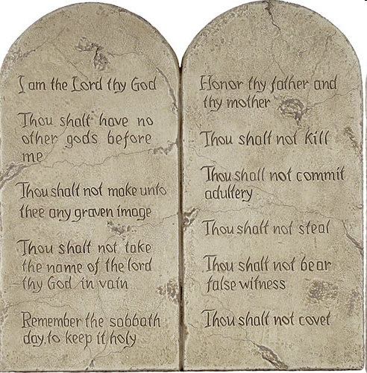
1-4 Love the Lord your God
5-10 Love your neighbor as yourself

Slide 14
Matthew 22:34-40
The entire law and demands of the prophets are based on these commandments
Love God
Love people

Slide 15
Romans 13:8-10
The commandments are summed up in love your neighbor as yourself
Love does no wrong to others
Love fulfills the requirements of the law
Galatians 5:13 - 14 ¹³For you have been called to live in freedom, my brothers and sisters. But don’t use your freedom to satisfy your sinful nature. Instead, use your freedom to serve one another in love. ¹⁴For the whole law can be summed up in this one command: “Love your neighbor as yourself.”

Slide 16
1 Corinthians 13:3 If I gave everything I have to the poor and even sacrificed my body, I could boast about it; but if I didn’t love others, I would have gained nothing.

Slide 17
The law used correctly – 1 Timothy 1:5-11
Purpose of my instruction - believers filled with love
Some people want to be teachers of the law, but don’t know what they are talking about
The law is good when used correctly
Not for people who do right, but for lawless and rebellious
Example – Ray Comfort “180movie.com”

Slide 18
IV. Unclean Food
Leviticus 11:1-12
Land animals – split hooves and chew the cud
The pig is unclean
Marine animals – both fins and scales
If no fins and scales it is detestable

Slide 19
Mark 7:18 - 19 (NASB) ¹⁸And He said* to them, “Are you so lacking in understanding also? Do you not understand that whatever goes into the man from outside cannot defile him, ¹⁹because it does not go into his heart, but into his stomach, and is eliminated?” (Thus He declared all foods clean.)

Slide 20
Acts 10 – Peter’s Vision of Unclean Animals
Sheet of unclean animals
Kill and eat
Jewish laws declared impure and unclean
Do not call something unclean if God has made it clean
God has shown me I should no longer think of anyone as impure or unclean
Peter’s Reproof – Galatians 3:11-16

Slide 21
1 Timothy 4:3-4
Some say it is wrong to eat certain foods
Everything God created is good
Not reject any of it, but receive it with thanks
Romans 14:1-13
One believes it’s alright to eat anything
Another will eat only vegetables
Eat or not eat – to please the Lord
Don’t condemn but live so as to not cause another to stumble

