Slide 2
Men’s Fraternity The Great Adventure

Slide 3
The Family Adventure – teamed with your wife and reproducing life in your children
The Noble Cause Adventure – teamed with like-minded partners to fight for a better life to make this world a better place for others
Man-Sized Adventures – teamed with friends to enjoy life
Spiritual Adventure – teamed with God to experience more that this life can offer

Slide 4
Your Unique Design
Dreamer – calm, reflective
Catalyzer – persuasive, bold
Energizer – spontaneous, funloving
Persister – dedicated, conscientious
Harmonizer – compassionate, warm
Achiever – logical, organized
The Adventurer’s Sacred Oath – I will fervently live my life according to my design with the end in mind

Slide 5
Numbers 14:24 But My servant Caleb, because he has had a different spirit and has followed Me fully, I will bring into the land which he entered, and his descendants shall take possession of it.
Let’s go at once to take the land. We can certainly conquer it!
Give me the high ground that the Lord promised me

Slide 7
God So Loved Series
John 3:16 For God so loved (dearly prized) the world that He gave His only begotten Son, that whoever believes in (trusts in, clings to, relies on) Him should not perish but have everlasting life.

Slide 8
The Purpose of the Law
God So Loved Series

Slide 9
I. Review
Israelites delivered from Egypt and headed to the Promised Land (promised to Abraham and his descendants)
On the way – stop at Mt. Sinai where they receive the Covenant of Law
God reveals his glory to Moses – his character and nature

Slide 10
II. God so Loved – He Disciplined
Hebrews 3
Hardened hearts always turn away from me
Rebellious – refused to do what I tell them
Result – corpses in the wilderness

Slide 11
Hebrews 12
The Lord disciplines those he loves
His discipline is always good – that we might share in his holiness
Harvest of right living for those trained this way

Slide 12
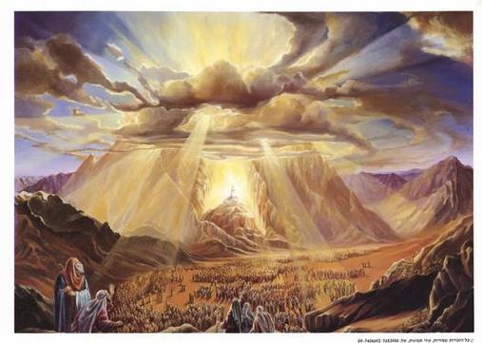
Sinai vs. Zion
Israelites at Sinai – quaking mountain, fire, thunder, the voice of God, fear and trembling

Slide 13
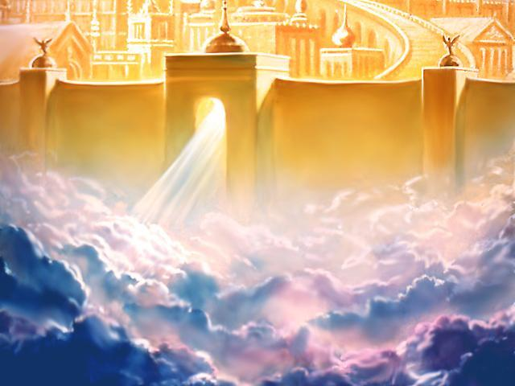
Sinai vs. Zion
You have come to Zion – God’s heavenly city, mediator Jesus, new covenant with God, a kingdom that is unshakable

Slide 14
Be careful not to refuse to listen to the one who is speaking
Not escape if we reject the one speaking from heaven

Slide 15
In the various covenants we have observed so far, we see man being justified or declared righteous on the basis of God’s grace and man approaching God through faith and the blood of atonement. However, when the Covenant of Law was interjected into the Covenant with Abraham and his descendants, it appears as though man is to be justified by his works, or his ability to keep a set of rules. Why the law then? Has the unchanging God changed the way he deals with man? What is the purpose of what the Bible calls a ministry of condemnation, and a ministry of death, the Law?

Slide 16
III. Purpose of the Law
Galatians 3 – perfected by human effort?
God made a promise to Abraham and his child (Jesus)
The agreement was not cancelled when God gave the law to Moses
Why was the law given? – to show people their sin

Slide 17
Romans 7:7-13
The law showed me my sin
I lived without understanding of the law
I learned the law, the power of sin came to life and I died
The law is good – sin and the nature of sin in me is bad
Romans 5:20-21
The law given so all people could see how sinful they were
Grace became more abundant
Grace rules over sin to give us right standing with God

Slide 18
Romans 3:19-20
The purpose of the law is to show the entire world is guilty before God
Can’t be made right with God by keeping the law
The law shows us how sinful we are

Slide 19
The Diagnosis vs. the Cure

Slide 20
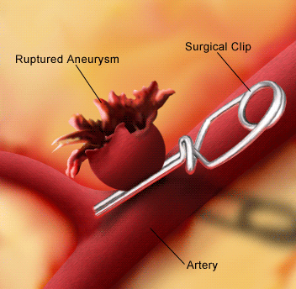

Slide 21
The law is the diagnosis – sin is the problem

Slide 22
IV. The Cure
Galatians 3:23-25

Slide 23
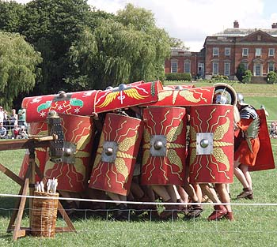
We were placed under guard and kept in custody by the law
To mount guard as a sentinel, to hem in

Slide 24
The law was our guardian (tutor) till Christ came (to lead us to Christ)

Slide 25
Made right with God through faith
No longer need the law as our guardian

Slide 26
Matthew 5:17 (NLT) “Don’t misunderstand why I have come. I did not come to abolish the law of Moses or the writings of the prophets. No, I came to accomplish their purpose. (NASB - I did not come to abolish but to fulfill)

Slide 27
Next Week – walking in the fulfillment of the Law

