Slide 2
God So Loved Series
John 3:16 For God so loved (dearly prized) the world that He gave His only begotten Son, that whoever believes in (trusts in, clings to, relies on) Him should not perish but have everlasting life.

Slide 3
Brief Biblical History
Isaac marries Rebekah – two sons Esau and Jacob

Slide 4
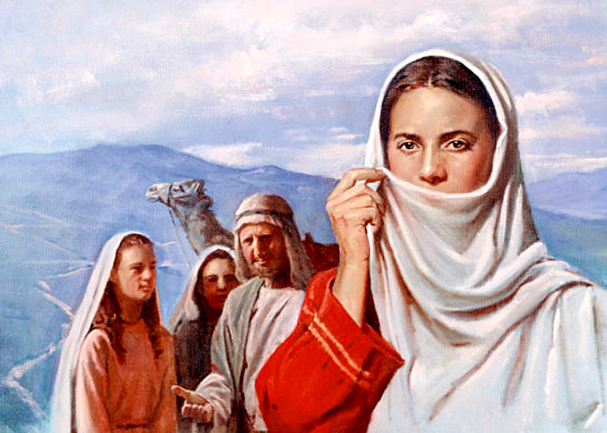
Genesis 24:64 And Rebekah lifted up her eyes, and when she saw Isaac, she lighted off the camel.

Slide 5
Jacob (Israel) – 12 Sons – including Joseph
Joseph sold by jealous brothers to slavery in Egypt
From slavery to prison to prime minister of Egypt second to Pharaoh
Famine brings Israel and family to Egypt
Become slaves in Egypt for 400 years

Slide 6
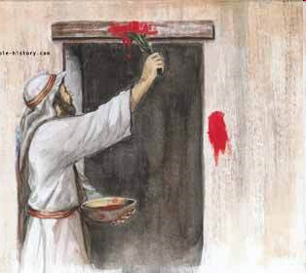
Delivered from Egypt through the leadership of Moses – saved by the blood of the Passover lamb

Slide 7
Led to take possession of the promised land (Canaan)
On the way to Canaan – Mt. Sinai

Slide 8
The Covenant of Law
God So Loved Series

Slide 9
Covenants observed so far…
Man declared righteous on the basis of God’s grace and man’s response of faith
Atonement through blood sacrifice
Now the Covenant of Law is interjected into God’s covenant with Abraham and his descendants
Is man now to be justified by keeping the Law?
Has it gone from grace to works?
Why the law?
Has God changed in the way he deals with man?

Slide 10
I. The Law – Exodus 19-23
Three Parts
Moral Law – the 10 Commandments
Civil Law – to govern Israel’s social life
Ceremonial Law – to govern Israel’s religious life – tabernacle, priesthood and sacrifice

Slide 11
Conditional Covenant – Exodus 19:5-8
If you will obey and keep my covenant
You will be my special people
Kingdom of priests, Holy nation
We will do everything the Lord has commanded

Slide 12
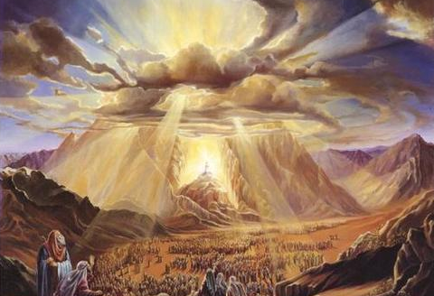
Fear of God will keep you from sinning

Slide 13
10 Commandments given 20:1-21
Ordinances given Exodus 21-23

Slide 14
II. Covenant Confirmed Exodus 24 -34
Moses declares the Lord’s instructions
People’s response – we will do everything the Lord has commanded
Sacrifices made
Moses repeats the recorded words of the Lord
People’s response – we will do everything the Lord has commanded
The covenant confirmed with blood

Slide 15
Purpose of the Covenant of Law
To regulate conduct
To define sin
To show propensity for evil
To awaken the need for God’s mercy, grace, and forgiveness
An expression of God’s Character – love, goodness, justice, and hatred of evil

Slide 16
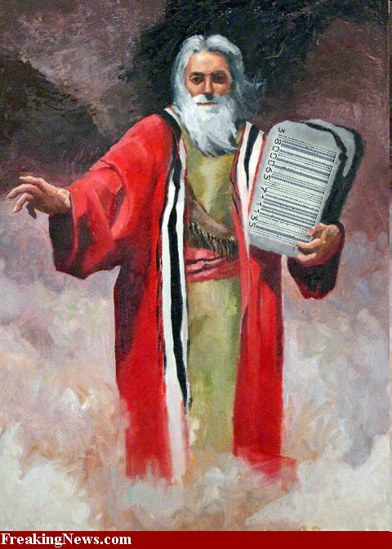
Moses on the mountain 40 days and nights
Blueprints for the tabernacle
Stone tablets of the terms of the covenant

Slide 17
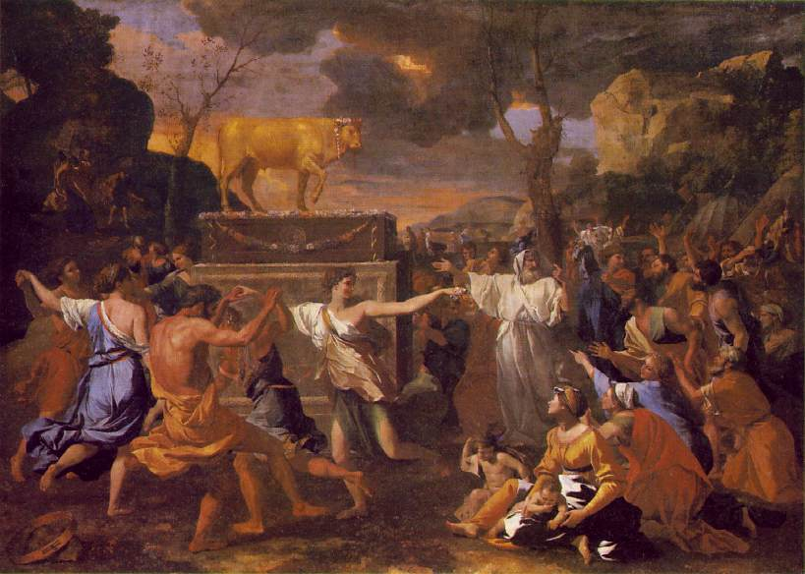
Israelites at the base of the mountain
First commandment broken

Slide 18
Moses’ appeal (intercession) – change your mind
The Lord changed his mind

Slide 19
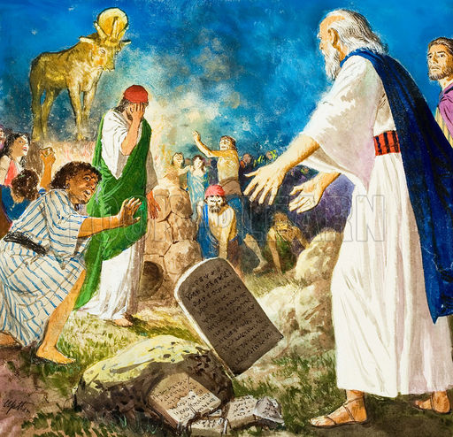

Slide 20
Moses’ Intimacy with God – Exodus 33-34
Tent of Meeting – the Lord would speak to Moses, face to face, as one to a friend
Let me know your ways – understand you more fully – continue to enjoy your favor
Psalms 103:7 (NASB) He made known His ways to Moses, His acts to the sons of Israel.
Your presence sets us apart from all other people on the earth
Show me your glory (glorious presence)
The Lord’s glory – his character and nature

Slide 21
Example of God’s Character at Nineveh (Jonah)
Jonah 3:10 - 4:3 (NLT) ¹⁰When God saw what they had done and how they had put a stop to their evil ways, he changed his mind and did not carry out the destruction he had threatened. ¹This change of plans greatly upset Jonah, and he became very angry. ²So he complained to the LORD about it: “Didn’t I say before I left home that you would do this, LORD? That is why I ran away to Tarshish! I knew that you are a merciful and compassionate God, slow to get angry and filled with unfailing love. You are eager to turn back from destroying people. ³Just kill me now, LORD! I’d rather be dead than alive if what I predicted will not happen.”

Slide 22
III. God so Loved – He Disciplined
Hebrews 3
Hardened hearts always turn away from me
Rebellious – refused to do what I tell them
Result – corpses in the wilderness

Slide 23
Hebrews 12
The Lord disciplines those he loves
His discipline is always good – that we might share in his holiness
Harvest of right living for those trained this way

Slide 24
Sinai vs. Zion
Israelites at Sinai – quaking mountain, fire, thunder, the voice of God, fear and trembling
You have come to Zion – God’s heavenly city, mediator Jesus, new covenant with God, a kingdom that is unshakable
Be careful not to refuse to listen to the one who is speaking
Not escape if we reject the one speaking from heaven

