Slide 2
God So Loved Series
John 3:16 For God so loved (dearly prized) the world that He gave His only begotten Son, that whoever believes in (trusts in, clings to, relies on) Him should not perish but have everlasting life.

Slide 3
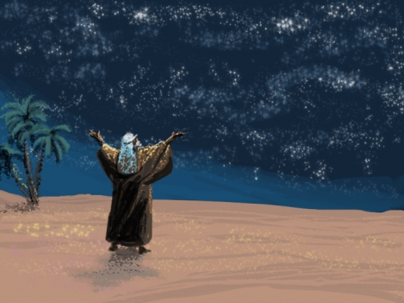

Slide 4
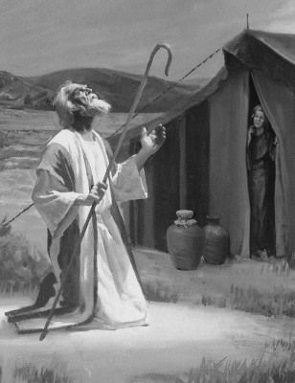

Slide 5
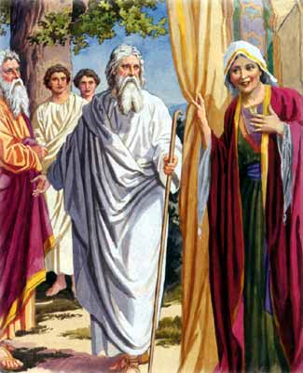

Slide 6
Abraham and Sarah’s Faith to Receive the Promise
Romans 4:18-22
No reason for hope – old man and worn out woman
Kept hoping – faith grew stronger
Fully convinced God is able to do what he promises
Hebrews 11:11-12
By faith Sarah was able to have a child
She believed God would keep his promise

Slide 7
The Blessing of Sacrifice
God So Loved Series

Slide 8
I. The Sacrifice
“It’s nice when God says what’s mine is yours, but what about when God says what’s yours is mine?”

Slide 9
Genesis 21:1-7 – Isaac is born
Genesis 22 – God tested Abraham

Slide 10
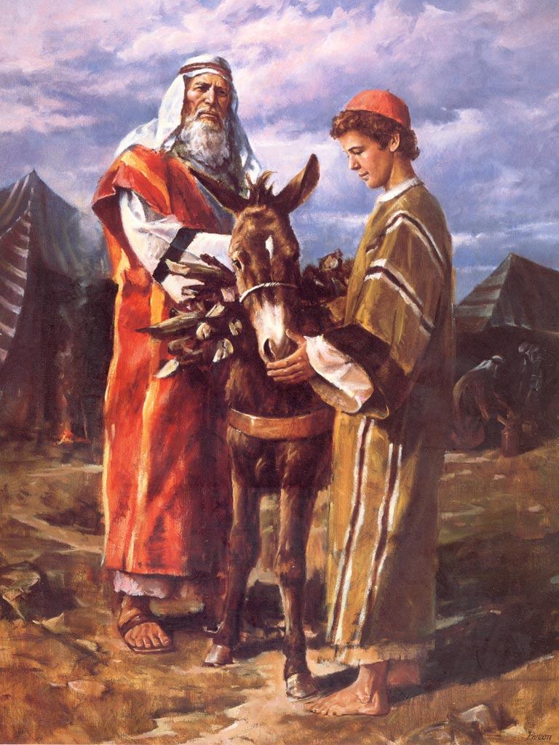
Take your only son Isaac and sacrifice him
3 day journey

Slide 11
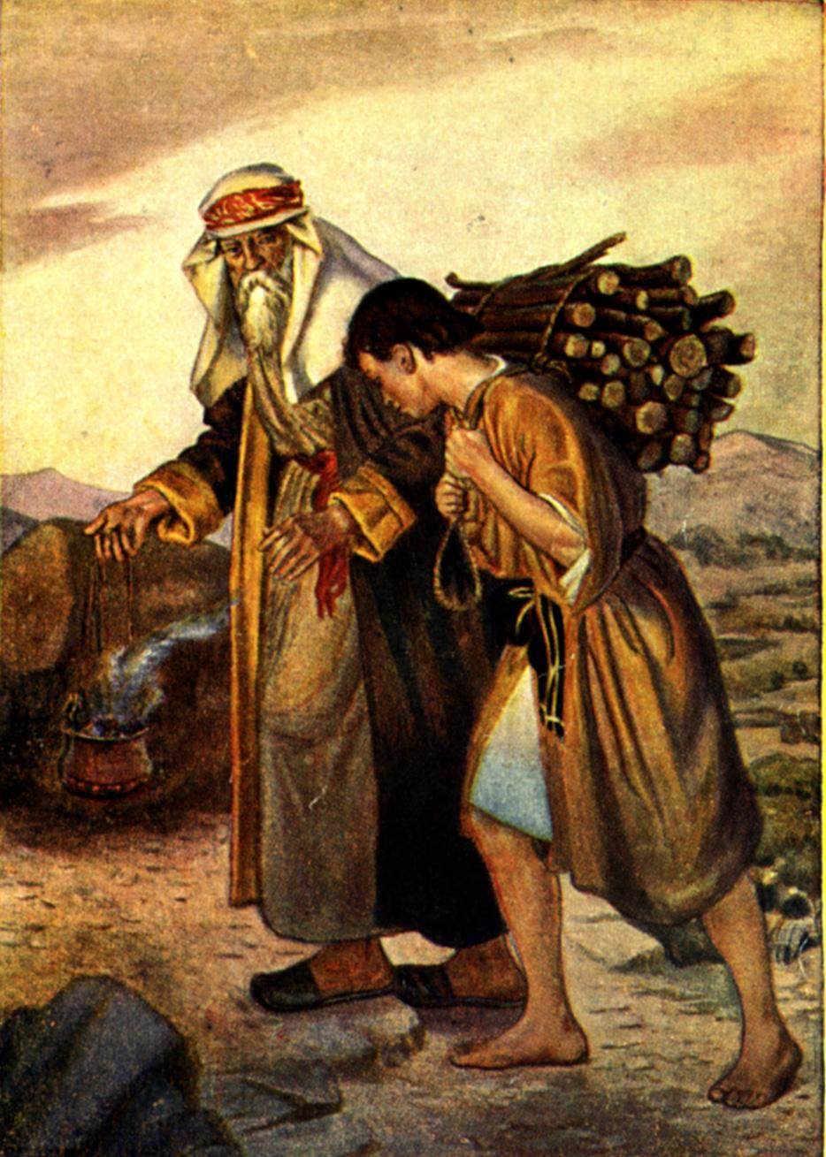
We will worship and we will return
Where is the sheep for offering?
God will provide a sheep

Slide 12
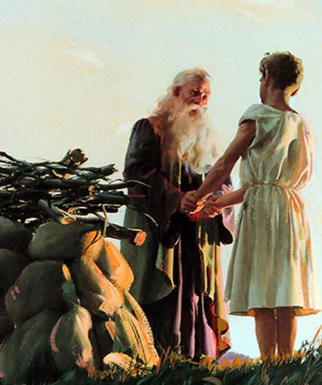
Isaac’s submission

Slide 13
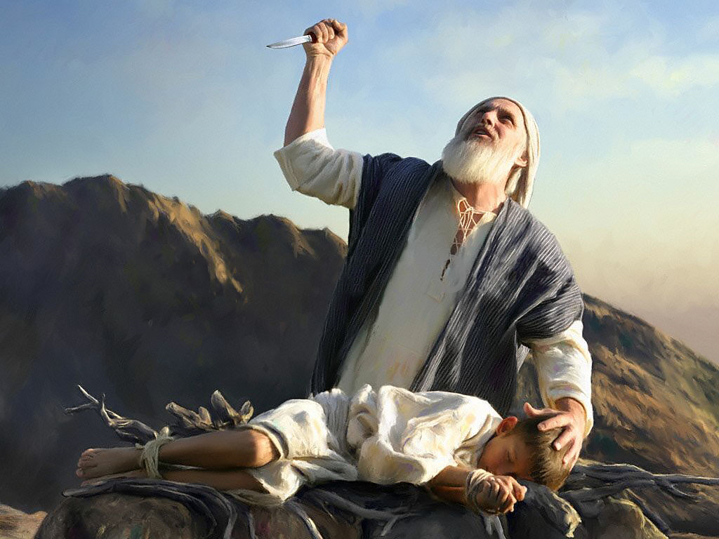
Abraham picked up his knife to kill Isaac

Slide 14
You truly fear God – you have not withheld your only son from me

Slide 15
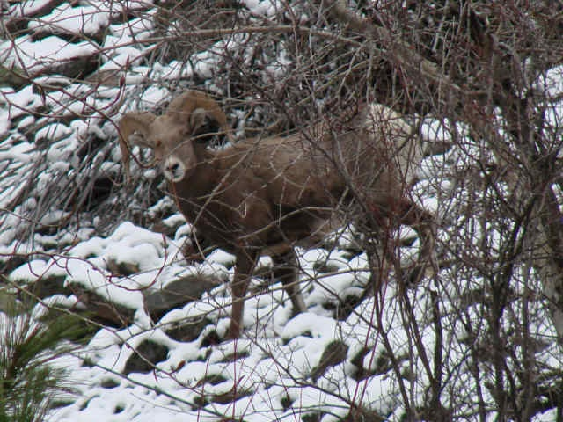
God provided the sacrifice – Jehovah Jireh

Slide 16
Hebrews 11:17-19
By faith Abraham offered Isaac as a sacrifice
Abraham reasoned – God would bring him back to life
Abraham “received” his son back from the dead

Slide 17
II. Result of Sacrifice
Genesis 22:15-18
Swear by my own name – I will bless you
Multiply descendants
Conquering descendants
Through descendants all the nations of the earth will be blessed
Because you obeyed me

Slide 18
Covenant - If you would do it, so must I – God makes his son the sacrifice
John 8:56 (NASB) “Your father Abraham rejoiced to see My day, and he saw it and was glad.”
The father sacrificing his only son
The willing son submitting to the sacrifice
An innocent substitute provided by God
The son as dead for 3 days
The son raised from the dead
All the families of the earth blessed as a result of the willingness to sacrifice

Slide 19
III. The Blessing of SELF Sacrifice
“It’s nice when God says what’s mine is yours, but what about when God says what’s yours is mine?”

Slide 20
Romans 12:1 - 2 (NLT) ¹And so, dear brothers and sisters, I plead with you to give your bodies to God because of all he has done for you. Let them be a living and holy sacrifice—the kind he will find acceptable. This is truly the way to worship him. ²Don’t copy the behavior and customs of this world, but let God transform you into a new person by changing the way you think. Then you will learn to know God’s will for you, which is good and pleasing and perfect.

Slide 21
2 Corinthians 5:14 - 15 (NLT) ¹⁴Either way, Christ’s love controls us. Since we believe that Christ died for all, we also believe that we have all died to our old life. ¹⁵He died for everyone so that those who receive his new life will no longer live for themselves. Instead, they will live for Christ, who died and was raised for them.

Slide 22
Matthew 16:24 - 26 (NLT) ²⁴Then Jesus said to his disciples, “If any of you wants to be my follower, you must turn from your selfish ways, take up your cross, and follow me. ²⁵If you try to hang on to your life, you will lose it. But if you give up your life for my sake, you will save it. ²⁶And what do you benefit if you gain the whole world but lose your own soul? Is anything worth more than your soul?

Slide 23
Luke 17:33 (NLT) If you cling to your life, you will lose it, and if you let your life go, you will save it.
…that whoever believes in (trusts in, clings to, relies on) Him should not perish but have everlasting life.

Slide 24
The only reason sacrifice is hard
You only see the death
You don’t see the life (blessing) beyond
Hebrews 12:2 (NLT) We do this by keeping our eyes on Jesus, the champion who initiates and perfects our faith. Because of the joy awaiting him, he endured the cross, disregarding its shame. Now he is seated in the place of honor beside God’s throne.

Slide 25
God so Loved…
Sacrifice your life so you can experience his
You, your family, everyone else blessed
Because you obeyed me

Slide 26
“It’s nice when God says what’s mine is yours, and it’s great when God says what’s yours is mine. It is the pathway to blessing”

