Slide 2
God So Loved Series
John 3:16 For God so loved (dearly prized) the world that He gave His only begotten Son, that whoever believes in (trusts in, clings to, relies on) Him should not perish but have everlasting life.

Slide 3
Abraham and His Seed
God So Loved Series

Slide 4
Galatians 3:29

Slide 5
I. The Call and the Promise
Genesis 12
Leave – country and relatives
Go – to the land I will show you
God is beginning a work of separating a people through whom he will bring his promised Son/Savior/Deliverer

Slide 6
Genesis 18:19 I have singled him out so that he will direct his sons and their families to keep the way of the LORD by doing what is right and just. Then I will do for Abraham all that I have promised.”

Slide 7
Seven-fold Promise
Make you a great nation
Bless you
Make your name great (famous)
You will be a blessing to others
Bless those who bless you
Curse those who curse you
All families on earth blessed through you
Abraham did as the Lord instructed
Abraham is called God’s friend

Slide 8
2 Chronicles 20:7 O our God, did you not drive out those who lived in this land when your people Israel arrived? And did you not give this land forever to the descendants of your FRIEND Abraham?
Isaiah 41:8 But as for you, Israel my servant, Jacob my chosen one, descended from Abraham my FRIEND,
James 2:23 And so it happened just as the Scriptures say: “Abraham believed God, and God counted him as righteous because of his faith.” He was even called the FRIEND of God.
But Abraham is not a man without issues

Slide 9
II. The Covenants
Genesis 15 – Covenant for Land
I have no son – so my servant will be my heir
You will have a son of your own

Slide 10
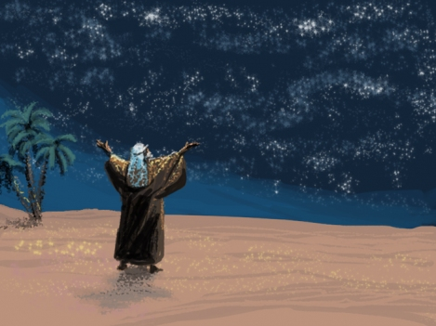
Descendents as many as the stars of the sky
Abraham believed God – counted as righteous because his faith

Slide 11
This land is your possession
How can I be sure?
The Lord made a covenant with Abraham
Hebrew – BERITH – to divide or cut in two, alluding to a sacrificial ceremony in connection with covenant making
The Lord passes between the divided animals and speaks

Slide 12
Genesis 16
A rational plan to fulfill the promise of God
Result of man’s work – Ishmael

Slide 13
Genesis 17 – Covenant of descendants
Covenant by which I will guarantee to give you countless descendants – father of a multitude
Obey the terms of the covenant
Circumcision
Your bodies will bear the mark - marking of the very organ by which they would become a multitude

Slide 14
Abraham was considered righteous because of his faith, before he was circumcised - Romans 4:10
Colossians 2:11 When you came to Christ, you were “circumcised,” but not by a physical procedure. Christ performed a spiritual circumcision—the cutting away of your sinful nature.
Romans 2:29 …And true circumcision is not merely obeying the letter of the law; rather, it is a change of heart produced by God’s Spirit.

Slide 15
III. Covenant Confirmed through Isaac – Genesis 17-18

Slide 16
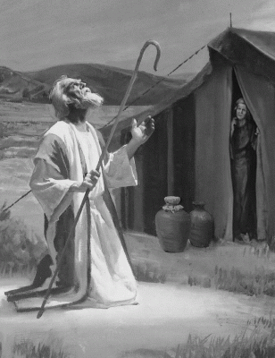
I will give you a son through Sarah
I will confirm my covenant with Isaac and descendants

Slide 17
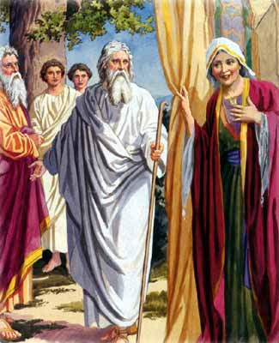
This time next year Sarah will have a son
Is anything too hard for the Lord?

Slide 18
God so loved…
Separated a family for fulfillment of a promise
Trusting and obedient – leads to friendship (Romans 5:11)
Not without doubt – but dealing with it by the help of God
Has to be the work of God, not the work of man

