Slide 2
God So Loved Series
John 3:16 For God so loved (dearly prized) the world that He gave His only begotten Son, that whoever believes in (trusts in, clings to, relies on) Him should not perish but have everlasting life.

Slide 3
Noah Found Favor
God So Loved Series

Slide 4
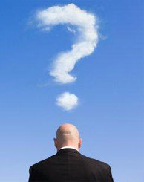
Sons of God wanted beautiful women as their wives – producing giants?
3 theories
Cosmological Mix - Angels with women of earth
Religious Mix - Descendents of godly Seth with daughters of ungodly line of Cain
Sociological mix – sons of nobles, kings, lords with daughters of commoners
Giants – Nephil, a bully or tyrant:-giant

Slide 5
I. Noah –Trusted and Trusting – Genesis 6
Condition of humanity
Only evil continually
God is sorry he made them – broken hearted
God’s judgment – destroy the human race
God’s grace – Noah found favor with God

Slide 7
Noah
Righteous, blameless, walked in close fellowship with God
Trusted – I will confirm my covenant with you
Build an ark
Waterproof it with tar (pitch) inside and out

Slide 8
Pitch – 3722 - kaphar kaw-far‘ to cover (specifically with bitumen); figuratively to expiate or condone, to placate or cancel:—appease, make (an) atonement, cleanse, disannul, forgive, be merciful, pacify, pardon, to pitch, purge (away), put off, (make) reconcile (-liation).
Translated “pitch” 1 time
Translated “atonement” 69 times
Leviticus 17:11 (KJV) For the life of the flesh is in the blood: and I have given it to you upon the altar to make an ATONEMENT for your souls: for it is the blood that maketh an ATONEMENT for the soul.

Slide 9
Compared to “Pitch” 2203– Exodus 2:3 And when she could not longer hide him, she took for him an ark of bulrushes, and daubed it with slime and with PITCH, and put the child therein; and she laid it in the flags by the river’s brink. zepheth zeh'-feth (meaning to liquify); asphalt (from its tendency to soften in the sun):—pitch.
What is God saying to Noah when he tells him to pitch it inside and out? – Your salvation is in the atonement

Slide 10
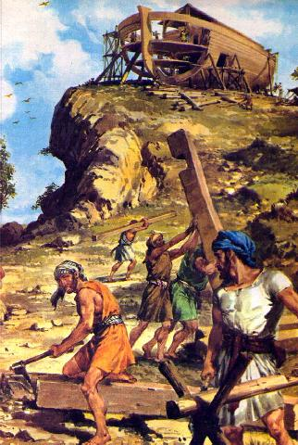
Trusting - Noah did everything exactly as God commanded

Slide 11
Hebrews 11:7 It was by faith that Noah built a large boat to save his family from the flood. He obeyed God, who warned him about things that had never happened before. By his faith Noah condemned the rest of the world, and he received the righteousness that comes by faith.

Slide 12
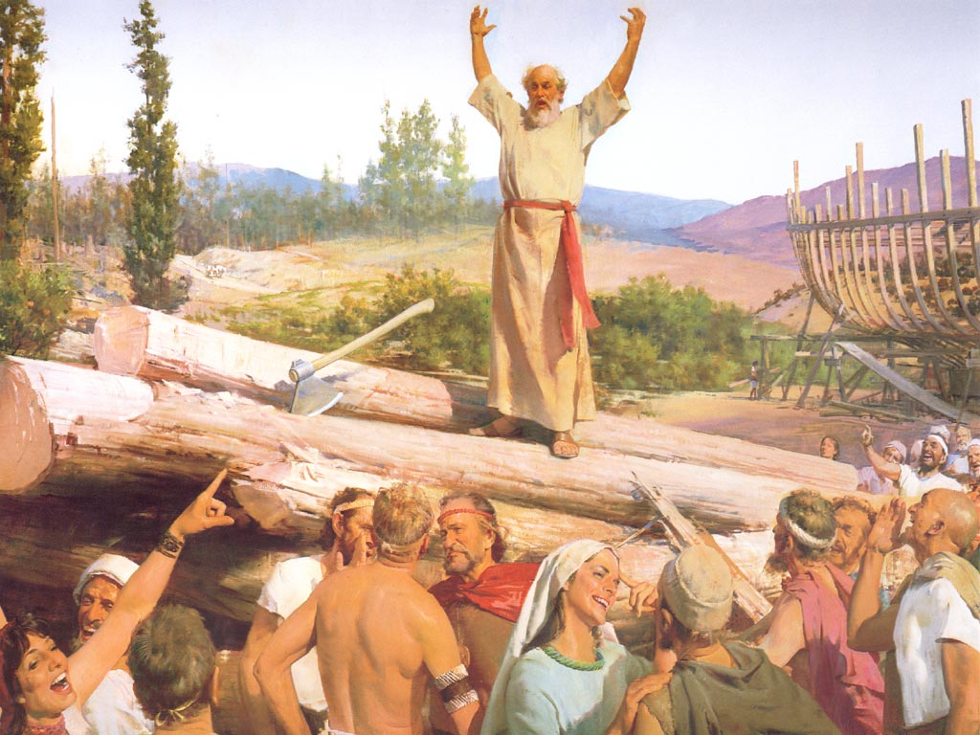
Noah preacher of righteousness - 2 Peter 2:5 [God] did not spare the ancient world, but preserved Noah, a preacher of righteousness, with seven others, when He brought a flood upon the world of the ungodly;

Slide 13
II. The Flood – Genesis 7,8
The completed ark – everything ready – 100 year building project (Noah 600 years old)
Your family
Animals – for reproducing, for eating, for sacrifice

Slide 14
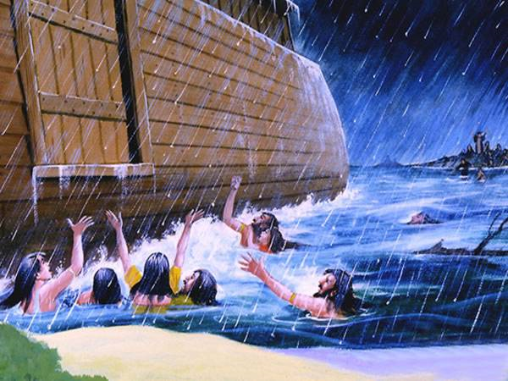
The Lord closed the door

Slide 15
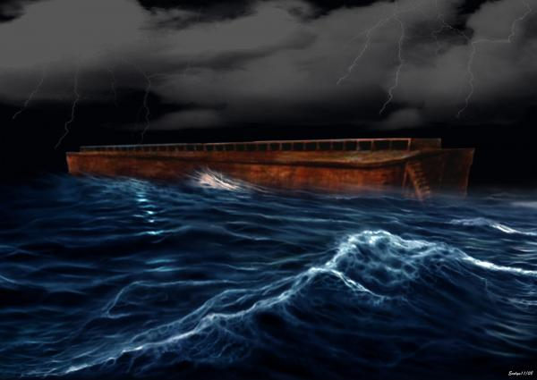
Flood waters cover the earth

Slide 16
III. God’s Covenant – Genesis 8,9

Slide 17
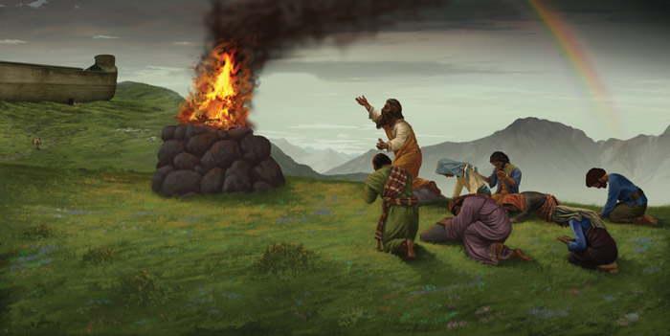
Noah makes blood sacrifice – the Lord was pleased

Slide 18
Unconditional Covenant – “I will…”

Slide 19
Never again curse the ground, with flood waters destroy the earth, kill all living creatures

Slide 20
There will always be the seasons and seedtime and harvest

Slide 21
Covenant confirmed – sign of the covenant - Rainbow

Slide 22
IV. Present Truth – God so loved (loves)…
Matthew 24:37-38
Jesus’ return like the days of Noah
People didn’t realize what was going to happen
Judgment came

Slide 23
1 Peter 3:18-21
Jesus died to bring you safely home to God
Those who disobeyed God when God patiently waited while Noah built the ark
The flood – baptism – not removal of dirt, but response to God

Slide 24
1 John 4:16-18
Put our trust in his love
Living in God – no fear of day of judgment
Fear of judgment? – not fully experienced his perfect love

Slide 26
2 Corinthians 5:19 - 20 ¹⁹For God was in Christ, reconciling the world to himself, no longer counting people’s sins against them. And he gave us this wonderful message of reconciliation. ²⁰So we are Christ’s ambassadors; God is making his appeal through us. We speak for Christ when we plead, “Come back to God!”

Slide 27
Romans 10:9 - 10 ⁹If you confess with your mouth that Jesus is Lord and believe in your heart that God raised him from the dead, you will be saved. ¹⁰For it is by believing in your heart that you are made right with God, and it is by confessing with your mouth that you are saved.

