Slide 2
God So Loved Series
John 3:16 For God so loved (dearly prized) the world that He gave His only begotten Son, that whoever believes in (trusts in, clings to, relies on) Him should not perish but have everlasting life.

Slide 3
Adam Outside the Garden
God So Loved Series

Slide 4
I. The Fall
Genesis 3:1-7
Satan’s lies
Did God really say…?
You won’t die
The woman was convinced – she took and ate
He ate it too
E.L.E. – Extinction Level Event

Slide 5
Curse – consequences of disobedience – Genesis 3:8-19
Shame and blame
Afraid, hid, naked
Adam - the woman you gave me
Eve - the serpent deceived me
Satan – serpent most cursed
Woman – childbirth will be hard, husband will rule
Man – struggle for your living, to dust you will return

Slide 6
Earth –
Romans 8:20 - 22 ²⁰Against its will, all creation was subjected to God’s curse. But with eager hope, ²¹the creation looks forward to the day when it will join God’s children in glorious freedom from death and decay. ²²For we know that all creation has been groaning as in the pains of childbirth right up to the present time.
2 Peter 3:10-13

Slide 7
Promise –
Seed of the woman – virgin birth
Crush the head of Satan – end of destructive work

Slide 8
II. Atonement
Atonement defined - The covering over of sin, the reconciliation between God and man
The shedding of blood – Genesis 3:21
Different covenant given to order life after sin and outside of the garden

Slide 9
Forgiveness
Leviticus 17:11,14 (NLT) ¹¹for the life of the body is in its blood. I have given you the blood on the altar to purify you, making you right with the LORD. It is the blood, given in exchange for a life, that makes purification possible.¹⁴The life of every creature is in its blood…
Hebrews 9:22 (NLT) In fact, according to the law of Moses, nearly everything was purified with blood. For without the shedding of blood, there is no forgiveness.

Slide 10
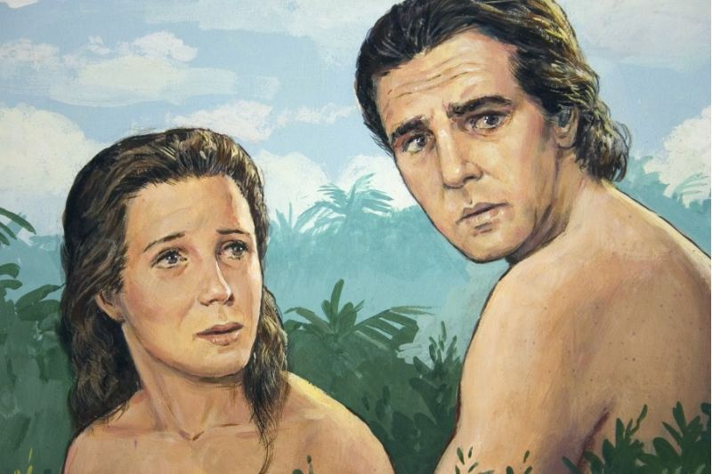
The covering from animal skins – God’s work, not man’s

Slide 11
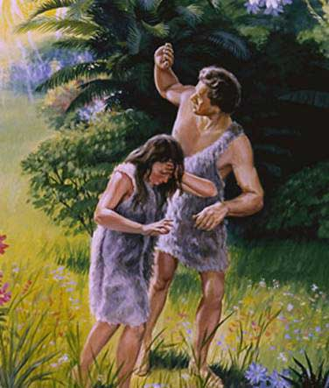

Slide 12
III. A Covenant Requiring Blood Sacrifice
Genesis 4:1-12

Slide 13
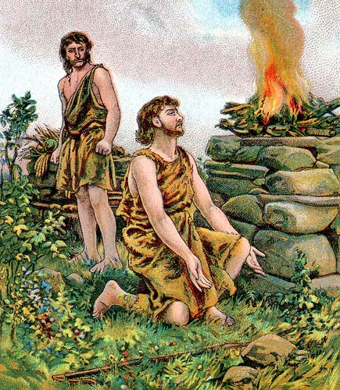
Abel’s gift to the Lord – best of the firstborn lambs – accepted by God

Slide 14
Hebrews 11:4 (NLT) It was by faith that Abel brought a more acceptable offering to God than Cain did. Abel’s offering gave evidence that he was a righteous man, and God showed his approval of his gifts. Although Abel is long dead, he still speaks to us by his example of faith.

Slide 15
Cain’s gift to the Lord – some of his crops – not accepted by God

Slide 16
Cain’s anger
God’s grace
Do what is right
Sin is eager to control you
You must master it
Cain’s sin - Pride

Slide 17
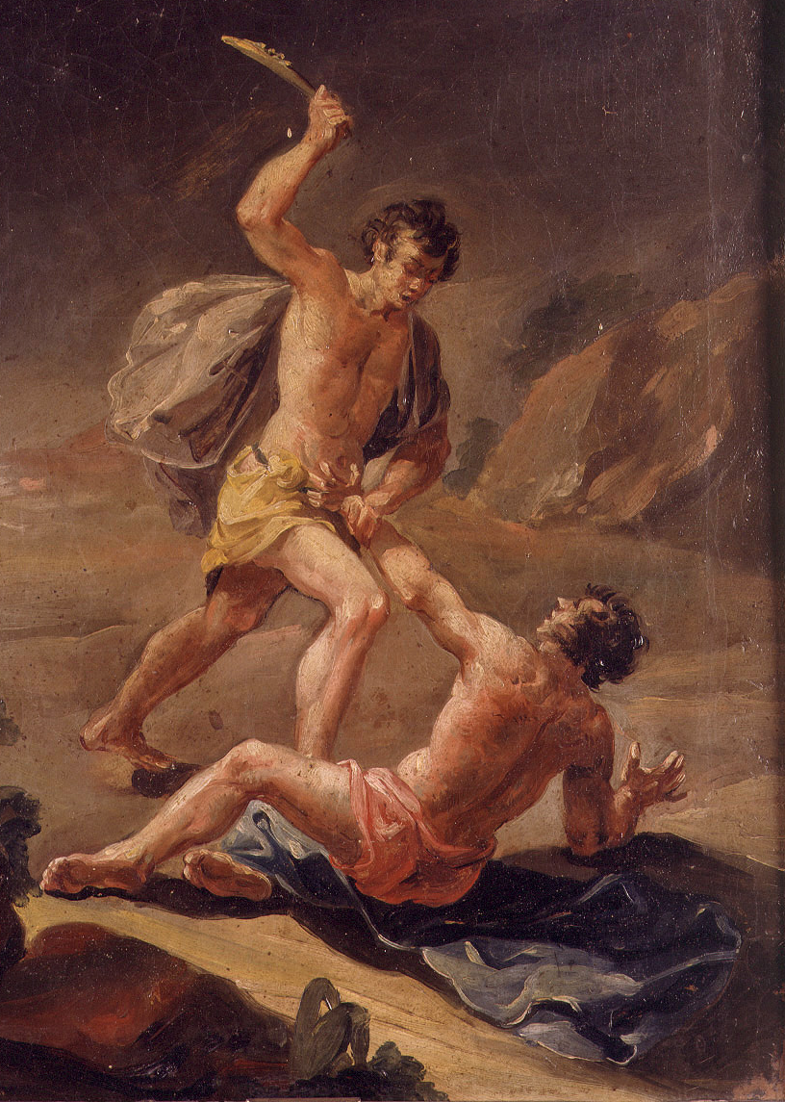
Cain kills Abel
Knew how – death by bleeding
Your brother’s blood cries out to me
Cain’s curse – homeless wanderer

Slide 18
IV. God So Loved…
When Adam and Eve sinned – he made a way for them to be reconciled to him
He proclaimed the virgin born child that would destroy the works of the enemy
He warned Cain of the results of his choice – soliciting a response – Faith in God’s works
He allowed Cain to still choose – even when it cost Abel his life

Slide 19
If God is a loving God, why do the innocent suffer? – 1 Peter 4:12-13, 19
Romans 8:18 - 19 ¹⁸Yet what we suffer now is nothing compared to the glory he will reveal to us later. ¹⁹For all creation is waiting eagerly for that future day when God will reveal who his children really are.

