Slide 2
God So Loved
God So Loved Series

Slide 3
I. Introduction and Objectives
Being established in the foundational truth of God’s unconditional love for all
Knowing that God’s love is the motivation for His dealings with people
God’s Love and it’s resultant expressions are the basis for our abundant life in Christ Jesus
Understanding God’s love expressed in His eternal covenant established in Jesus
Nothing can separate you from God’s love

Slide 4
God so loved the world…
John 3:16 (NKJV) For God so loved the world that He gave His only begotten Son, that whoever believes in Him should not perish but have everlasting life.
John 3:16 (AMP) For God so greatly loved and dearly prized the world that He [even] gave up His only begotten (unique) Son, so that whoever believes in (trusts in, clings to, relies on) Him shall not perish (come to destruction, be lost) but have eternal (everlasting) life

Slide 5
No greater love…
John 15:13 (NASB) Greater love has no one than this, that one lay down his life for his friends.
God is love – 1 John 4:9-10
God showed his love by sending Jesus
A sacrifice to take away our sin
So we could have eternal life
The solicited response
His love brought to full expression in us
Know how much he loves us
Put our trust in his love

Slide 6
God’s gift and our response
God’s gift – grace – the unearned favor of God
Our response – faith – trust in the person and work of God
Ephesians 2:8 - 9 (NASB) ⁸For by grace you have been saved through faith; and that not of yourselves, it is the gift of God; ⁹not as a result of works, so that no one may boast.

Slide 7
II. Covenant of Grace
God’s dealings with man – covenant
Covenant Defined – an agreement between men or between God and men
Contrast with contract
Grace and mercy on God’s part
Shared assets and liabilities

Slide 8
Hebrew – BERITH – to divide or cut in two, alluding to a sacrificial ceremony in connection with covenant making
Greek – DIATHEKE – primarily signifies a disposition of property by will or otherwise (will or testament)

Slide 9
Biblical Covenants
Conditional – depends on man, recognized in the formula “if you…then…”
Unconditional – depends on God alone, recognized in the formula “I will…”
Covenants of…
Eden
Adam
Noah
Abraham
Law
New

Slide 10
III. Eden – Genesis 1,2
The love of God as expressed in creation
The environment – wows man (Job 38)

Slide 11
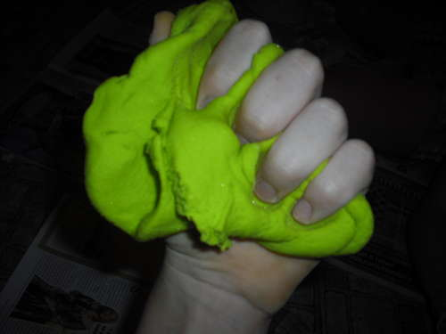
The breath of God in his claydough

Slide 12
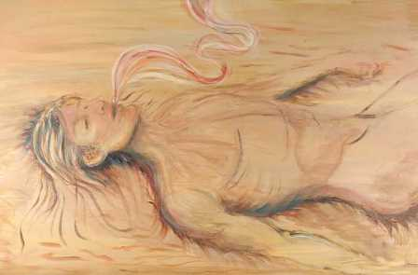
Spirit

Slide 13
The animals

Slide 14
The just right helper
NASB Fashioned - built

Slide 15
Order in the garden - You rule – you subdue
Eat anything except…
Solicited response
Established choice
Freewill
Condition – if you eat – you will die
The E.L.E. – Extinction Level Event
Broken covenant – the fall of man

