Slide 2
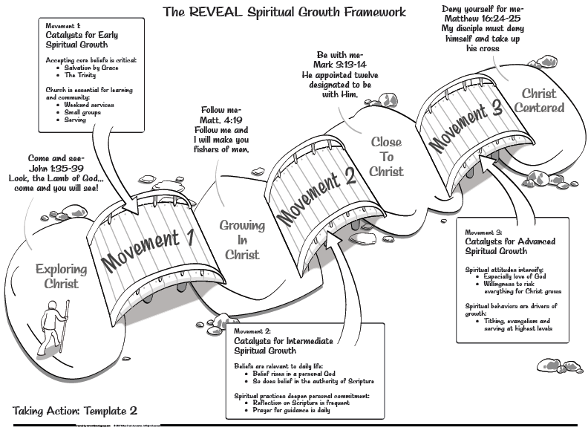

Slide 3
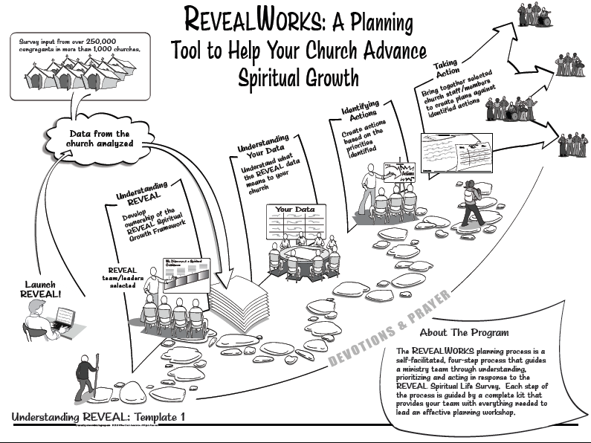

Slide 4
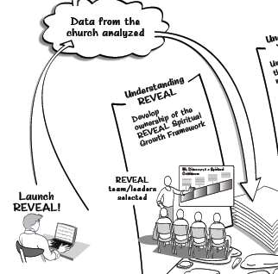

Slide 5
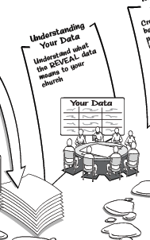

Slide 6
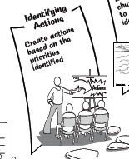

Slide 7
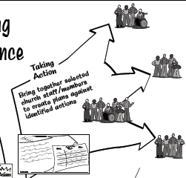

Slide 8
From 1 Thessalonians
Commending them in their relationship with the Lord
Challenging them to step it up
Filling in the gaps of their understanding
How now they should live
Expectation of the Lord’s return

Slide 9
Living in the Light 1 Thessalonians 5
Encouraged in Your Faith Series

Slide 10
I. No Surprise – 1 Thessalonians 5:1-11
How and when this all will happen
The day of the Lord’s return

Slide 11
Like a thief in the night
sudden and unexpected

Slide 12
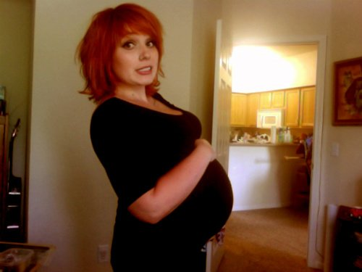
Like a pregnant woman’s labor pains
Certain, sudden, unavoidable

Slide 13
False sense of security - disaster will fall suddenly
No escape

Slide 14
You aren’t in the dark
You won’t be surprised
You are children of light

Slide 15
Darkness
Represents unalert (sleeping)
Represents unsound judgment (drunk)

Slide 16
Stay alert
Clear headed
Not ignorant
Not impaired
Protected by the armor
Helmet of salvation - confidence

Slide 17
Chosen for salvation – not judgment
1 Thessalonians 1:10 …Jesus, … He is the one who has rescued us from the terrors of the coming judgment.
Whether dead or alive when he returns – we live with him forever
1 Corinthians 15:51-58
All transformed
Mortal bodies transformed into immortal
Death swallowed up in victory
Victory over sin and death by our Lord Jesus Christ
Encourage each other with these words – as you are doing

Slide 18
II. P.S. - 5:12-19
Honor (respect) those who are leaders in the Lord’s work

Slide 19
1 Peter 5:2-4 (NLT) ² Care for the flock that God has entrusted to you. Watch over it willingly, not grudgingly—not for what you will get out of it, but because you are eager to serve God. ³ Don’t lord it over the people assigned to your care, but lead them by your own good example. ⁴ And when the Great Shepherd appears, you will receive a crown of never-ending glory and honor.

Slide 20
Warn the lazy
Encourage the timid
Care for the weak
Be patient with everyone
Don’t pay back evil – do good to all people
Always be joyful
Never stop praying
Be thankful in all circumstances
Don’t stifle, quench, suppress the Holy Spirit- Do not put out the Spirit's fire (NIV)
Stay away from every kind of evil

Slide 21
III. Benedictions – 5:23-28
May God keep you holy and blameless
Spirit
Soul
Body
Pray for us
Greet one another
Read this to all the brothers and sisters
May the grace of our Lord Jesus Christ be with you – (beginning and ending with God’s grace)

Slide 22
Conclusion
Paul wrote to strengthen their faith and bolster their resistance to persecution and temptation
Make sure that we continue in our faith and don't become sidetracked by wrong beliefs or practices.
Better equip us to help our brothers and sisters in Christ

