Slide 1
Encouraged in Your Faith Series
Paul’s First Letter to the Thessalonians
Commending them in their relationship with the Lord
Challenging them to step it up
Filling in the gaps of their understanding
How now they should live
Expectation of the Lord’s return

Slide 2
Living to Please God 1 Thessalonians 4
Encouraged in Your Faith Series

Slide 3
2 Corinthians 5:8-9 (NLT) ⁸ Yes, we are fully confident, and we would rather be away from these earthly bodies, for then we will be at home with the Lord. ⁹ So whether we are here in this body or away from this body, our goal is to please him.

Slide 4
I. God’s Will for You
Step it up: 4:1-2
Live in a way that pleases God
You live this way already
Do so even more
Be holy: 4:3-8

Slide 5
Stay away from sexual sin
Control your own body
Live in holiness and honor
Not lustful passion
Not rejecting God

Slide 6
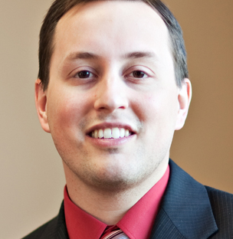
Trevin Wax - Managing Editor of The Gospel Project at LifeWay Christian Resources “How I Wish the Homosexuality Debate Would Go”

Slide 7
4:9-11
Love one another
Already showing love
Even so love them even more – step it up
Mind your own business
A quiet life
Non-Christians will respect you

Slide 8
II. The Resurrection and Rapture
2 Corinthians 5:8-9 (NLT) ⁸ Yes, we are fully confident, and we would rather be away from these earthly bodies, for then we will be at home with the Lord. ⁹ So whether we are here in this body or away from this body, our goal is to please him.

Slide 9
4:13-14
Know what will happen to believers who have died
Not grieve like people with no hope
1 Corinthians 15:17-20 (NLT) ¹⁷ And if Christ has not been raised, then your faith is useless and you are still guilty of your sins. ¹⁸ In that case, all who have died believing in Christ are lost! ¹⁹ And if our hope in Christ is only for this life, we are more to be pitied than anyone in the world. ²⁰ But in fact, Christ has been raised from the dead. He is the first of a great harvest of all who have died.

Slide 10
4:15-17
The Lord himself will come down from heaven
The voice of the archangel and the trumpet blast
Resurrection – Christians who have died
Rapture – catching away of the saints
With the Lord forever
4:18 – So encourage each other with these words

Slide 11
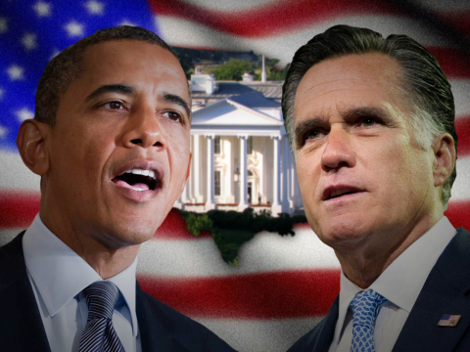

Slide 12
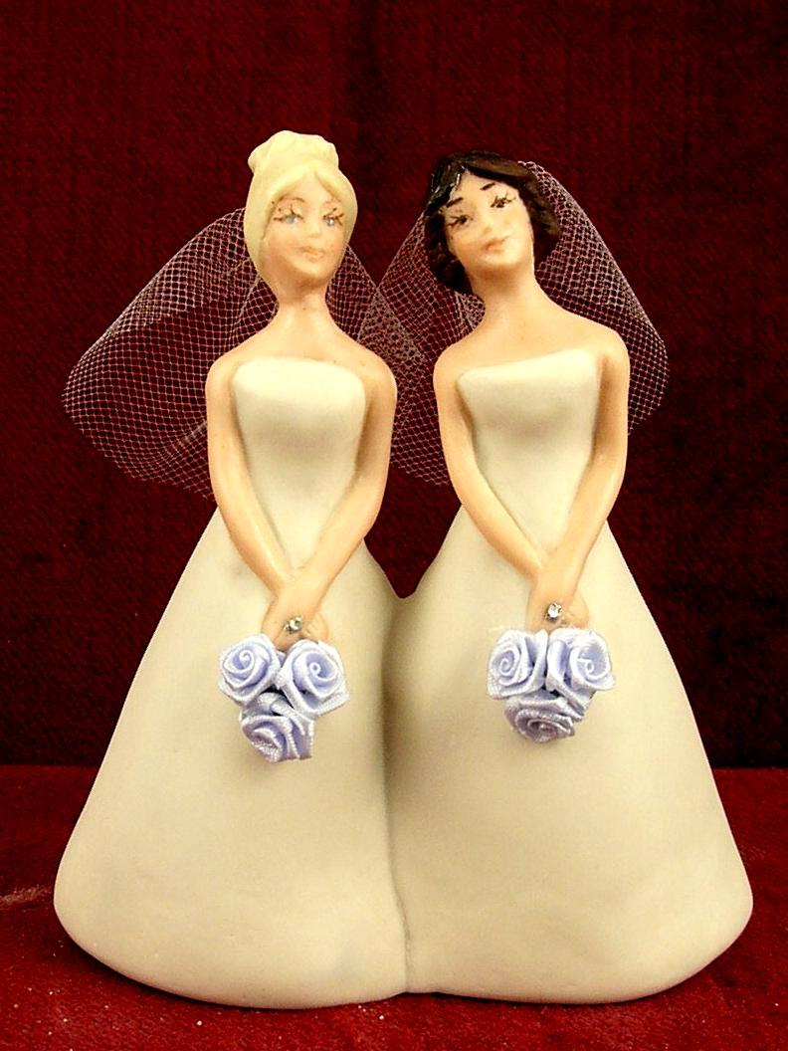
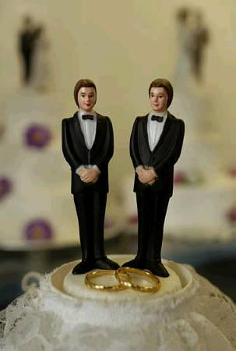

Slide 13
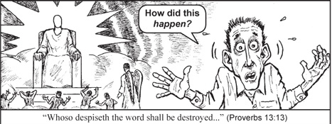

Slide 15
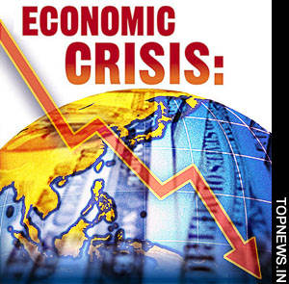

Slide 16
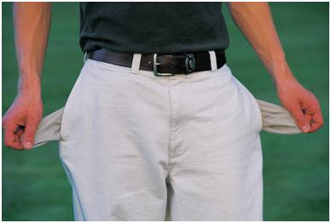

Slide 17
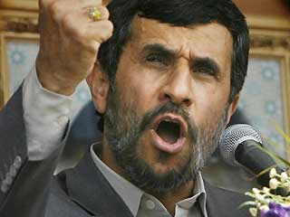

Slide 18
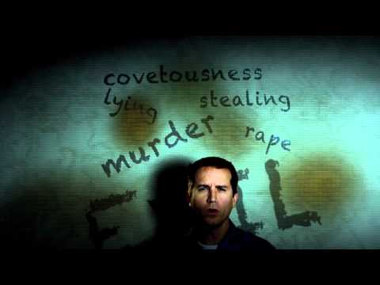

Slide 19
Revelation 21:1-4 (NLT) ¹ Then I saw a new heaven and a new earth, for the old heaven and the old earth had disappeared. And the sea was also gone. ² And I saw the holy city, the new Jerusalem, coming down from God out of heaven like a bride beautifully dressed for her husband. ³ I heard a loud shout from the throne, saying, “Look, God’s home is now among his people! He will live with them, and they will be his people. God himself will be with them. ⁴ He will wipe every tear from their eyes, and there will be no more death or sorrow or crying or pain. All these things are gone forever.”

Slide 21
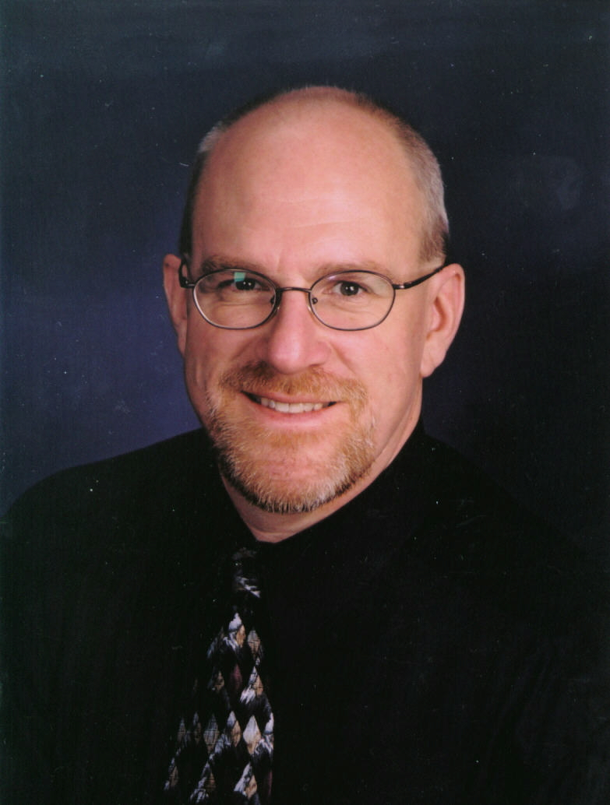
“I love you and…”

