Slide 2
Standing Firm in the Lord 1 Thessalonians 3
Encouraged in Your Faith Series

Slide 3
I. Troubles and Temptations
1 Thessalonians 3:1-5
Paul unable to return to Thessalonica
Sent Timothy
Encourage them in their faith
Keep from being shaken by troubles

Slide 4
The trouble or triumph with troubles
Destined for troubles – don’t understand – if faithful
Faith tested - weary
Opportunity for temptations
H-hungry
A-angry
L-lonely
T-tired

Slide 5
II. Standing Firm in the Lord
1 Thessalonians 3:6-10
Good news about your faith and love
Faith tested – completing
James 1:3-4 (NLT) ³ For you know that when your faith is tested, your endurance has a chance to grow. ⁴ So let it grow, for when your endurance is fully developed, you will be perfect and complete, needing nothing.

Slide 6
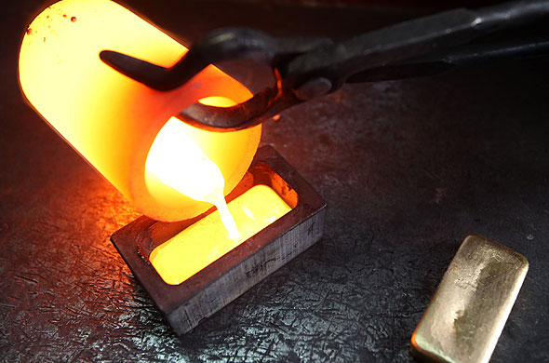
1 Peter 1:7 (NLT) ⁷ These trials will show that your faith is genuine. It is being tested as fire tests and purifies gold—though your faith is far more precious than mere gold. So when your faith remains strong through many trials, it will bring you much praise and glory and honor on the day when Jesus Christ is revealed to the whole world.

Slide 7
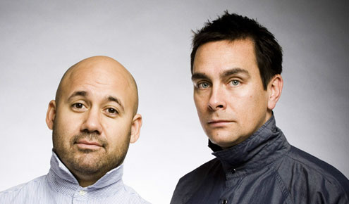
You have remained strong in your faith
You are standing firm in the Lord
Skit Guys – What Keeps You from Following God?

Slide 8
Prayer for you – to see you – to fill the gaps in your faith
Colossians 1:28 (NASB) ²⁸ We proclaim Him, admonishing every man and teaching every man with all wisdom, so that we may present every man complete in Christ.
John 16:12 (NASB) ¹² "I have many more things to say to you, but you cannot bear them now.

Slide 9
III. Blameless Before God
1 Thessalonians 3:11-13
Commended for their love (1:3; 3:6)
Now step it up – may the Lord make it grow and overflow
Result – hearts strong, blameless and holy as you stand before God

Slide 10
Jude 1:24 (NLT) ²⁴ Now all glory to God, who is able to keep you from falling away and will bring you with great joy into his glorious presence without a single fault.
Jude 1:24 (NASB) ²⁴ Now to Him who is able to keep you from stumbling, and to make you stand in the presence of His glory blameless with great joy,

