Slide 2
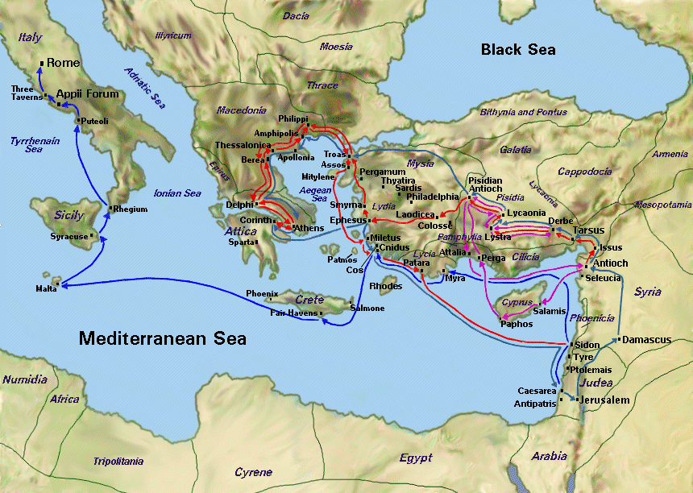

Slide 3
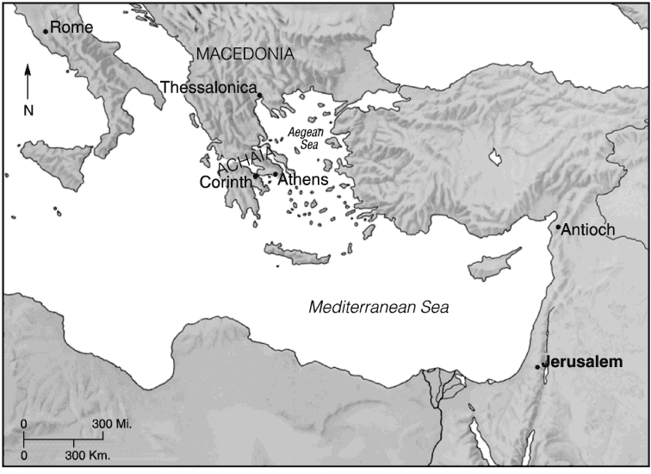

Slide 4
Becoming Examples 1 Thessalonians 1
Encouraged in Your Faith Series

Slide 5
I. A Commendation
1 Thessalonians 1:1-3
Thank God for you
Pray for you constantly
Your faithful work
Your loving deeds
Your enduring hope

Slide 6
1 Thessalonians 1:3 (NIV) We continually remember before our God and Father your work produced by faith, your labor prompted by love, and your endurance inspired by hope in our Lord Jesus Christ.
Faith, Hope, and Love
1 Corinthians 13:13 (NASB) ¹³ But now faith, hope, love, abide these three; but the greatest of these is love.

Slide 7
Faithful Work – Work produced by faith
Ephesians 2:8-10 (NASB) ⁸ For by grace you have been saved through faith; and that not of yourselves, it is the gift of God; ⁹ not as a result of works, so that no one may boast. ¹⁰ For we are His workmanship, created in Christ Jesus for good works, which God prepared beforehand so that we would walk in them.
James 2:26 (NASB) ²⁶ For just as the body without the spirit is dead, so also faith without works is dead.

Slide 8
Loving deeds – labor prompted by love
Work – Greek – ergon (to do); Definition: work
Labor – Greek - kopos Definition: laborious toil
John 15:13 (NLT) ¹³ There is no greater love than to lay down one’s life for one’s friends.
1 John 3:16 (NLT) ¹⁶ We know what real love is because Jesus gave up his life for us. So we also ought to give up our lives for our brothers and sisters.

Slide 9
James 2:14-16 (NLT) ¹⁴ What good is it, dear brothers and sisters, if you say you have faith but don’t show it by your actions? Can that kind of faith save anyone? ¹⁵ Suppose you see a brother or sister who has no food or clothing, ¹⁶ and you say, “Good-bye and have a good day; stay warm and eat well”—but then you don’t give that person any food or clothing. What good does that do?

Slide 10
Enduring hope – endurance inspired by hope
Endurance – Greek - hypomonē: hoop-om-on-ay‘ – strong fortitude in the face of opposition (Not just a passive acceptance)
Romans 12:9-13

Slide 11
II. Become an Example
1 Thessalonians 1:4-7
The Good News delivered – not just with words but with power
Holy Spirit confirmation of truth brought assurance

Slide 12
1 Corinthians 2:4-5 (NASB) ⁴ and my message and my preaching were not in persuasive words of wisdom, but in demonstration of the Spirit and of power, ⁵ so that your faith would not rest on the wisdom of men, but on the power of God.
Received with joy – even with suffering
Result – an example to all believers

Slide 13
III. A Witness (Testimony)
1 Thessalonians 1:8-10
The Word is ringing out everywhere
People are telling us about your faith in God
Turned from idols
To serve the living God
Looking forward to the return of Jesus

Slide 14
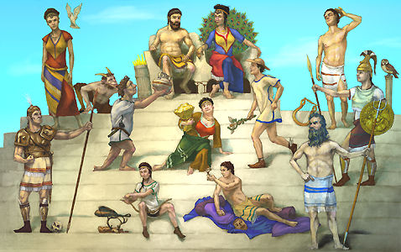
Turned from idols

Slide 15
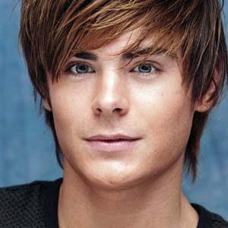
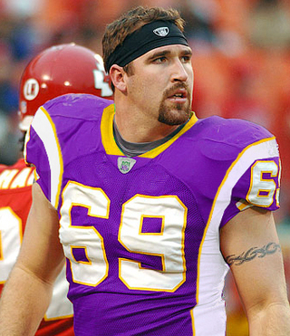
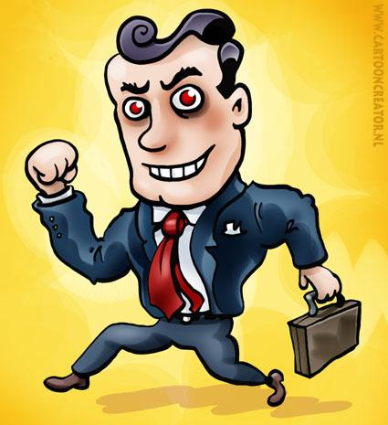
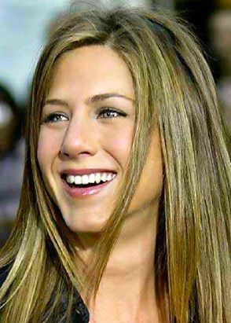
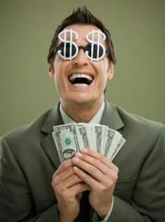
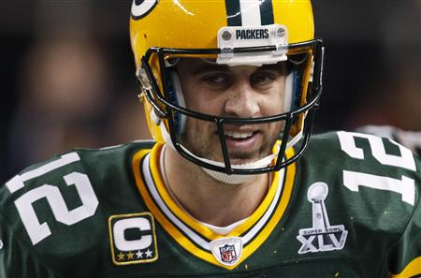
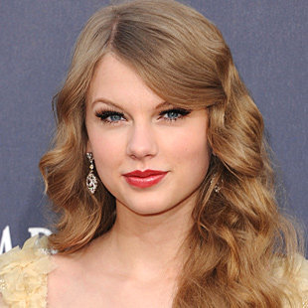
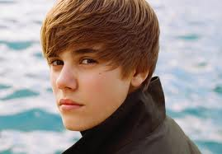
Romans 1:21-23
Application – today’s idols

Slide 16
Serving the living God
Auto response -2 Corinthians 5:14-15 (NLT) ¹⁴ Either way, Christ’s love controls us. Since we believe that Christ died for all, we also believe that we have all died to our old life. ¹⁵ He died for everyone so that those who receive his new life will no longer live for themselves. Instead, they will live for Christ, who died and was raised for them.
Works motivated by faith
Labor motivated by love

Slide 17
Serving the living God
Auto response -2 Corinthians 5:14-15 (NLT) ¹⁴ Either way, Christ’s love controls us. Since we believe that Christ died for all, we also believe that we have all died to our old life. ¹⁵ He died for everyone so that those who receive his new life will no longer live for themselves. Instead, they will live for Christ, who died and was raised for them.
Works motivated by faith
Labor motivated by love

Slide 18
Looking forward to the return of Jesus
The one who rescued us from the terrors of the coming judgment
2 Peter 3:8-14
The day of the Lord will come – unexpected
Everything found to deserve judgment – destroyed
Looking forward to that day – new heavens, new earth
So – make every effort to be found living peaceful lives that are pure and blameless

