Slide 2
Genuine Relationship
Cultivating Spiritual Awareness Series

Slide 3
More about Relationship than Knowledge
Effective witness – ordinary men, not trained in the scriptures, had been with Jesus
Authority over forces of darkness – I know Jesus, and I know Paul, but who are you
Submit to God, resist the devil, he will flee

Slide 4
2 Corinthians 13:5-14
Examine yourselves to see if your faith is genuine
Receive correction
We must always stand for the truth
We pray that you become mature
Live in harmony and peace
Grace of Jesus, Love of God, Fellowship of Holy Spirit be with you

Slide 5
I. Become Mature
1 Corinthians 3:1-3
Couldn’t talk to you as spiritual
Jealous, quarrelsome, controlled by sinful nature
Harmony and peace?
Still infants – need milk, not solid food

Slide 6
Hebrews 5:11-14
Spiritually dull and don’t listen
Ought to be teachers by now
Need someone to teach you the basics
Babies who need milk
Solid food is for the mature
Trained to recognize right and wrong

Slide 7
II. Fellowship With God
2 Corinthians 13:14 May the grace of the Lord Jesus Christ, the love of God, and the fellowship of the Holy Spirit be with you all.

Slide 8
The Grace of Jesus
Saved by grace through faith
Enabled by grace
The Love of God
Nothing can separate us from his love
The Fellowship of the Holy Spirit
Fellowship – koinonia - partnership, that is, (literally) participation, or (social) intercourse, or (pecuniary) benefaction:—(to) communicate (-ation), communion, (contri-), distribution, fellowship.

Slide 9
Communion of the Holy Spirit
2 Corinthians 13:14 (TMSG) The amazing grace of the Master, Jesus Christ, the extravagant love of God, the intimate friendship of the Holy Spirit, be with all of you.

Slide 10
1 Corinthians 2:10-12
Only God’s Spirit knows God’s thoughts
We have received God’s Spirit so we can know the wonderful things God has freely given us

Slide 11
Partnership of the Holy Spirit
Luke 5:10 His partners (koinonos), James and John, the sons of Zebedee, were also amazed. Jesus replied to Simon, “Don’t be afraid! From now on you’ll be fishing for people!”

Slide 12
Partner in revelation – John 16:13 When the Spirit of truth comes, he will guide you into all truth. He will not speak on his own but will tell you what he has heard. He will tell you about the future.
He will guide you into all truth
He will tell you what he has heard
Ears to hear?

Slide 13
Partner in glorifying Jesus – John 16:14-15 ¹⁴He will bring me glory by telling you whatever he receives from me. ¹⁵All that belongs to the Father is mine; this is why I said, ‘The Spirit will tell you whatever he receives from me.’
He will bring Jesus glory
Spirit receives from Jesus who receives from God

Slide 14
Partner in Character - 2 Corinthians 3:18 So all of us who have had that veil removed can see and reflect the glory of the Lord. And the Lord—who is the Spirit—makes us more and more like him as we are changed into his glorious image.
the Spirit makes us more and more like Jesus
Changed into his glorious image
Reflect the glory of the Lord

Slide 15
Partner in prayer – Romans 8:26-27
We don’t know how to pray as we ought
The Holy Spirit helps us in our weakness
The Holy Spirit prays for us – (Amplified – goes to meet our supplications)
According to God’s will
1 Corinthians 14:14 (Amplified) – “For if I pray in an [unknown] tongue, my spirit [by the Holy Spirit within me] prays, but my mind is unproductive [it bears no fruit and helps nobody]

Slide 16
III. Conclusion

Slide 17
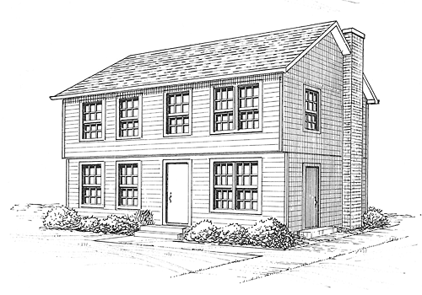
Escape from Reason – living life on the second level – mind set on things above

Slide 18
Fullness of the Spirit – for leading and empowering to be witnesses
Cultivating a Mind of Peace – anxious for nothing, fixed thoughts (fixed as in repaired, fixed as in focused)
Transformed by a Renewed Mind – changing the way that you think to God’s higher thoughts and ways
Angels on Assignment – perceiving God’s servants to those that are saved
Opportunity Awareness – minds ready for action to share the hope within you

Slide 19
Spiritual Forces of Darkness – awareness of the spiritual battle – standing strong with the armor of God – resisting firm in your faith

