Slide 2
Forces of Darkness
Cultivating Spiritual Awareness Series

Slide 3
I. Origin of Evil

Slide 4
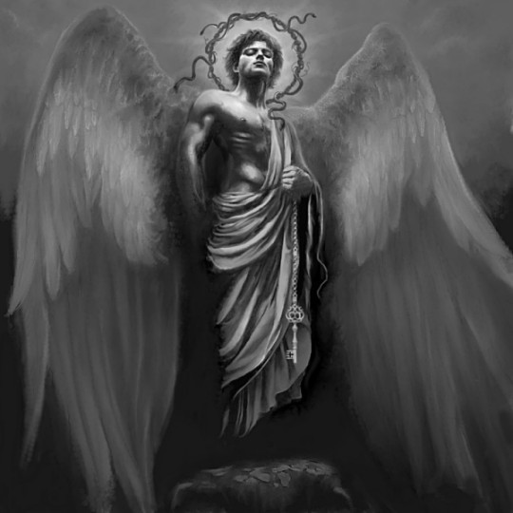
Archangel Lucifer’s rebellion
Isaiah 14:12-16 – how you are fallen from Heaven O Lucifer
Ezekiel 28:11-19 – Anointed Cherub, blameless until evil was found in you

Slide 5
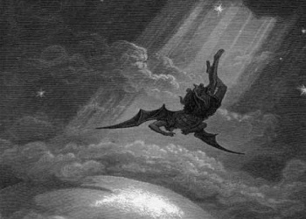
Lucifer’s deception
Revelation 12:9 – Satan thrown down to earth with all his angels

Slide 6
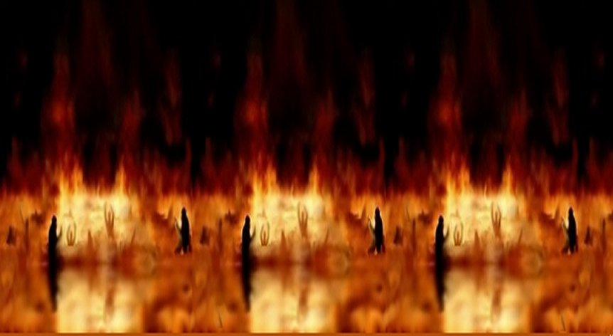
God’s judgment
2 Peter 2:4 – angels who sinned, God threw into hell until the day of judgment

Slide 7
Man’s rebellion
Genesis 3:5-6 – eat it and you will be like God. She ate it and he ate it too.
Curse of the fall

Slide 8
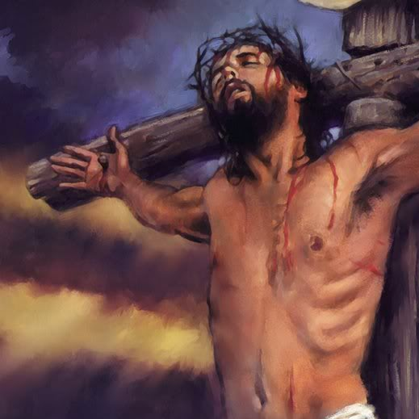
Man’s redemption and deliverance
1 John 3:8 - But the Son of God came to destroy the works of the devil
Colossians 2:14 - 15 ¹⁴He canceled the record of the charges against us and took it away by nailing it to the cross. ¹⁵In this way, he disarmed the spiritual rulers and authorities. He shamed them publicly by his victory over them on the cross.

Slide 9
Colossians 2:14 - 15 ¹⁴He canceled the record of the charges against us and took it away by nailing it to the cross. ¹⁵In this way, he disarmed the spiritual rulers and authorities. He shamed them publicly by his victory over them on the cross.

Slide 10
We wrestle
Ephesians 6:12 – not fighting flesh and blood enemies, but evil rulers and authorities of the unseen world, mighty powers in the dark world, evil spirits in the heavenly places

Slide 11
II. Cultivating Awareness
1 Peter 5:8-9
Stay alert!
The devil is looking for someone to devour
Resist him - strong in your faith

Slide 12
2 Corinthians 2:11 so that Satan will not outsmart us. For we are familiar with his evil schemes.
1 Corinthians 12:7 –11 ⁷But to each one is given the manifestation of the Spirit for the common good. …and to another the distinguishing of spirits… ¹¹But one and the same Spirit works all these things, distributing to each one individually just as He wills.

Slide 13
III. Resistance
Authority based on relationship
James 4:7 So humble yourselves before God. Resist the devil, and he will flee from you.
Mark 16:17 These miraculous signs will accompany those who believe: They will cast out demons in my name, and they will speak in new languages.

Slide 14
Acts 19:13-16
A group of traveling Jews casting out evil spirits
Used the name Jesus in their incantation
Come out in the name of Jesus whom Paul preaches
I know Jesus and Paul – who are you?
Authority is a result of relationship

Slide 15
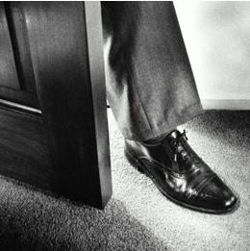
Give no place to the devil – Ephesians 4:26-27
Don’t sin by letting anger control you
Anger-sin gives a foothold to the devil
_____________-sin gives a foothold to the devil

Slide 16
God’s armor for resistance – Ephesians 6:10-18
Able to stand firm against devil’s strategies
Able to resist the enemy
Truth
Righteousness
Peace from the good news of the gospel
Faith
The word of God
Prayer in the Spirit

