Slide 2
Colossians 3:1 - 2 ¹Since you have been raised to new life with Christ, set your sights on the realities of heaven, where Christ sits in the place of honor at God’s right hand. ²Think about the things of heaven, not the things of earth.
1 Peter 1:13 (NASB) ¹³Therefore, prepare your minds for action, keep sober in spirit, fix your hope completely on the grace to be brought to you at the revelation of Jesus Christ.

Slide 3
Opportunity Awareness
Cultivating Spiritual Awareness Series

Slide 4
I. Ready for Action
1 Peter 3:15-16
Always ready
To explain your hope
To give an answer
To make a defense
In a gentle and respectful way
Defense without offense
Offense without offensive

Slide 5
Friendly or hostile environments
Acts 3:12
Peter saw his opportunity
Acts 4:13
Ordinary men
No special training in the Scriptures
Men who had been with Jesus

Slide 6
Matthew 10:18 - 20 ¹⁸You will stand trial before governors and kings because you are my followers. But this will be your opportunity to tell the rulers and other unbelievers about me. ¹⁹When you are arrested, don’t worry about how to respond or what to say. God will give you the right words at the right time. ²⁰For it is not you who will be speaking—it will be the Spirit of your Father speaking through you.
More about relationship than knowledge

Slide 7
Acts 5:20
Go to the temple – give the message of life
Acts 6:12
Stephen brought before the high council
Stephen’s reply

Slide 8
Phillip and Friendly Environments
Acts 8:4-8 – Phillip in Samaria
Persecution scatters believers
The scattered preached wherever they went
Phillip went to Samaria
The crowds listened intently eager to hear
Acts 8:26 – Phillip and the Ethiopian Eunuch
Angel said go south
Holy Spirit said go walk along beside
Eunuch invites Phillip to explain the scriptures

Slide 9
Acts 10 – Peter and Friendly Environment
Holy Spirit said – go with the three men
We are all here waiting to hear the message

Slide 10
Acts 16 – Paul and Silas to Macedonia
Holy Spirit prevented them going to Asia
Holy Spirit prevented them going to Bithynia
God calling them to Macedonia to preach the Good News there

Slide 11
2 Corinthians 2:12 When I came to the city of Troas to preach the Good News of Christ, the Lord opened a door of opportunity for me.

Slide 12
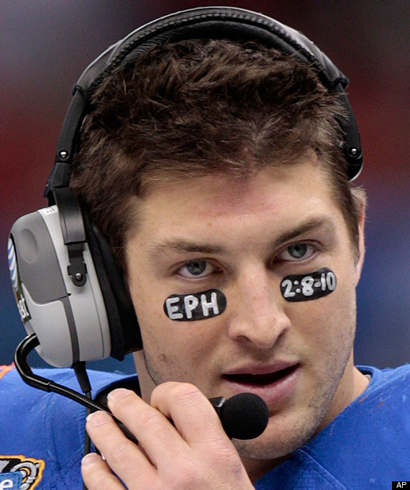

Slide 13
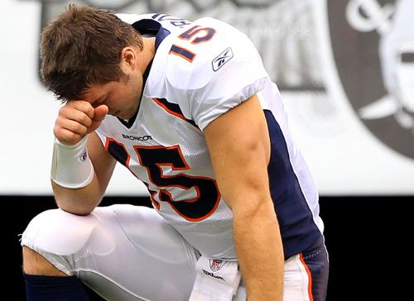

Slide 14
II. Adequate Servants
Colossians 4:5 - 6
Live wisely among unbelievers
Make the most of every opportunity
Gracious and attractive conversation
The right response for everyone.

Slide 15
2 Corinthians 3
Your life is a letter written by the Spirit of God on human hearts
Not qualified to do anything on our own
Confident because of our trust in God
He qualified us
He made us a able to be ministers of this new covenant
This new way gives us confidence
We can be very bold
The Spirit makes us more and more like Jesus – reflecting his glory

Slide 16
Prayer for friendly environments – 2 Timothy 2:1-7
Pray for all people
Pray for leaders
So we can live peaceful lives, marked by godliness
God wants everyone to be saved
Jesus gave his life to purchase freedom for everyone
This is the message God gave to the world
I am called to share this message

