Slide 1
Cultivating Spiritual Awareness
Colossians 3:1 - 2 ¹Since you have been raised to new life with Christ, set your sights on the realities of heaven, where Christ sits in the place of honor at God’s right hand. ²Think about the things of heaven, not the things of earth.

Slide 2
Angels on Assignment
Cultivating Spiritual Awareness Series

Slide 3
I. Servants of God
Psalm 103:20-21
Angels – mighty ones who carry out his plans
Listening for each of his commands
Armies of angels serve him and do his will
Psalms 91:11-12
He will order his angels to protect you

Slide 4
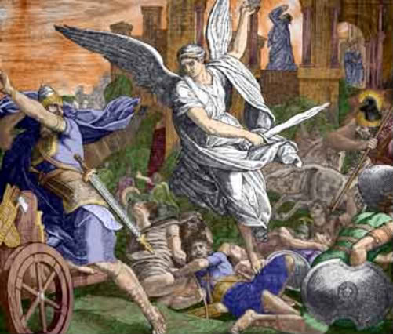
2 Kings 19:35
The angel killed 185,000 Assyrian soldiers

Slide 5
Hebrews 1:13-14
Angels are servants
Spirits sent to care for people who will inherit salvation

Slide 6
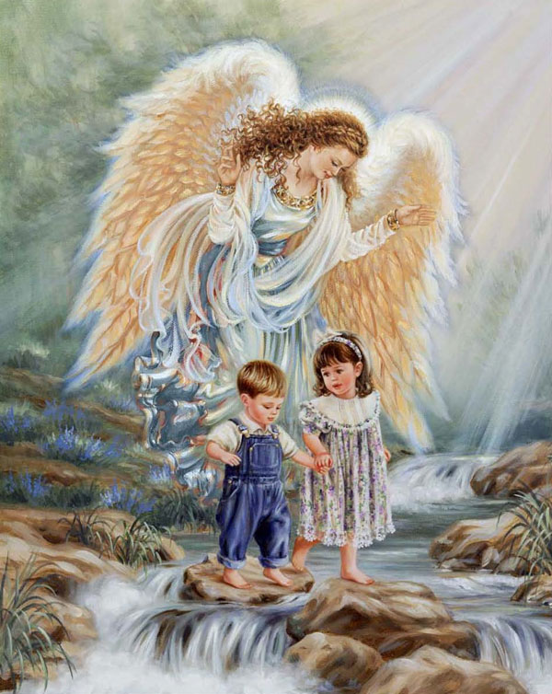
Matthew 18:10 Beware that you don’t look down on any of these little ones. For I tell you that in heaven their angels are always in the presence of my heavenly Father.

Slide 7
II. Perceiving Angels Presence

Slide 8
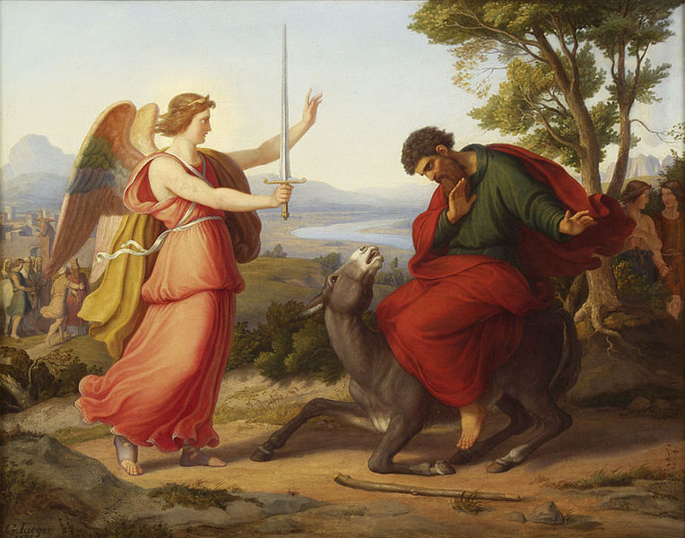
Numbers 22:21-35
The Lord opened Balaam’s eyes and he saw the angel of the Lord

Slide 9
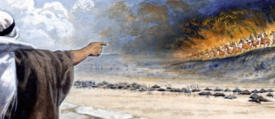
2 Kings 6:8-17
Lord open his eyes and let him see

Slide 10
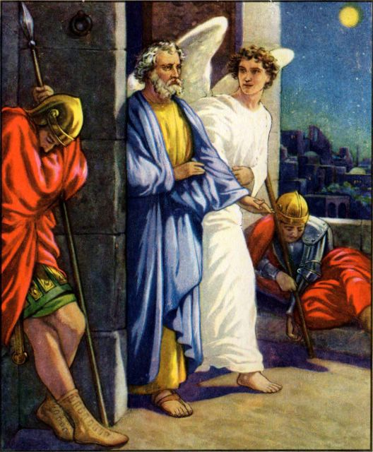
Acts 12:6-11
Peter thought it was a vision
Peter finally came to his senses (spiritual)

Slide 11
Hebrews 13:2 Don’t forget to show hospitality to strangers, for some who have done this have entertained angels without realizing it!
Show hospitality to strangers
Some have entertained angels unaware

Slide 12
III. Messengers of God

Slide 13
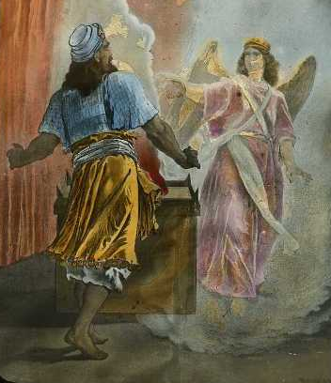
Luke 1
God sent the angel Gabriel to Zechariah

Slide 14
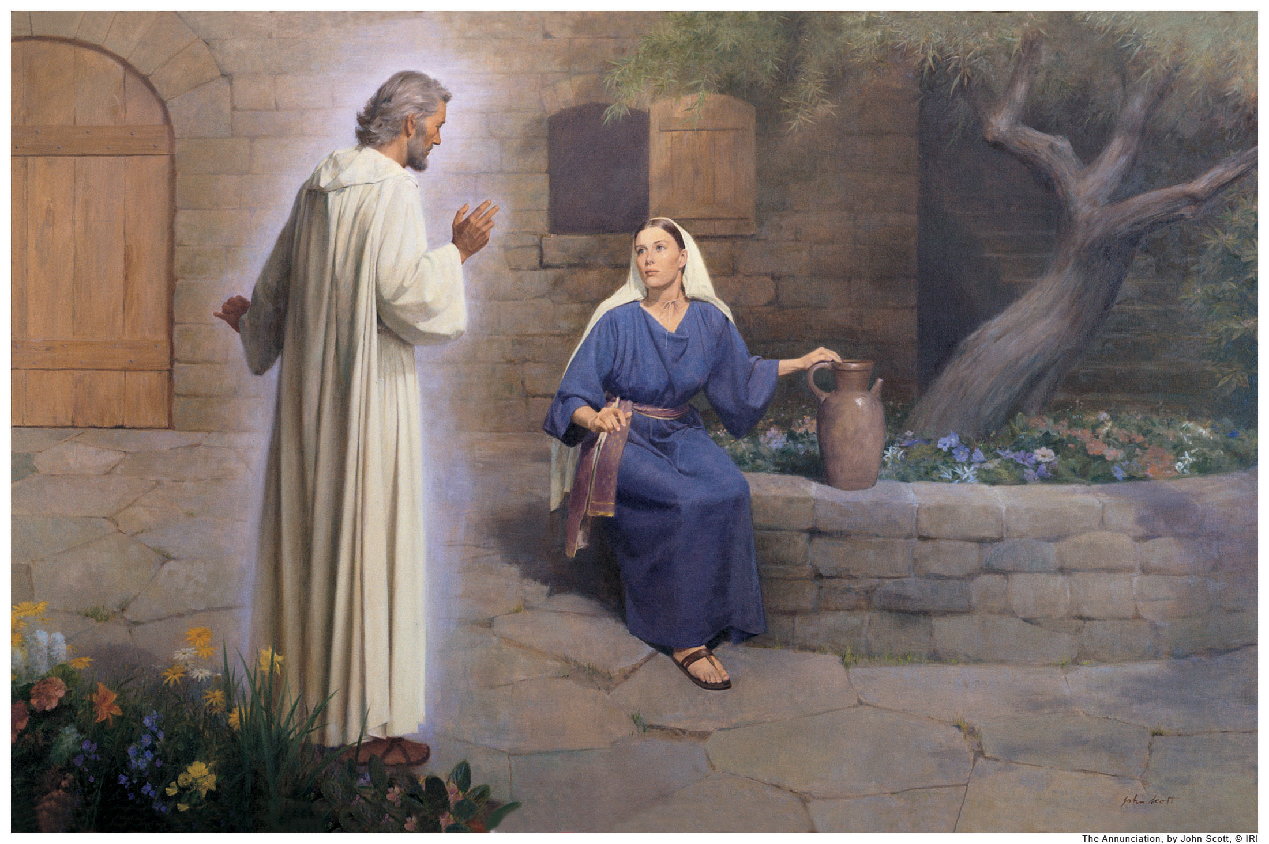
Luke 1
God sent the angel Gabriel to Mary

Slide 15
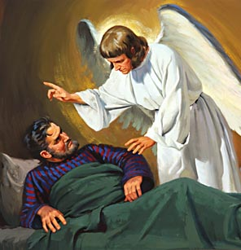
Matthew 1
An angel of the Lord appeared to Joseph

Slide 16
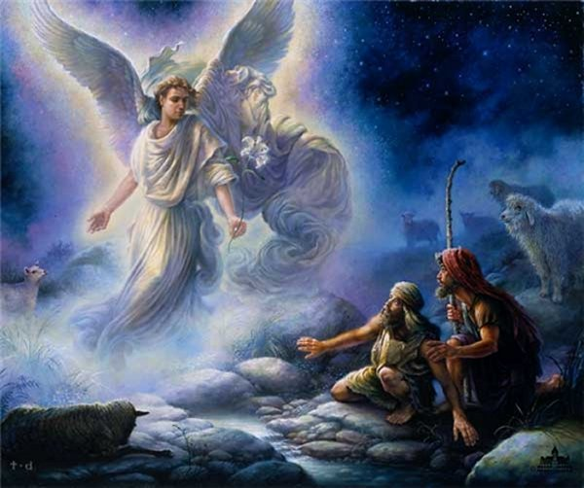
Luke 2
An angel of the Lord appeared to the shepherds

Slide 17
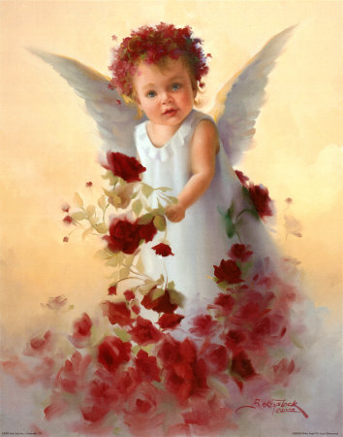
IV. Angel Apps

Slide 18
Angel Awareness
Serving God
Serving you

Slide 19
Angel appearance?
2 Corinthians 2:11 so that Satan will not outsmart us. For we are familiar with his evil schemes.
2 Corinthians 11:13 - 14 ¹³These people are false apostles. They are deceitful workers who disguise themselves as apostles of Christ. ¹⁴But I am not surprised! Even Satan disguises himself as an angel of light.

Slide 20
1 Kings 13 – Angel appearance to someone else
Come with me – eat and drink with me
I can’t – the Lord told me not to
An angel gave me this command – bring him home with you so he can eat and drink
You have defied the word of the Lord

Slide 21
Galatians 1:8 – 9 – Angel with a different message
⁸Let God’s curse fall on anyone, including us or even an angel from heaven, who preaches a different kind of Good News than the one we preached to you. ⁹I say again what we have said before: If anyone preaches any other Good News than the one you welcomed, let that person be cursed.

