Slide 1
Cultivating Spiritual Awareness
Development of senses with which we perceive spiritual things
Fullness of the Spirit – enabling us to understand things not perceive with the physical senses
Minds guarded by peace
Colossians 3:2 mind set on things above, not things on the earth

Slide 2
Transformed by Renewed Mind
Cultivating Spiritual Awareness Series

Slide 3
I. Morphing
Romans 12:2
Not conformed – copying the behavior and customs of this world
Transformed – into a new person by changing the way you think
Greek - metamorphoo��met-am-or-fo'-o; to transform (literally or figuratively “metamorphose”):—change, transfigure, transform

Slide 4
Conformed Transformed

Slide 5
Conformed Transformed
Behave like the world
New person

Slide 6
Changing the way that you think – Isaiah 55:8-11
God’s thoughts higher than ours – far beyond anything you could imagine
Rain and snow come down to water seed and produce grain
So it is with my word – produces fruit
Fruit – the character and nature of God
Partakers of his divine nature – 2 Peter 1:4 – escaping the corruption of the world
Destined to be conformed to the image of Christ – Romans 8:29
Jesus washes his bride with the water of the word – Ephesians 5:26

Slide 7
Conformed Transformed
Behave like the world - corrupted
New person – Like God, like Jesus

Slide 8
Captive or Conqueror
Colossians 2:8 Don’t let anyone capture you with empty philosophies and high-sounding nonsense that come from human thinking and from the spiritual powers of this world, rather than from Christ.
2 Corinthians 10:3-5
God’s mighty weapons to destroy human reasoning
Capture rebellious thoughts – (NASB - every lofty thing raised up against the knowledge of God)

Slide 9
Conformed Transformed
Captured by human reasoning
Taking every thought captive

Slide 10
Mind Control – Romans 8:5-8
Mind controlled by the sinful nature
Think of sinful things
Hostile to God
Leads to death
Can never please God
Mind controlled by the Spirit
Think about things that please the Spirit
Life and peace

Slide 11
Conformed Transformed
Death
Life and peace

Slide 12
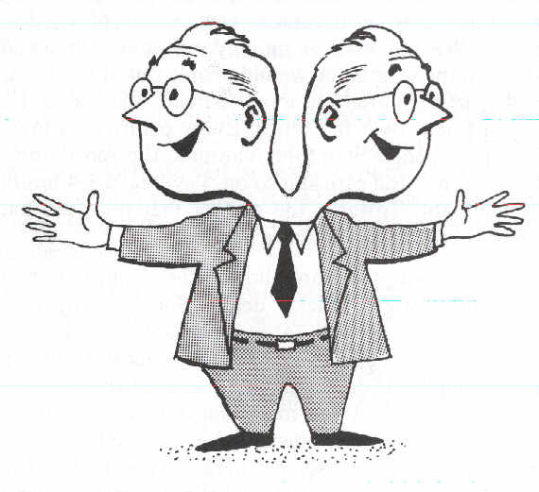
Conformed Transformed Double Minded

Slide 13
Double Minded – James 1:5-8
Divided loyalty between God and the world
Unstable in everything
Should not expect to receive anything from God

Slide 14
II. Ready Minds
Ephesians 4:17-24
Live no longer like the world (Gentiles)
Hopelessly confused, mind full of darkness, hardened hearts
Let the Spirit renew your thoughts and attitudes
New nature created to be like God

Slide 15
1 Peter 1:13-16
1 Peter 1:13 (NASB) ¹³Therefore, prepare your minds for action, keep sober in spirit, fix your hope completely on the grace to be brought to you at the revelation of Jesus Christ.
Discerning thoughts
Taking thoughts captive
Taking up divinely powerful weapons
Mind controlled by the Spirit
Renewing thoughts and attitudes
Loyal to God only – not divided
Walk in the fruit of transformation

Slide 16
Conformed Transformed
Corrupted
Captured
Confused
Controlled by sin
Death
New person
Captor
Renewed mind
Controlled by the Spirit
Life and peace

