Slide 2
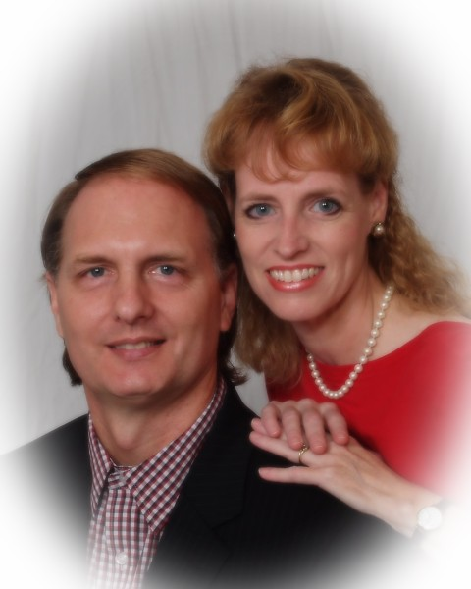

Slide 3
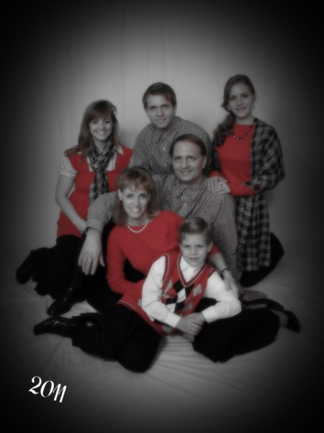

Slide 4
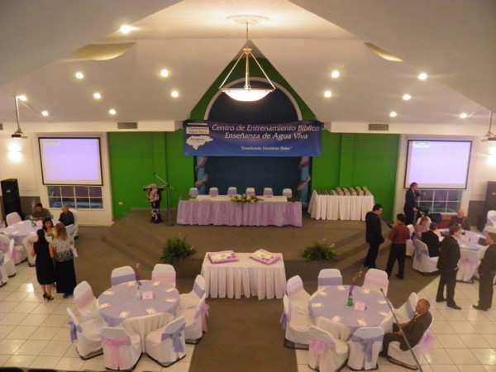

Slide 5
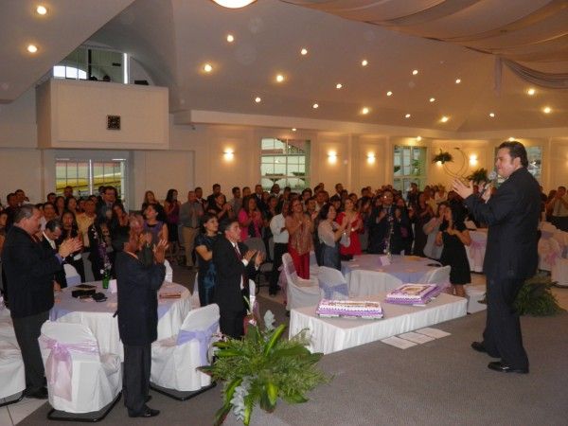

Slide 7
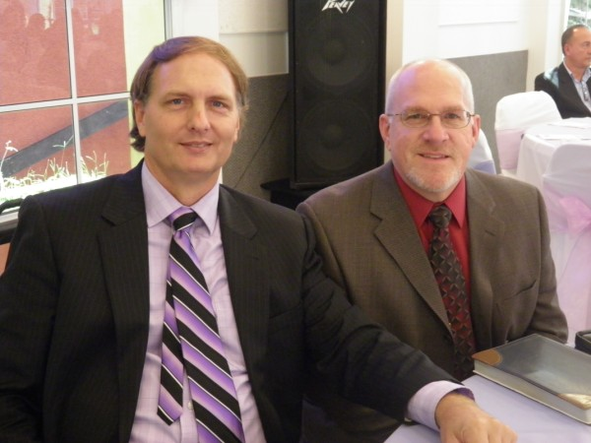

Slide 8
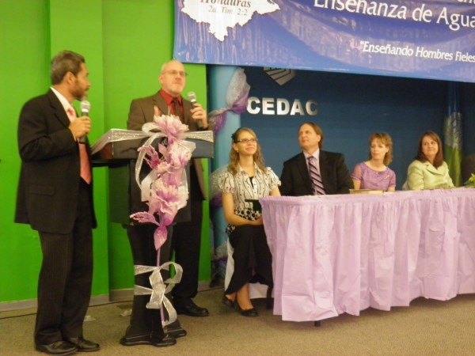

Slide 9
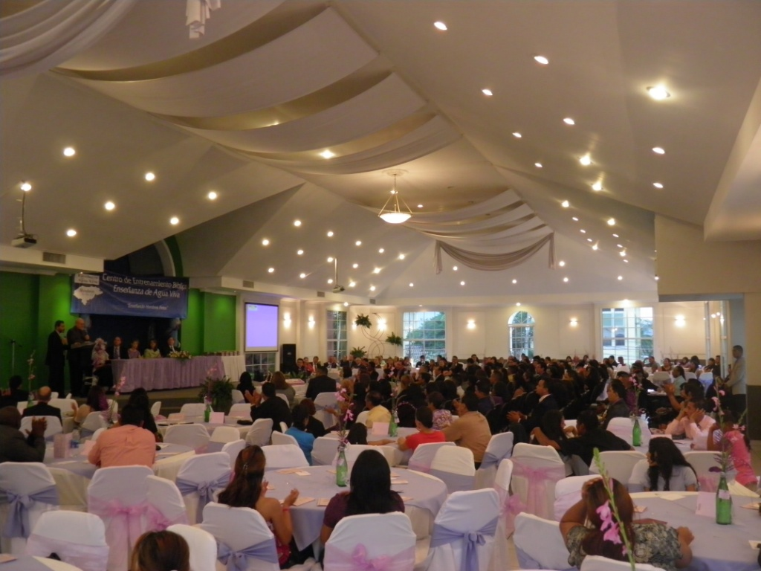

Slide 10
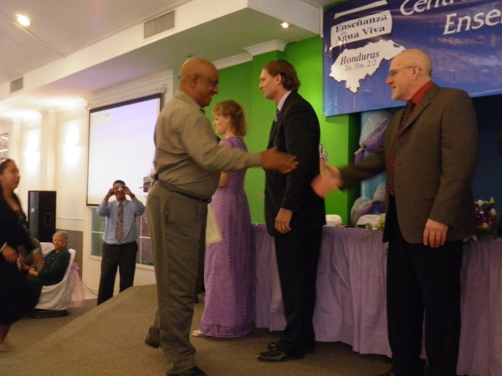

Slide 11
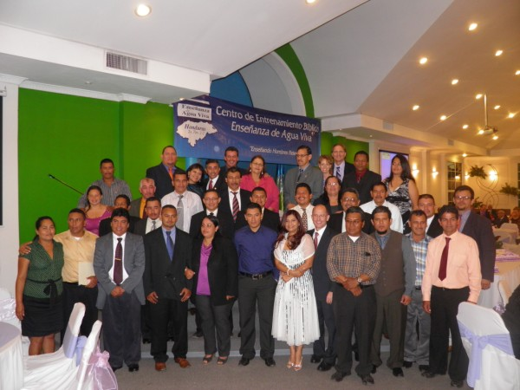

Slide 12
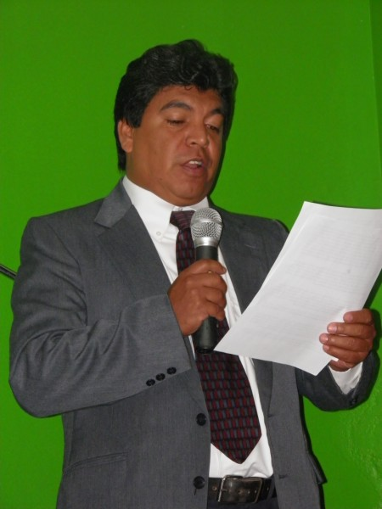

Slide 13
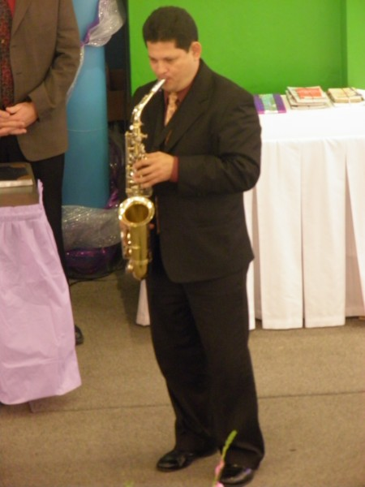

Slide 15
Cultivating a Mind of Peace
Cultivating Spiritual Awareness Series

Slide 16
Colossians 3:1 - 2 ¹Since you have been raised to new life with Christ, set your sights on the realities of heaven, where Christ sits in the place of honor at God’s right hand. ²Think about the things of heaven, not the things of earth.

Slide 17
I. Exchange Anxiety for Peace

Slide 18
Philippians 4:6-9

Slide 19
(NASB) ⁶Be anxious for nothing, but in everything by prayer and supplication with thanksgiving let your requests be made known to God.
(NLT) ⁶Don’t worry about anything; instead, pray about everything. Tell God what you need, and thank him for all he has done.

Slide 20
(NASB) ⁷And the peace of God, which surpasses all comprehension, will guard your hearts and your minds in Christ Jesus.
(NLT) ⁷Then you will experience God’s peace, which exceeds anything we can understand. His peace will guard your hearts and minds as you live in Christ Jesus.

Slide 21
(NASB) ⁸Finally, brethren, whatever is true, whatever is honorable, whatever is right, whatever is pure, whatever is lovely, whatever is of good repute, if there is any excellence and if anything worthy of praise, dwell on these things.
(NLT) ⁸And now, dear brothers and sisters, one final thing. Fix your thoughts on what is true, and honorable, and right, and pure, and lovely, and admirable. Think about things that are excellent and worthy of praise.

Slide 22
(NASB) ⁹The things you have learned and received and heard and seen in me, practice these things, and the God of peace will be with you.
(NLT) ⁹Keep putting into practice all you learned and received from me—everything you heard from me and saw me doing. Then the God of peace will be with you.

Slide 23
II. Fixed Thoughts
Fixed - as in repaired
Fixed – as in focused

Slide 24
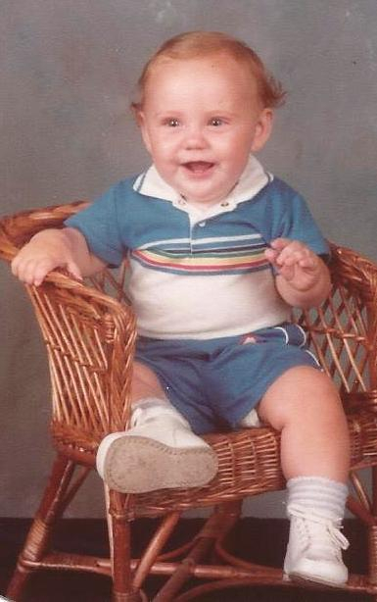

Slide 25
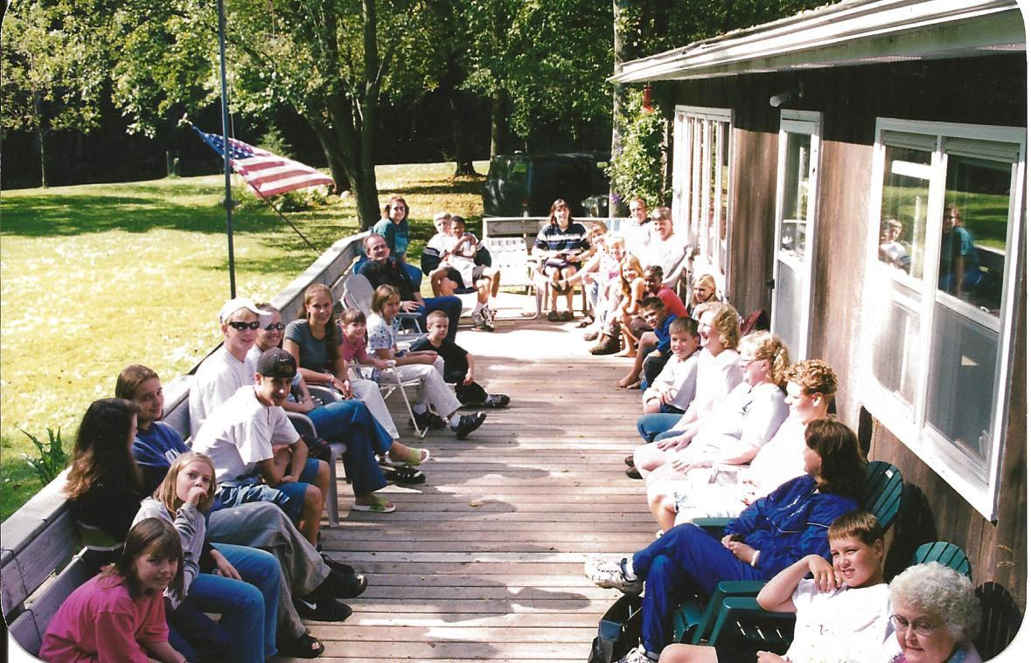

Slide 29
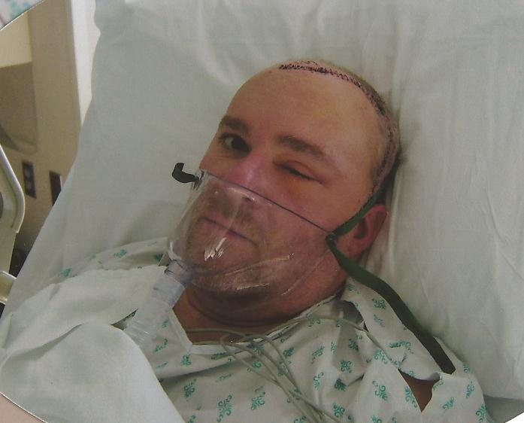

Slide 30
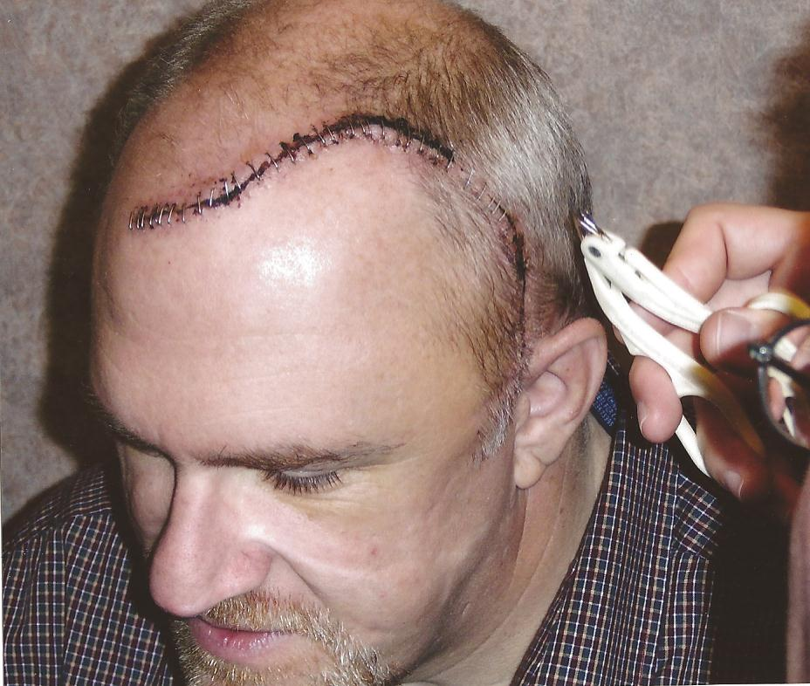

Slide 31
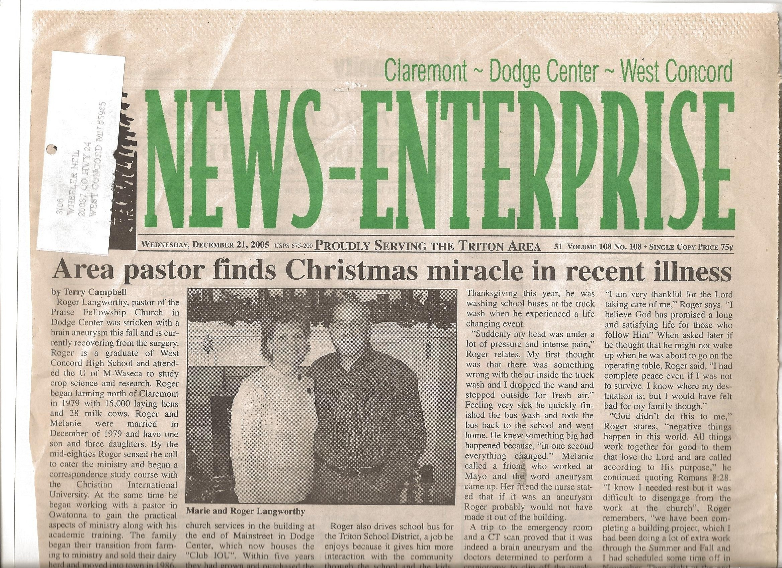
Melanie and Roger Langworthy

Slide 32
Perfect peace
Isaiah 26:3 You will keep in perfect peace all who trust in you, all whose thoughts are fixed on you!

