Slide 1
Cultivating Spiritual Awareness Series

Slide 2
Colossians 3:1 - 2 ¹Since you have been raised to new life with Christ, set your sights on the realities of heaven, where Christ sits in the place of honor at God’s right hand. ²Think about the things of heaven, not the things of earth.

Slide 3
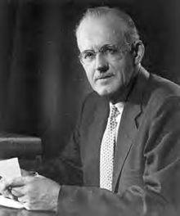
“…we possess spiritual faculties by means of which we can know God and the spiritual world if we will obey the Spirit’s urge and use them.”
A.W. Towzer “The Pursuit of God”

Slide 4
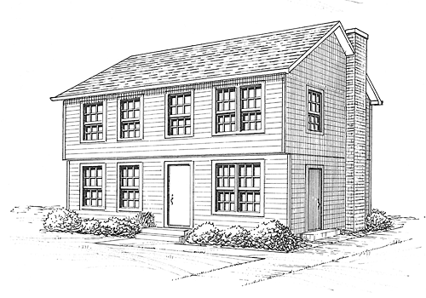
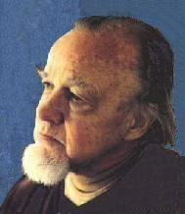
Francis Schaeffer
“Escape from Reason”
Life – like a two story house
First level – natural things, well furnished
Second level – presence of God, consciousness of all things eternal
Dwell more on the second - much more effective on the first

Slide 5
Able to perceive the things that God has prepared for you
Able to evaluate spiritual things – not regarding the things of God as foolish

Slide 6
Fullness of the Spirit
Cultivating Spiritual Awareness Series

Slide 7
I. Walking with the Spirit
John 16:12-15,7
So much more, but you can’t bear it now
When the Spirit of Truth comes
Guide into all truth
Tell you about the future
Tell you what he receives of Jesus and Father
Best for us – Jesus send the Holy Spirit

Slide 8
John 14:16-17
World cannot receive him
Lives with you, will be in you

Slide 9
Luke 24:46-49
Message to be proclaimed – forgiveness of sins for all who repent
You are witnesses of these things
Stay until the Holy Spirit comes and fills you with power
Acts 1:4-5, 8
Stay here – in a few days you will be baptized with the Holy Spirit
You will receive power and you will be my witnesses

Slide 10
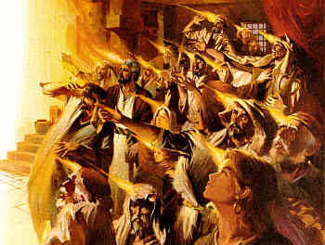
Acts 2:1-4 – everyone present was filled with the Spirit

Slide 11
Two directions of the ministry of the Holy Spirit under the purpose of one - Witnesses
Leading – to effective witnessing ministry
Who, what, where, when, how
Empowering – for effective witnessing ministry
Truth – John 16:13
Boldness – Acts 4:29-31
Gifts – 1 Corinthians 12
Fruit – Galatians 5:22-23
Examples in Acts
Promised to all – Acts 2:32-33, 38-39

Slide 12
II. Yielding to the Spirit
Yielding to receive
Yielding to empowerment

Slide 13
Acts 2:38
Repent of sin
Turn to God
Be baptized
Receive the gift of the Holy Spirit
Acts 8:4-17 – Phillip in Samaria

Slide 14
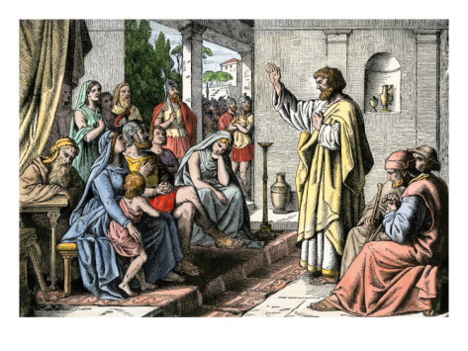
Acts 10:39-48 – Peter at Cornelius’ house
Peter preaching forgiveness to those who believe in Jesus
The Holy Spirit fell on all who were listening
Baptized in the name of Jesus

Slide 15
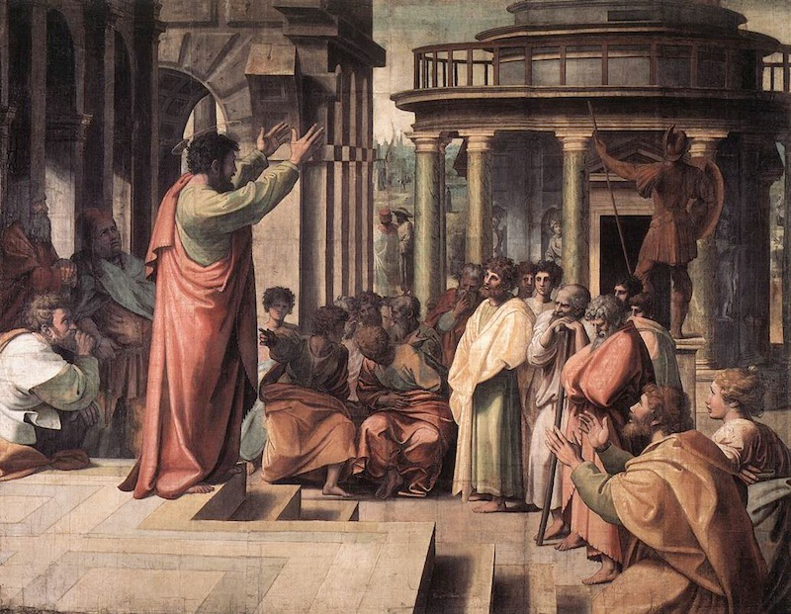
Acts 19:1-7 – Paul with 12 Ephesians
Did you receive the Holy Spirit when you believed?
Haven’t heard there was a Holy Spirit
Paul laid hands on them, the Spirit came on them

Slide 16
Ephesians 5:15-18
Be careful how you live
Don’t live like fools – but like the wise
Understand what the Lord wants you to do
Drunk with wine will ruin your life
Instead be filled with the Spirit
Ongoing – be being filled – (AMP – “Ever be filled…”)

