Slide 1
Colossians 2-3
Set your sights on the realities of heaven
Think about the things of heaven, not of earth

Slide 2
So heavenly minded that he’s no earthly good?

Slide 3
Cultivating Spiritual Awareness
Cultivating Spiritual Awareness Series

Slide 4
I. Cultivating Spiritual Senses

Slide 5
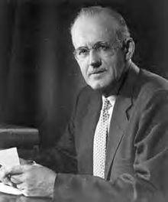
“Men can know God with at least the same degree of immediacy as they know any other person or thing that comes within the field of their experience. We have in our hearts organs by means of which we can know God as certainly as we know material things through our five senses. We apprehend the physical world by exercising the faculties given us for that purpose, and we possess spiritual faculties by means of which we can know God and the spiritual world if we will obey the Spirit’s urge and use them.”
A.W. Towzer “The Pursuit of God”

Slide 6
The eyes of your heart may be enlightened
Look not at the things that are seen but things which are not seen which are eternal
He who has ears to hear let him hear
My sheep hear my voice
O taste and see that the Lord is good
We are a Christ-like fragrance among the saved and unsaved
Senses trained to discern good and evil

Slide 7
Understanding Spirit, Soul, and Body - 1 Thessalonians 5:23 Now may the God of peace make you holy in every way, and may your whole spirit and soul and body be kept blameless until our Lord Jesus Christ comes again.
Body – the earthly dwelling place of your spirit and soul, temple of the Holy Spirit, to be used to glorify God
Spirit – the eternal part of man born again by the Spirit of God
Soul – emotional, decisional, mind – needs to be renewed to agree with God

Slide 8
Led by the Spirit
Fleeces?
Prophetic words?

Slide 9
Be on the alert – your adversary is seeking whom he may devour
Wrestle against principalities and powers
Not ignorant of his schemes
Disguises as an angel of light

Slide 10
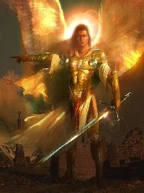
Angels are servants – spirits sent to care for people who will inherit salvation

Slide 11
II. Missing Out
1 Corinthians 2:6-16
Speak wisdom among the mature
Rulers of this world have not understood
Not perceived with the physical senses – eyes, ears, mind
God reveals what he has prepared for those who love him – by his Spirit

Slide 12
Those who are not spiritual cannot understand – it all sounds foolish to them
Those who are spiritual can evaluate all things
We have the mind of Christ

Slide 13
Philippians 3:8,10 Yes, Furthermore, I count everything as loss compared to the possession of the priceless privilege (the overwhelming preciousness, the surpassing worth, and extreme advantage) of knowing Christ Jesus my Lord and of progressively becoming more deeply and intimately acquainted with Him [of perceiving and recognizing and understanding Him more fully and clearly]. For His sake I have lost everything and consider it all to be mere rubbish (refuse, dregs), in order that I may win (gain) Christ (the Anointed One)

Slide 14
V.10 [For my determined purpose is] that I may know Him [that I may progressively become more deeply and intimately acquainted with Him, perceiving and recognizing and understanding the wonders of His Person more strongly and more clearly], and that I may in that same way come to know the power outflowing from His resurrection [which it exerts over believers], and that I may so share His sufferings as to be continually transformed [in spirit into His likeness even] to His death, [in the hope]

Slide 15
Cultivation of Spiritual Senses that we might know him, that we might know the things he has prepared for us

Slide 16
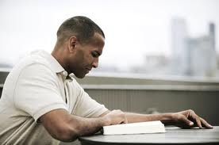
1 Timothy 4:8 “Physical training is good, but training for godliness is much better, promising benefits in this life and in the life to come.”

Slide 20
IV.

