Slide 2
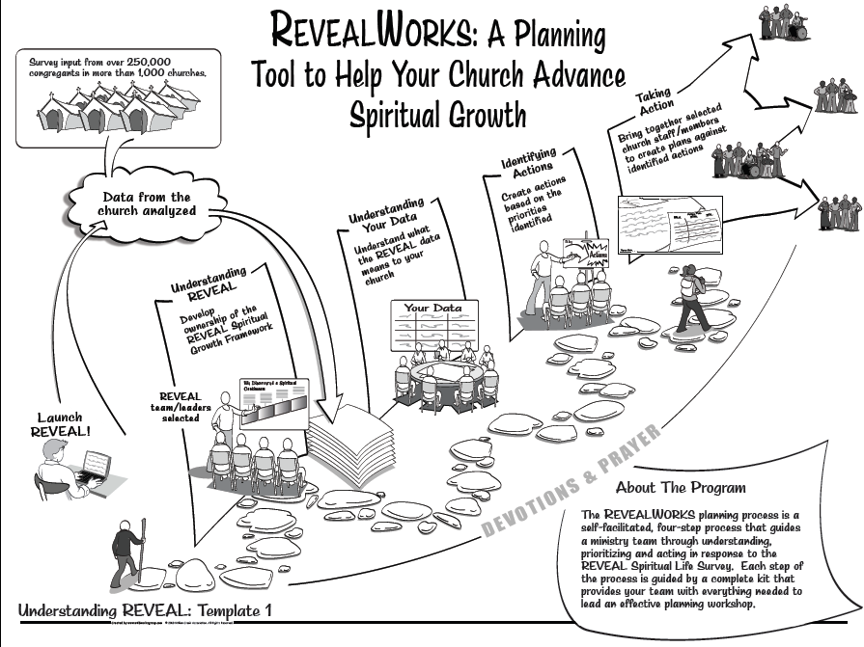

Slide 4
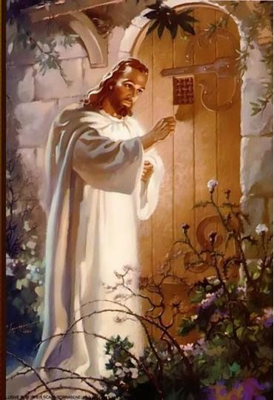
Revelation 3:20 (NASB) 'Behold, I stand at the door and knock; if anyone hears My voice and opens the door, I will come in to him and will dine with him, and he with Me.

Slide 5
Hot or Cold
Christ in You Series

Slide 6
I. Indifferent
Revelation 3:14-16
Neither hot nor cold
Lukewarm
Indifferent
Undecided
Listless
Riding the fence
One foot in the church and one in the world

Slide 7
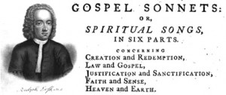
Ralph Erskine’s Gospel Sonnets Written in 1720
"To good and evil equal bent, I'm both a devil and a saint.”

Slide 8
Wish you were one or the other

Slide 9
Revelation 3:17
I have everything I want
Self-reliant
Self-sufficient
Independent
You don’t realize how bad off you are

Slide 10
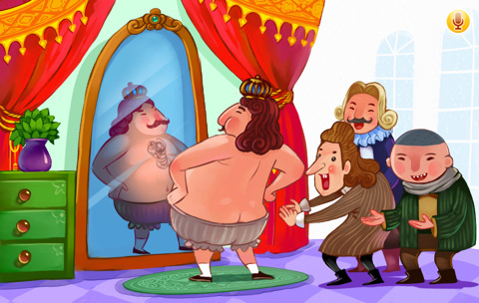

Slide 11
Ephesians 4:17-24 (NLT) ¹⁷ With the Lord’s authority I say this: Live no longer as the Gentiles do, for they are hopelessly confused. ¹⁸ Their minds are full of darkness; they wander far from the life God gives because they have closed their minds and hardened their hearts against him. ¹⁹ They have no sense of shame. They live for lustful pleasure and eagerly practice every kind of impurity. ²⁰ But that isn’t what you learned about Christ. ²¹ Since you have heard about Jesus and have learned the truth that comes from him, ²² throw off your old sinful nature and your former way of life, which is corrupted by lust and deception. ²³ Instead, let the Spirit renew your thoughts and attitudes. ²⁴ Put on your new nature, created to be like God—truly righteous and holy.

Slide 12
II. I Advise You…
Revelation 3:18
Buy from me…

Slide 13
Isaiah 55:1-3 (NASB) ¹ "Ho! Every one who thirsts, come to the waters; And you who have no money come, buy and eat. Come, buy wine and milk Without money and without cost. ² "Why do you spend money for what is not bread, And your wages for what does not satisfy? Listen carefully to Me, and eat what is good, And delight yourself in abundance. ³ "Incline your ear and come to Me. Listen, that you may live; And I will make an everlasting covenant with you, According to the faithful mercies shown to David.

Slide 14
Isaiah 55:6-7 (NASB) ⁶ Seek the LORD while He may be found; Call upon Him while He is near. ⁷ Let the wicked forsake his way And the unrighteous man his thoughts; And let him return to the LORD, And He will have compassion on him, And to our God, For He will abundantly pardon.

Slide 15
Revelation 3:19
I correct and discipline everyone I love
Be diligent and turn away from your indifference

Slide 16
III. Communion Revelation 3:20-22

Slide 17
Conclusion – Christ in you - Sharers in his glory
Transformed into the image of Jesus
Reflecting his glory
Proclaiming his message
Demonstrating his power
Impossible if indifferent
Lukewarm
Undecided
Listless
Riding the fence
One foot in the church and one in the world

Slide 18
So be diligent and turn from your indifference

