Slide 1
Christ in You – the hope of Glory (the assurance of sharing his glory)
Most important calling in eternity
Sent to represent him with the message of good news
Not in your own ability – his power in you
A Word and a Prayer
Reflecting his glory (the character and nature of God) – increasingly transformed to his image
Not only Christ in you – but you in Christ

Slide 2
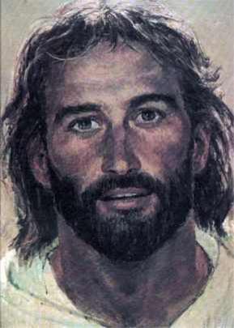

Slide 3
Partakers of God’s Nature
Christ in You Series

Slide 4
The value of being reminded – 2 Peter 1:12-13

Slide 5
I. Enabled to Share His Nature
2 Peter 1:1-4
By His divine power
Given us everything we need for godly living
Great and precious promises
Enabled to share (partakers) in his divine nature

Slide 6
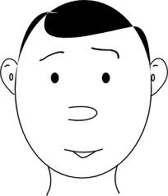
Divine Power

Slide 7
Coming to know Him

Slide 8
Great and Precious Promises

Slide 9
The seed of His nature

Slide 10
1 John 3:9 (NASB) ⁹ No one who is born of God practices sin, because His seed abides in him; and he cannot sin, because he is born of God.
Seed - sperma

Slide 11
Escape world’s corruption caused by human desires

Slide 12
II. Respond to God’s promises
2 Peter 1:5-7
Make every effort (diligence)

Slide 13
Respond to God’s Promises

Slide 14
Faith – comes first, everything else is a fruit of it
Moral excellence - courage, rigor, energy

Slide 15
Knowledge
Ephesians 1:17-19 (NASB) ¹⁷ that the God of our Lord Jesus Christ, the Father of glory, may give to you a spirit of wisdom and of revelation in the knowledge of Him. ¹⁸ I pray that the eyes of your heart may be enlightened, so that you will know what is the hope of His calling, what are the riches of the glory of His inheritance in the saints, ¹⁹ and what is the surpassing greatness of His power toward us who believe…

Slide 16
Self-control - Romans 6:16-19 (NASB) ¹⁶ Do you not know that when you present yourselves to someone as slaves for obedience, you are slaves of the one whom you obey, either of sin resulting in death, or of obedience resulting in righteousness? ¹⁷ But thanks be to God that though you were slaves of sin, you became obedient from the heart to that form of teaching to which you were committed, ¹⁸ and having been freed from sin, you became slaves of righteousness. ¹⁹ I am speaking in human terms because of the weakness of your flesh. For just as you presented your members as slaves to impurity and to lawlessness, resulting in further lawlessness, so now present your members as slaves to righteousness, resulting in sanctification.

Slide 17
Patient endurance
James 1:4 (NASB) ⁴ And let endurance have its perfect result, so that you may be perfect and complete, lacking in nothing.

Slide 18
Godliness
1 Timothy 6:11 (NASB) ¹¹ But flee from these things, you man of God, and pursue righteousness, godliness, faith, love, perseverance and gentleness.
1 Timothy 6:6 (NASB) ⁶ But godliness actually is a means of great gain when accompanied by contentment.

Slide 19
Brotherly affection – love for other believers Galatians 6:10 (NASB) ¹⁰ So then, while we have opportunity, let us do good to all people, and especially to those who are of the household of the faith.

Slide 20
Love for everyone - Love to all mankind. Romans 13:8 (NASB) ⁸ Owe nothing to anyone except to love one another; for he who loves his neighbor has fulfilled the law.

Slide 21
Diligent CULTIVATION of our virtues
Continued PROGRESS made from one virtue to another
An ACCUMULATION of virtues

Slide 22
III. Result of Sharing His Nature
2 Peter 1:8-11
Fruitful and useful
In the (true) knowledge of our Lord Jesus
Alternative – short-sighted, blind, forgetting their cleansing from sin
I.E. - the False Teachers 2 Peter 2
V.19 – promise freedom but are slaves of sin and corruption

Slide 23
Work hard to prove your calling
Assurance from stumbling (falling away)
Grand entrance into the Kingdom of God

Slide 24
Power
Promises
Person
Diligent
Reponse

