Slide 1
Christ in You – the hope of Glory (the assurance of sharing his glory)

Slide 2
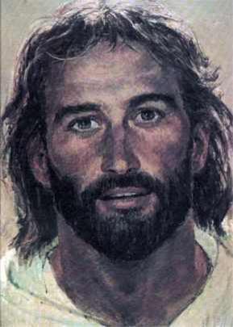

Slide 3
The Phrase to Remember?
A word and a prayer
The Word
We all fall short
We deserve eternity separate from God
God is making people right with him through Jesus
Jesus became our substitute
Believe and accept it for yourself
Be made right with God
The Prayer – God wants to show you he is real – is there something I can pray with you about?

Slide 4
Christ in You in Christ
Christ in You Series

Slide 5
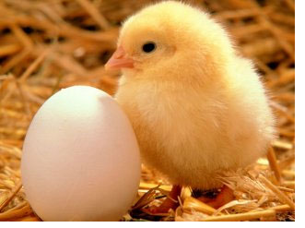

Slide 6
I. Bearing Fruit
1 John 15:1-17 - Vine, Branch and Fruit
Branch attached – remain in me, I will remain in you
Life flow from vine

Slide 7
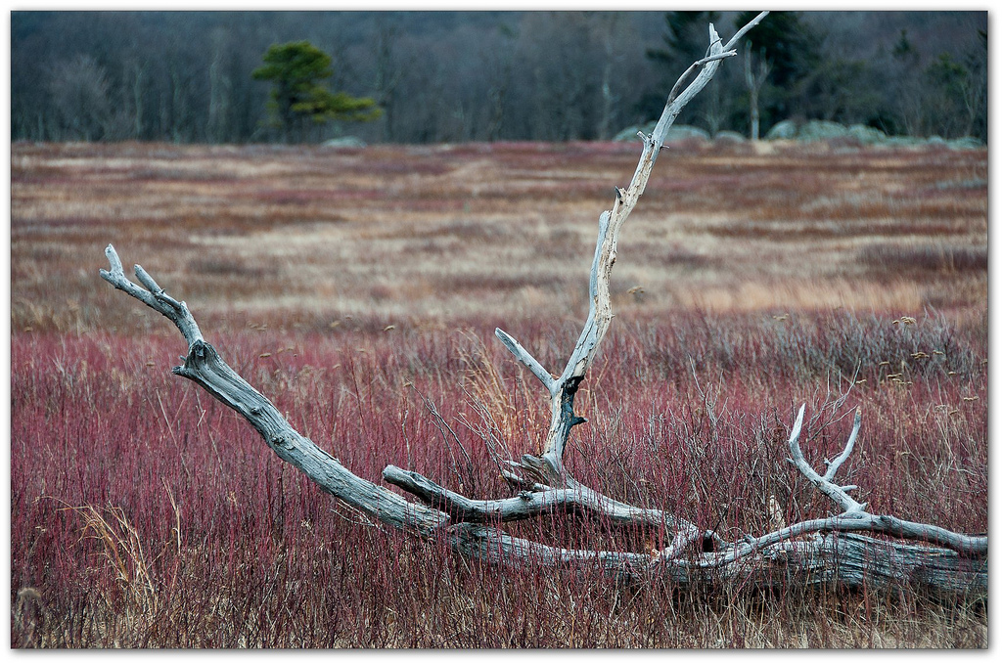
Severed branch - nothing

Slide 8
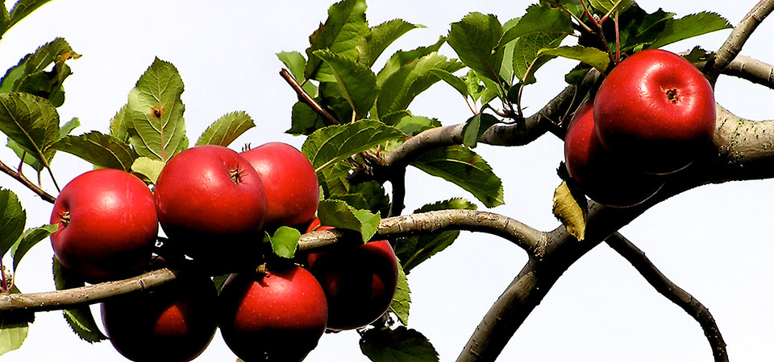
Fruit bearing – natural result of attachment
Pruned for more fruit
Much fruit – brings great glory to God

Slide 9
Remain
My words remain in you – ask - granted
Remain in my love – when you obey
Filled with joy – fulfillment, satisfaction
Chosen
I chose you
I appointed you
Produce lasting fruit

Slide 10
II. In Him
Ephesians 1:3-5
Blessed with every spiritual blessing because we are united with Christ
Chose us in Christ – before he made the world
Ephesians 1:7 (NASB) ⁷ In Him we have redemption through His blood, the forgiveness of our trespasses, according to the riches of His grace

Slide 11
Colossians 3:1-3
Raised to new life with Christ
Set your sights on the realities of heaven where Christ sits at God’s right hand
Ephesians 2:6 (NASB) and raised us up with Him, and seated us with Him in the heavenly places in Christ Jesus,
Your real life is hidden with Christ in God

Slide 12
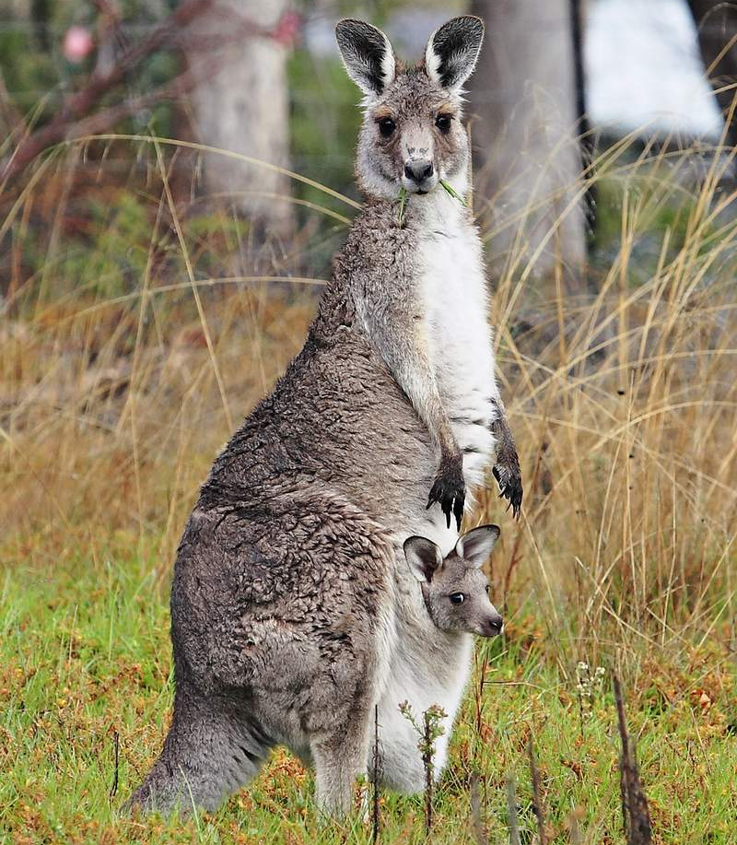

Slide 13
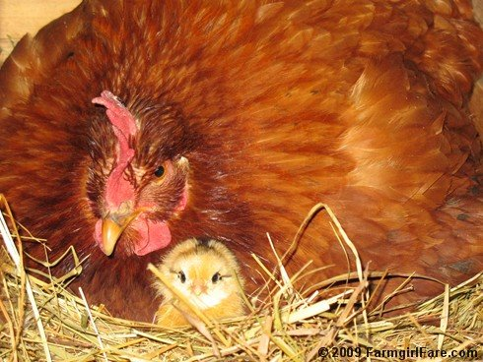

Slide 14
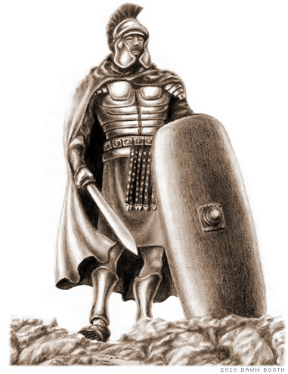
Ephesians 6:13 put on the whole armor of God
Salvation
Righteousness
Truth
Gospel
Faith
Word

Slide 15
When Christ is revealed you will share in all his glory

Slide 16
2 Thessalonians 1:11-12
Live a life worthy of his call
The name of Jesus honored because of the way you live – and you honored with him
NASB …the name of our Lord Jesus will be glorified in you, and you in Him

Slide 17
Colossians 1:9-10
Complete knowledge of his will
Give you spiritual wisdom and understanding
The way you live will always honor and please the Lord

Slide 18
Your lives will produce every kind of fruit
Learn to know God better

