Slide 1
Christ in You – the hope of Glory (the assurance of sharing his glory)
Most important calling in eternity
Represent him with the message of good news
Not in your own ability – his power in you
Reflecting his glory (the character and nature of God) – increasingly transformed to his image

Slide 2
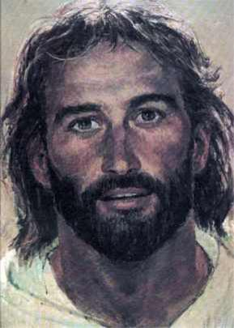

Slide 3
Followers of Jesus
Christ in You Series

Slide 4
I. Sent to Represent
Matthew 4-
17. Jesus’ message – repent of sin, turn to God, the kingdom of heaven is near
23. Announcing the Good News about the kingdom and healing

Slide 5
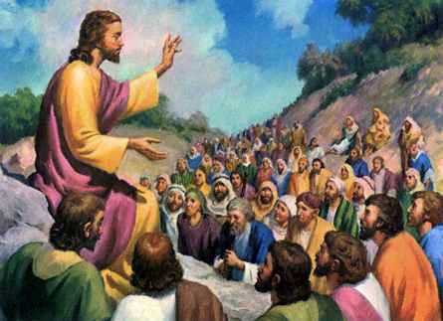
Matthew 5-7 Sermon on the mount
7:29. teaching with authority

Slide 6
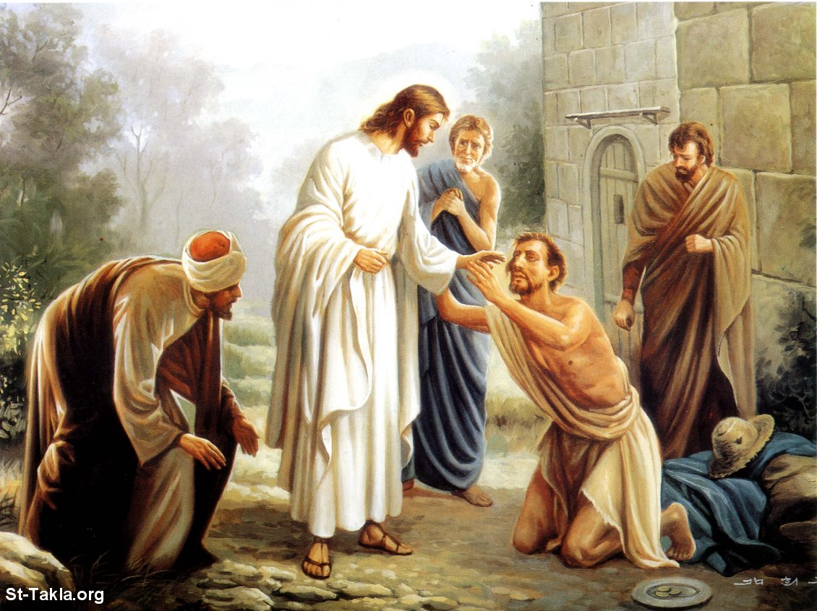
Matthew 8-9 Jesus heals

Slide 7
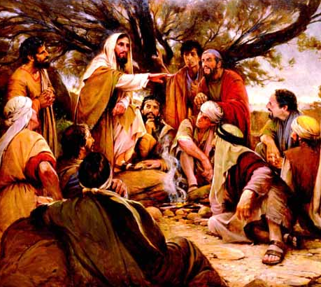
Matthew 10 Followers sent to represent
Announce the kingdom is here
Heal the sick, raise the dead, cast out demons
Demonstrations of the kingdom
20. not you who will be speaking

Slide 8
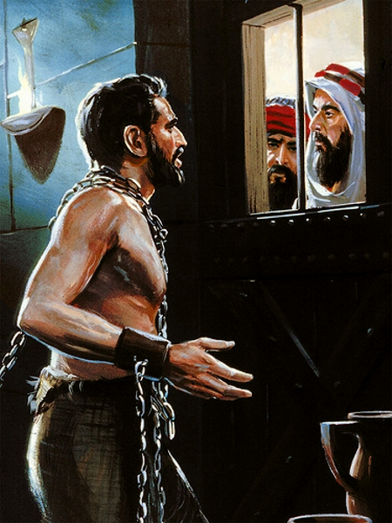
Matthew 11 John the Baptist
Are you Messiah?
Tell him what you see and hear
Demonstrations of the Kingdom of God
Good News preached

Slide 9
II. See and Hear
Paul’s discovery – 1 Corinthians 2:1-5
Simple message – Jesus crucified
Relied on the power of the Holy Spirit
So you would trust the power of God, not human wisdom

Slide 10
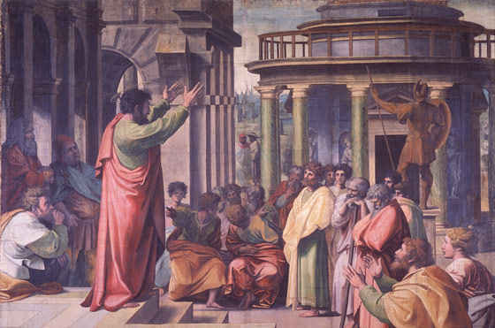
Contrast – persuasive words – Acts 17:16-33
Paul waxing culturally relevant to the Athenian Philosophers
A few join him

Slide 11
Mark 16:19-20 (NLT) ¹⁹ When the Lord Jesus had finished talking with them, he was taken up into heaven and sat down in the place of honor at God’s right hand. ²⁰ And the disciples went everywhere and preached, and the Lord worked through them, confirming what they said by many miraculous signs.
Disciples went everywhere and preached
The Lord worked through them
Confirming their words with many miraculous signs

Slide 12
III. A Word and a Prayer
The Word
All have fallen short of God’s standard (Romans 3:23)
We all deserve separation from God for eternity (Romans 6:23)
God is making people right with him through Jesus (2 Corinthians 5:19)
Jesus became the substitute for our sin and took what we deserved (2 Corinthians 5:21)

Slide 13
Believe what Jesus did – accept it for yourself (Romans 10:9)
Be made right with God (2 Corinthians 5:20)
The Prayer
God wants to show you he is real
Is there something I can pray with you about?
Don’t have to be their counselor
Don’t have to know the reason “why?”

