Slide 2
Sharing His Glory
Christ in You Series

Slide 3
I. The Glory of the Lord
Colossians 1:27 (NLT) ²⁷ For God wanted them to know that the riches and glory of Christ are for you Gentiles, too. And this is the secret: Christ lives in you. This gives you assurance of sharing his glory.

Slide 4
Glory Defined – Hebrew – KABOD; Greek DOXA
give weight to (importance), honor
Brightness or splendor emanating from God
The nature and acts of God in manifestation
The character and ways of God as exhibited through Christ to and through believers
Ascriptions of praise to God

Slide 5
II. Reflecting His Glory
2 Corinthians 3:7-18 - Comparison of Old and New Covenant
Old – glorious
Moses shining face – Exodus 34:28-35

Slide 6
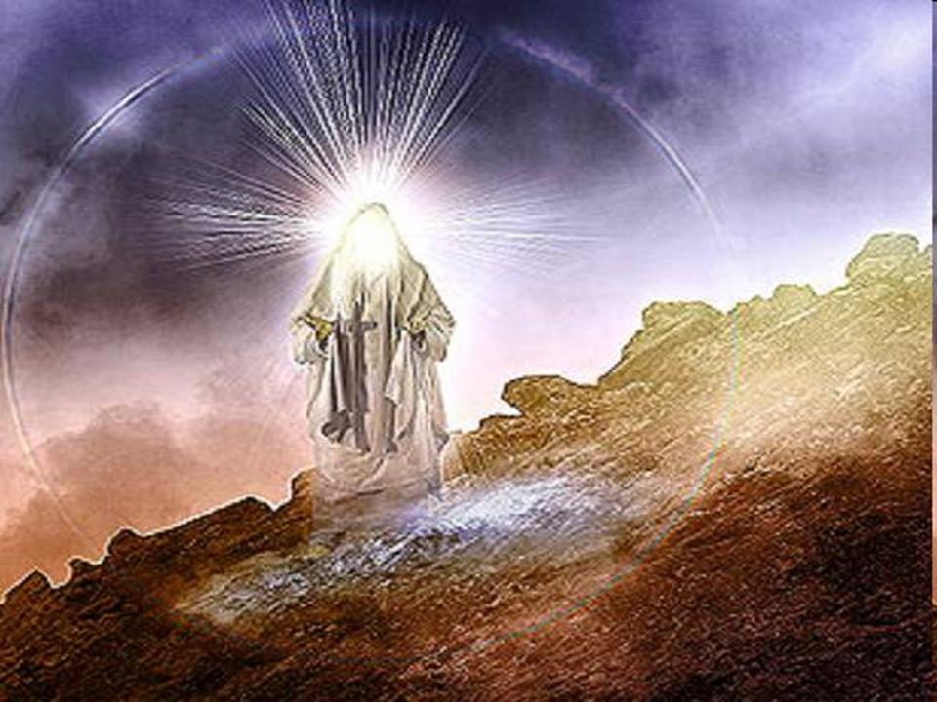

Slide 7
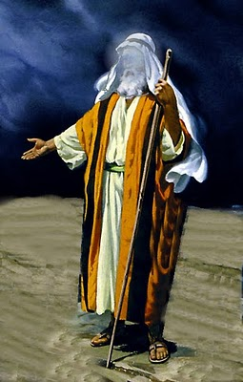

Slide 8
New – much more glorious
Life of the Spirit
Made right with God
Unfading glory – lasts forever
Confidence and boldness
See and reflect the glory of the Lord
Changed into his glorious image
Transformed
Sharing his glory
The character and ways of God as exhibited through Christ to and through believers

Slide 9
Giving greater weight (importance) to the Lord as a result of having encountered the Lord through his people
So this is the kind of change that can come about in your life
So this is the power of the one you worship
So this is how prayers can truly be answered

Slide 10
III. Changed Into His Image
Romans 8:29 (NLT) ²⁹ For God knew his people in advance, and he chose them to become like his Son, so that his Son would be the firstborn among many brothers and sisters.

Slide 11
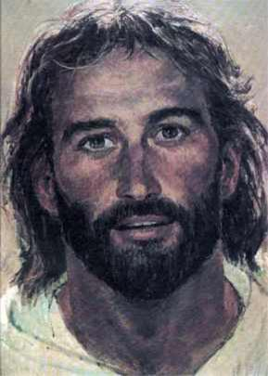
Romans 8:29 (NASB) …He also predestined to become conformed to the image of His Son…

Slide 13
http://www.youtube.com/watch?v=AhfUzodLRvk&feature=youtu.be

